Slide 1
STAR Cy22 Training for new IDOA employees
Presenter:
David Nguyen, IL STAR Coordinator, AISWCD
Collaborators:
Bruce Henrikson, STAR Assistant Coordinator, CCSWCD
Erin Gundy, Resource Conservationist, CCSWCD
Notes:
Hello everyone, and welcome to the IDOA staff training for STAR’s 2022 Crop Year. My name is David Nguyen, and I’m the IL STAR Coordinator. If you know someone who wanted to attend this session but couldn’t make it, don’t worry. I will send this presentation later on to Elliot and he can forward it to IDOA staff. It’ll also come complete with narration notes under each slide.

Slide 2
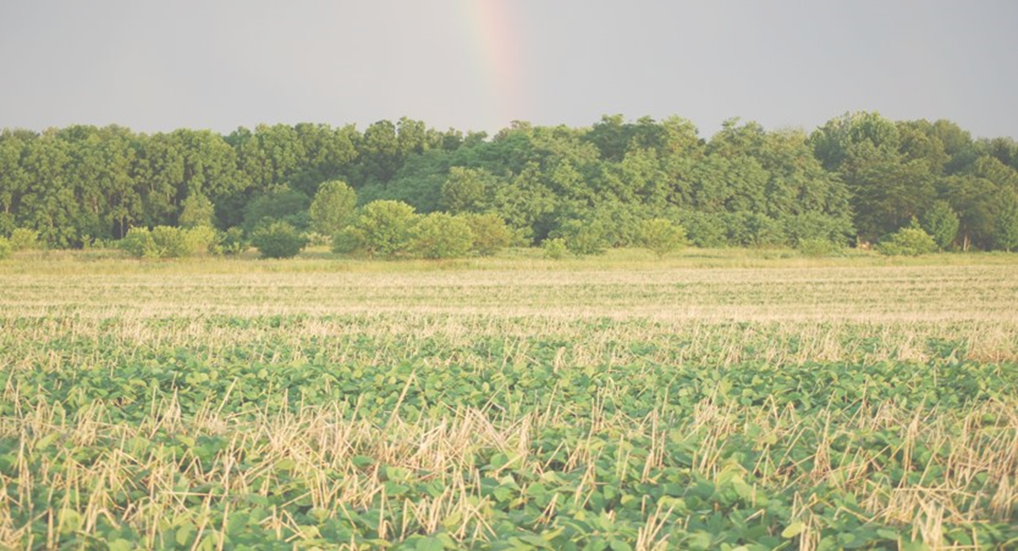
Agenda
STAR Introduction
STAR Web App Advantages
STAR Field Form Procedures
STAR Verification Process
Notes:
For this training, we will be going over an introduction of STAR for those unfamiliar with the program. Next, we’ll explain the merits of encouraging use of the STAR Web Application over the PDF field forms, and discuss how IDOA will handle PDF STAR field forms relating to the Partners for Conservation program. Finally, we’ll go over the verification process needed at the end of the crop year.

Slide 3
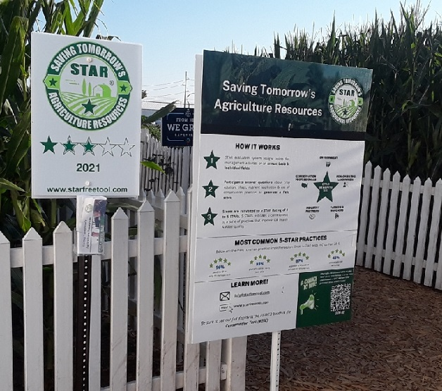
STAR Introduction
STAR is a free, accessible, and voluntary nationwide tool to assist farmers in evaluating their conservation practices on individual fields
Based on practices, a field is scored and rated from 1 to 5 STARs
STAR ratings encourage farmers to use management practices that reduce nutrient and soil losses from their fields
Program will help reduce the nutrient and soil losses from farmland over larger areas in addition to showcasing improved soil health on the same scale
Notes:
First, let’s briefly go over what STAR is. STAR stands for Saving Tomorrow’s Agriculture Resources. STAR is a free tool that is used by farmers to evaluate their conservation practices on a field-by-field basis. STAR can either be filled out on a 2-page fillable/printable PDF field form per field, or through our STAR web application. Either method only takes about 5 minutes per field and is convenient and accessible!
The practices selected for each field are assigned various points identified by our Science Advisory Committee. The total will then be converted to a simple 1 to 5 STAR rating. A 1-STAR rating means that that farm uses conventional practices, 3 STARs means that the farm has good evidence of conservation practices, and 5 STARs means that the farm has a comprehensive suite of practices that contribute to improving water quality and soil health.
These STAR-ratings are an easy-to-interpret indicator that will encourage farmers to improve their STAR ratings which will result in significant reductions of nutrient and soil loss over a large area. Our goal is to see an improvement in the entire Mississippi watershed!

Slide 4
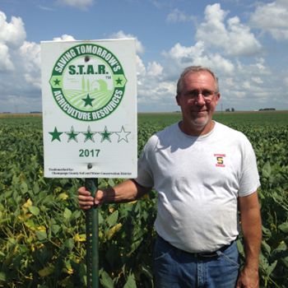
STAR Introduction
Created by the Champaign County Soil and Water Conservation District
Developed in 2017 to contribute to Nutrient Loss Reduction Strategy (NLRS) goals
73 soil and water conservation districts are STAR Licensees
STAR Affiliates: Iowa, Missouri, and Colorado
More details can be found at www.starfreetool.com
Joe Rothermel
Champaign SWCD Director & STAR Co-founder
Notes:
STAR was created for the Champaign County Soil and Water Conservation District by two farmers who serve on its Board of Directors: Steve Stierwalt and Joe Rothermel. Pictured here, is Joe himself.
This program was developed in 2017 as a response to the Illinois Nutrient Loss Reduction Strategy, and focuses specifically on water quality-improving practices
In the years following, STAR has grown from a Champaign-only program, to a multi-state program, locally adopted and administered by county soil and water districts. As of now, nearly 70% of counties in IL are licensed to administer STAR locally, and that number is expected to grow in the future
Other states that have adopted STAR include Iowa, Missouri, and Colorado. And we also have 4 counties in Indiana licensed to administer STAR as well

Slide 5
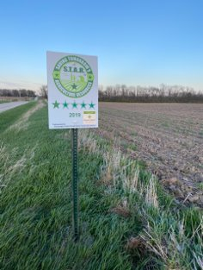
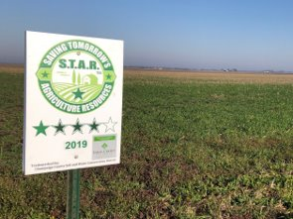
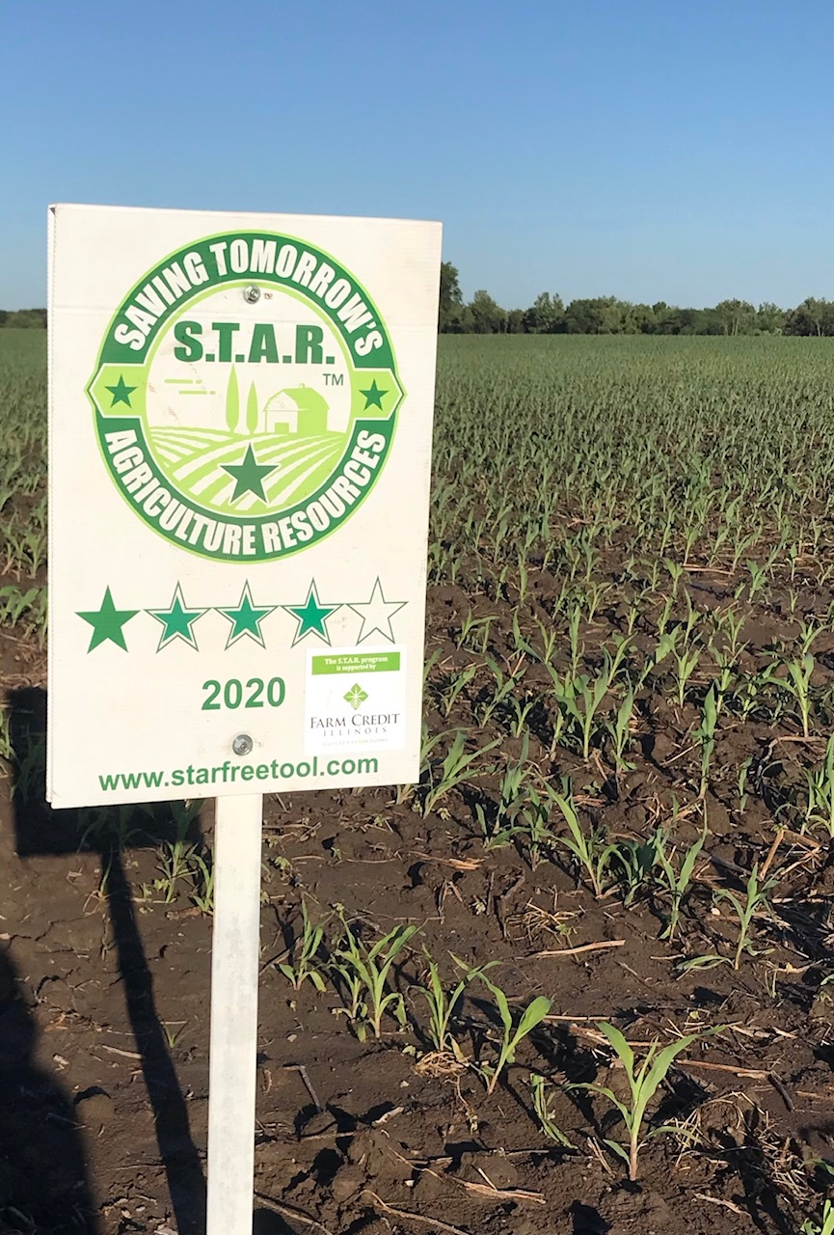
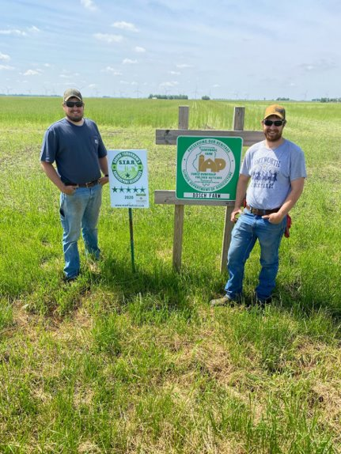
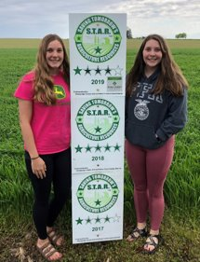
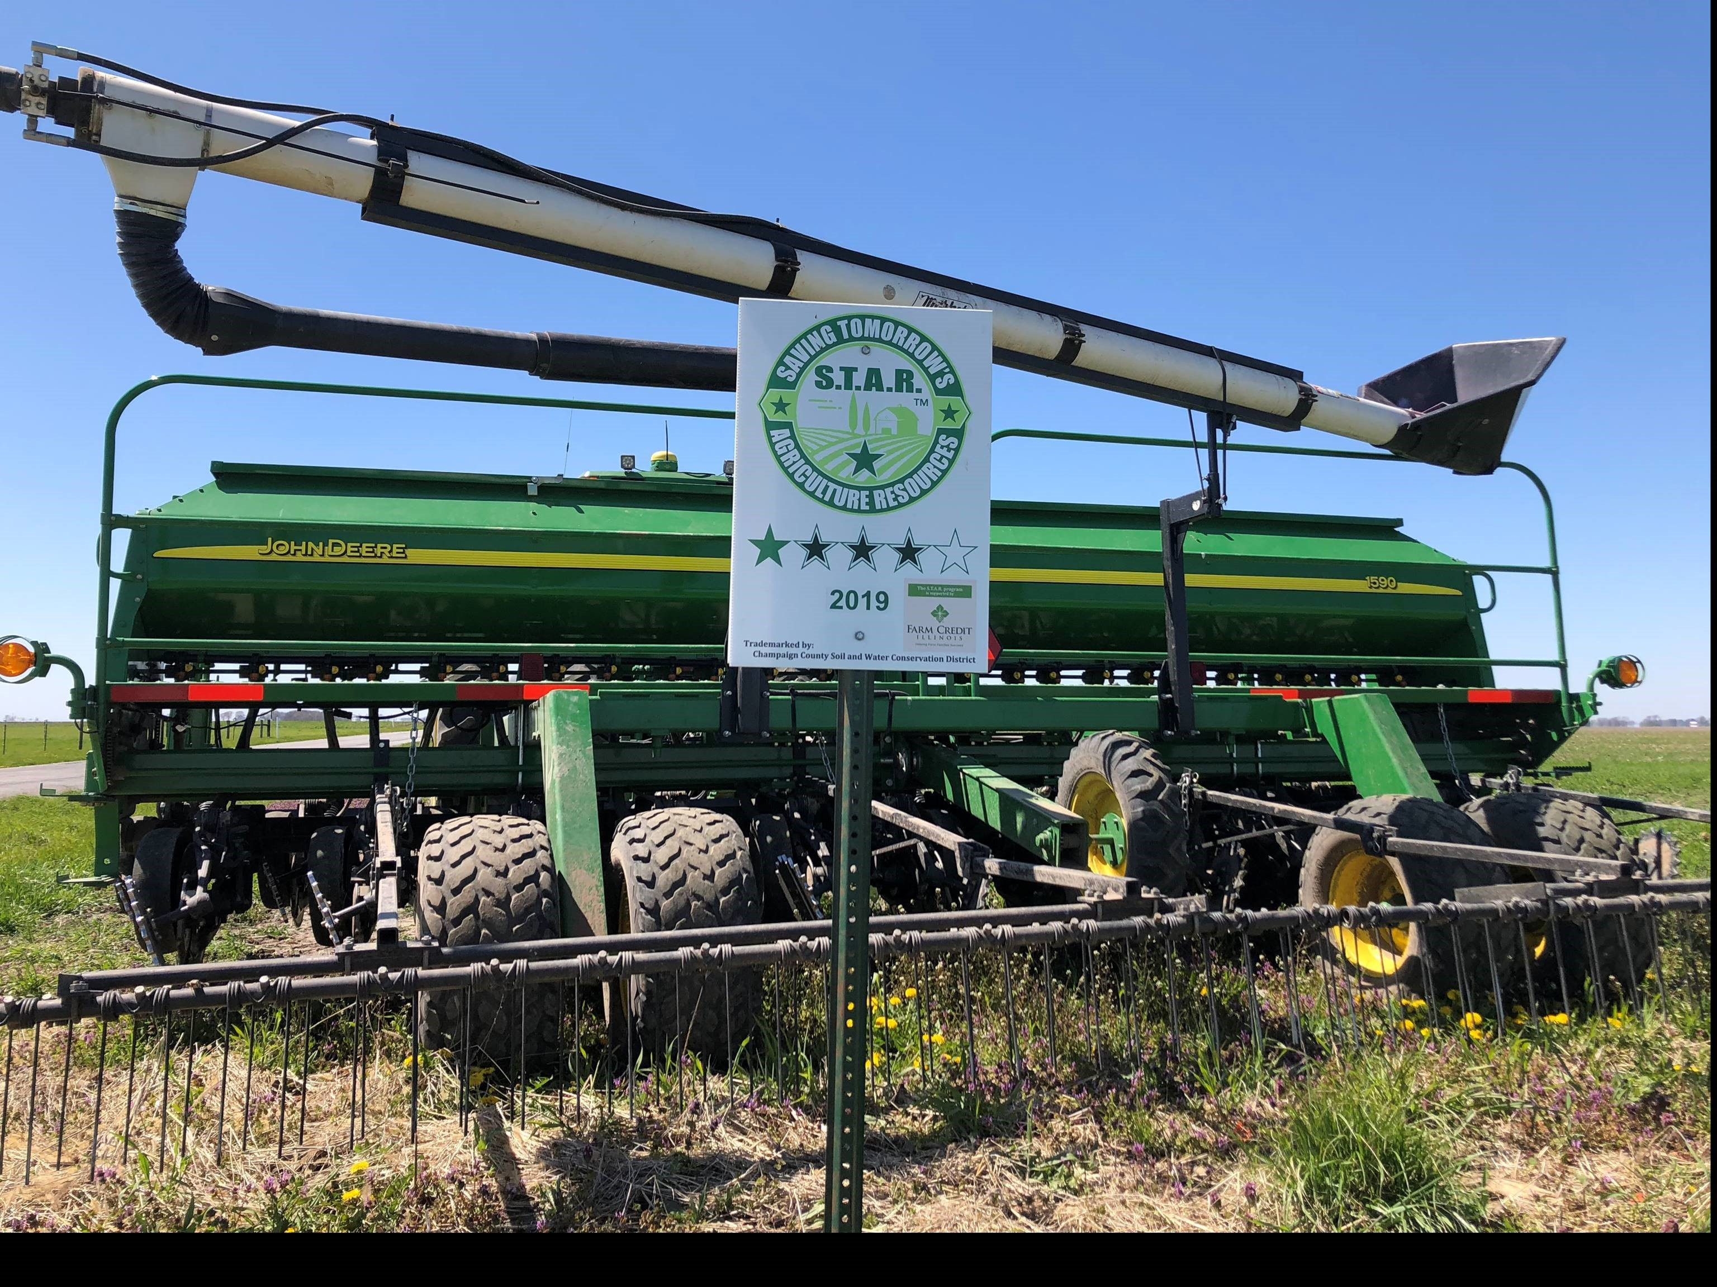
STAR Introduction
Bonus: STAR Farmers can request free field signs!
Notes:
Along with participation on STAR, farmers can request free field signs! Farm Credit Illinois and Compeer Financial have been sponsoring the signs.

Slide 6
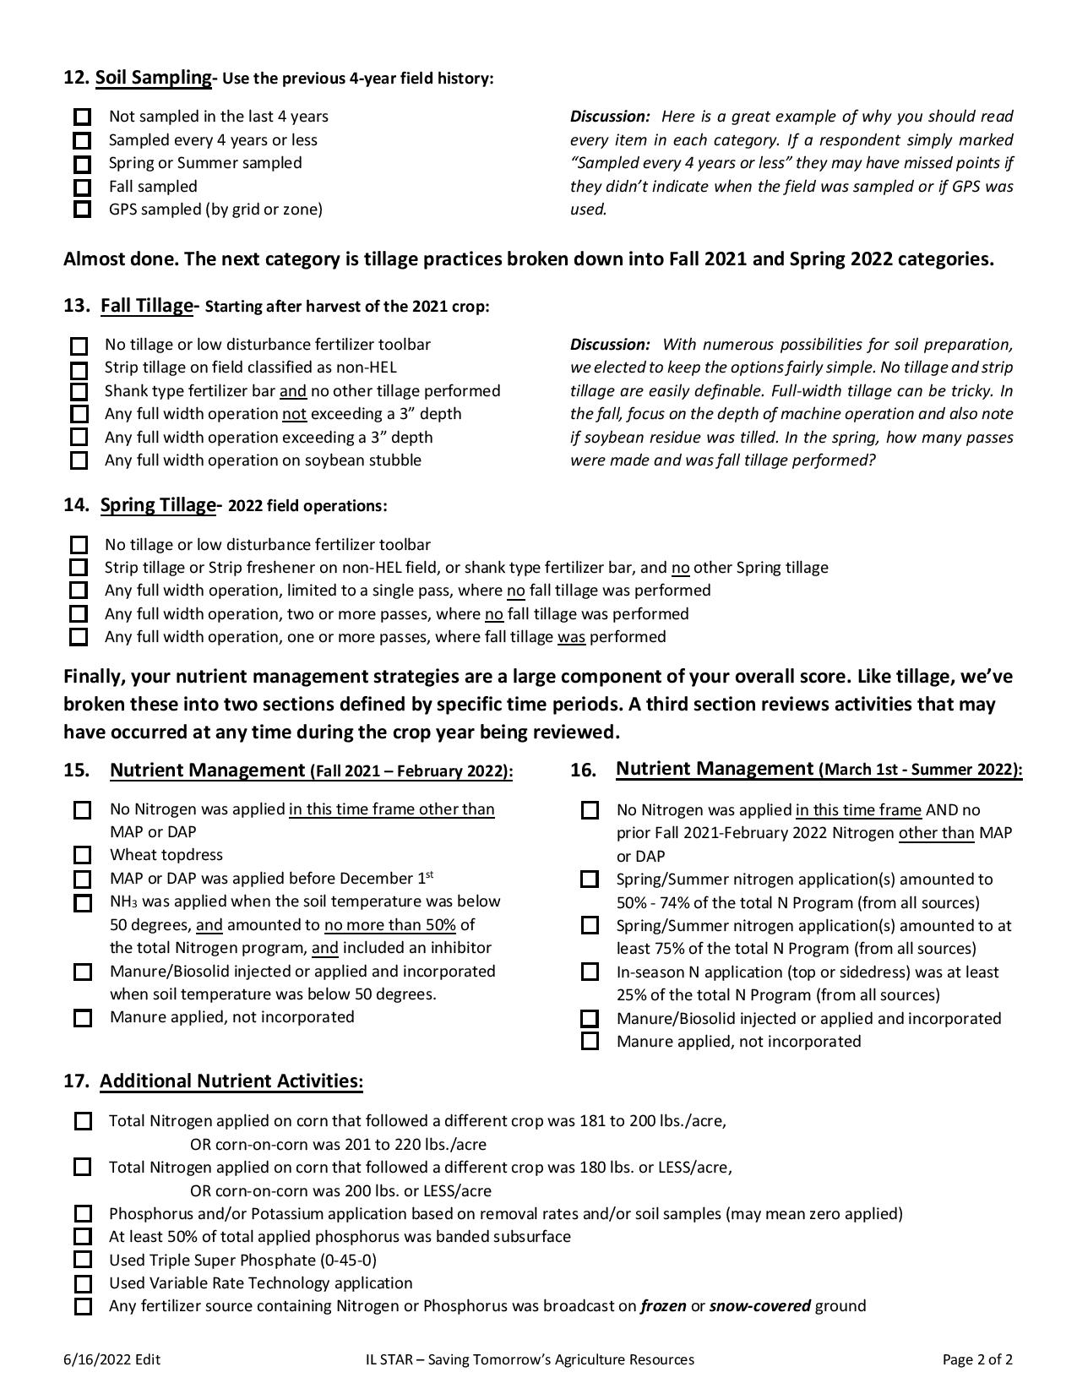
PDF Field Form
*CY22 runs 7/1/22-1/31/23
Notes:
Finally, here is what the PDF field form looks like. The form can be accessed from www.starfreetool.com or by contacting STAR staff.
Now that we’re done with the history of STAR, let’s talk about how IDOA is related to STAR. The success of STAR is based on a number of key factors, including several partners who deliver conservation programs. IDOA is one of them. IDOA requires those who participate in the Partners for Conservation program to complete a STAR Field Form application for fields related to that cost-share program

Slide 7
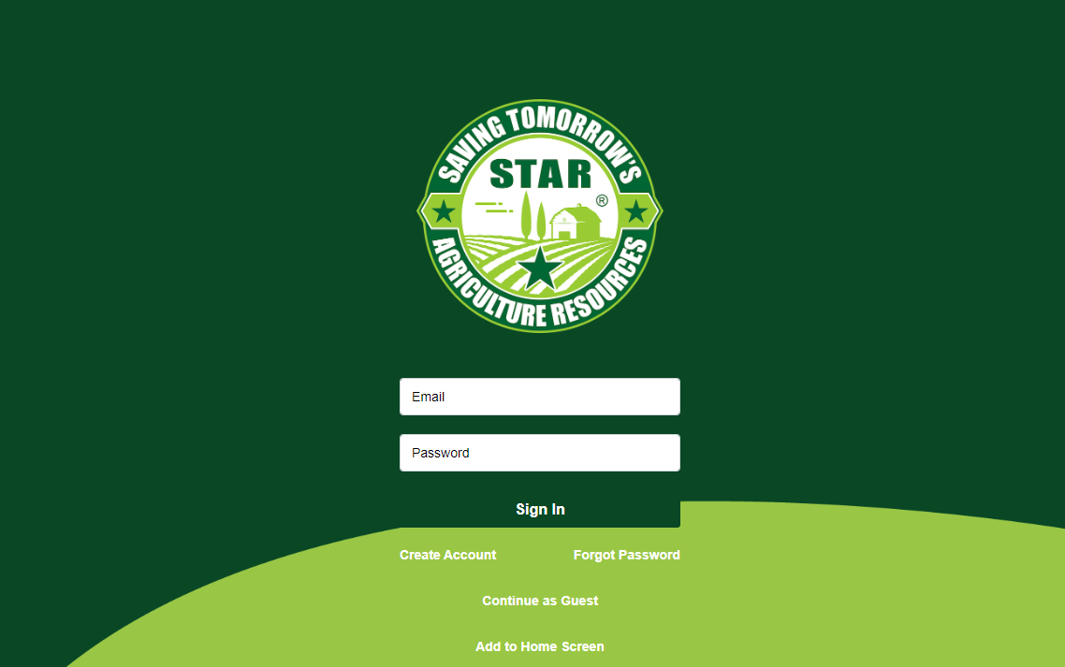
First (And Best) Method: STAR Web App!
For CY22: Open for entries 7/1/22 through 1/31/23
Notes:
As an alternative to the PDF field form, participants can use the STAR Web App. The picture shown here is the log in page for the desktop version. The STAR Web Application was developed for use last year for the first time, and this year’s version for the 2022 Crop Year is even better. There are many advantages for both the users and the local conservation district staff compared to using the Field Form version.
It is also important to note that there are a few communication hurdles to go through if a PFC farmer is located in a county where SWCD staff are not licensed to provide STAR technical assistance. Thus, STAR encourages IDOA reps to promote use of the Web App, which allows anyone from anywhere to fill out field information.

Slide 8
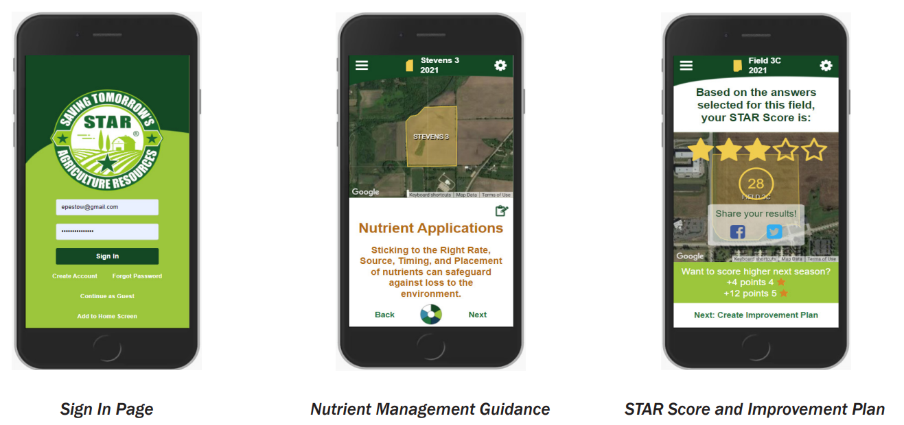
STAR Web App Advantages
Available on computers, tablets, and phones
Scoring done automatically​ and instantly
STAR Licensees (SWCDs) are given licensee access
STAR Licensees can download STAR Reports for each field
STAR Licensees can ‘tag’ fields to programs
Can track STAR participants year to year, see county-level info​
Log in frequently to check participation​
https://app.starfreetool.com/​
Notes:
In addition to that computer access, the Web App can also be used on tablets and smart phones. The primary advantage to both the reviewer and the participant is the automatic, immediate scoring of the submission.
We realize not every farmer or landowner will feel comfortable using the app, so the field form is still an option.
Licensed SWCDs are given access as Licensee administrators. This allows them to track STAR participants and eventually export data for our end of crop year summaries. Repeat STAR participants and fields can also easily be viewed if they use the Web App annually. This is very helpful as staff provide technical assistance to participants as they consider changing practices.
The link shown here will be posted for anyone to check the Web App’s functions after the training. You can also access the Web App from STAR’s website.

Slide 9
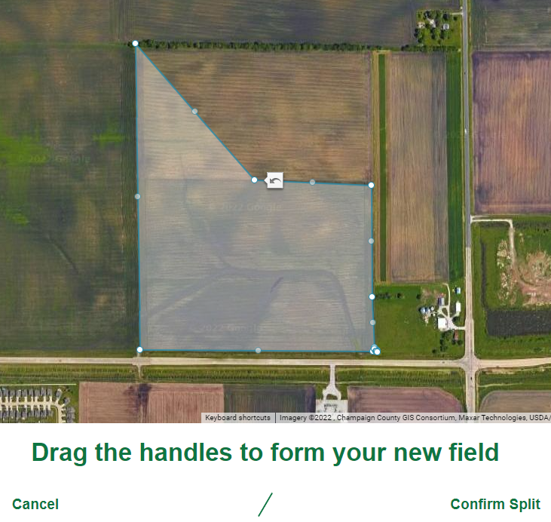
STAR Web App Advantages
Important: Limits amount of farmer data going through email correspondence, as opposed to PDF option
Web App-exclusive features:
Autogenerating improvement plans
Request for technical assistance
Request for field signs
Split fields tool
STAR reports from the Web App submitted to the IDOA rep
Notes:
We believe there is a huge advantage to the participant in getting the immediate feedback for the STAR Rating. But more importantly, by using the STAR Web App, we are limiting the amount of farmer data going through emails. STAR prides itself on keeping individual farmer data private and secure, and it is beneficial to minimize the amount of farmer data being exchanged via email.
Although questions asked are the same on both the PDF field form and the Web App, the latter contains additional features of great benefit. The user can request suggestions as to what changes can be made to improve a field rating for the next crop year. The Web App will then immediately show what changes should be considered AND how such changes will alter the STAR Rating. The participant can also request to be contacted by SWCD staff for technical advice and can also request field signs! Also pictured here is the newly developed Split fields tool when adding a new field, a much-requested feature that was not available in CY21.
Farmer users and Licensees have access to STAR Reports and STAR Improvement Plans from fields that received a STAR Rating. IDOA reps have no direct access to Web App reports, so STAR Reports from the Web App will be submitted to the IDOA representative by the associated district staff. If a PFC farmer in a non-licensed county uses the Web App, the farmer can download their STAR Report, OR STAR admin (Bruce and I) can download the STAR Report and send to IDOA. Non-licensed county employees does not have access to the Web App.

Slide 10
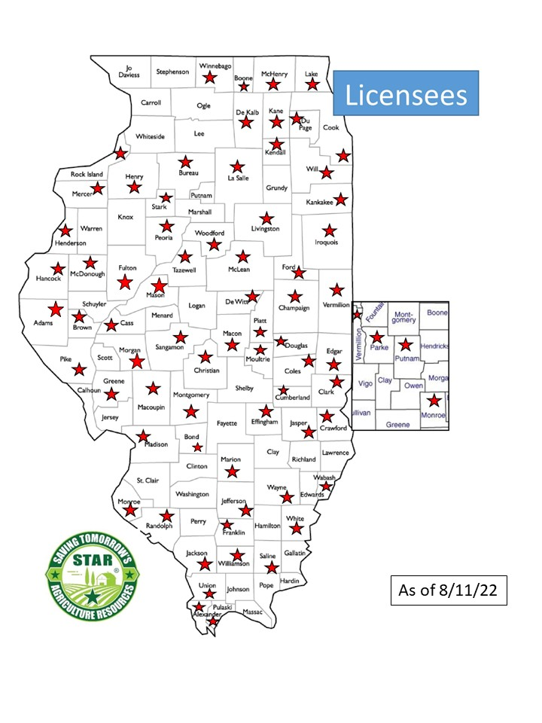
STAR Field Form Procedures
Completed STAR Forms are submitted to IDOA Regional Representatives
STAR-Licensed Districts:
Uses the STAR scoresheet to score each field
Uploads the scoresheet to assigned Box folder
Shares the scoresheet with the applicant
Stores the Field Form in case needed for verification
Districts NOT STAR-licensed:
STAR Forms submitted to IDOA will be sent to STAR staff for scoring
STAR staff will send results to the district staff and request they be passed to the applicant
Recommended: Web App referral
Notes:
Moving on to the STAR and PFC process. Please also note the current map of licensed SWCDs
Although the farmer or landowner seeking the PFC funding is required to complete the form, it is also very common for SWCD staff to complete it for the applicant. This can lead to some issues related to verification, that we will discuss later. Once the Field Form is completed it will be submitted to the IDOA representative. If the SWCD is Licensed with STAR, they are expected to do the scoring of that Field Form and upload the scoresheet to their assigned STAR Box folder, just like any other STAR scoresheet. Because SWCDs will do the scoring, it is not recommended for IDOA staff to have access to the blank scoresheet used for field forms. Once the completed field form is given to IDOA, it will be stored by SWCD staff case it’s needed for verification. There is also a period of time from January 31st until the new Field Form is available on July 1st when STAR does not accept forms for our regular participation. During that time, what we call the GAP period, PFC applicants WILL continue to use the 2022 Field Forms.
If the SWCD is NOT a licensed district, the SWCD is to submit the STAR Field Form to their IDOA Region Rep. The Region Rep will pass on the Field Form to the STAR staff (Bruce and I) who will score the fields and upload them to the appropriate Box folder. The STAR staff will send the results to the appropriate staff in the unlicensed district and request the information be provided to the farmer or landowner. This is a great way to help that district to have a conversation about conservation with the participants. Due to the lengthy process of this method, and farmer data being transferred being multiple parties, it is not preferred. The Web App is the fastest, and most secure, method for PFC farmers in non-licensed counties.

Slide 11
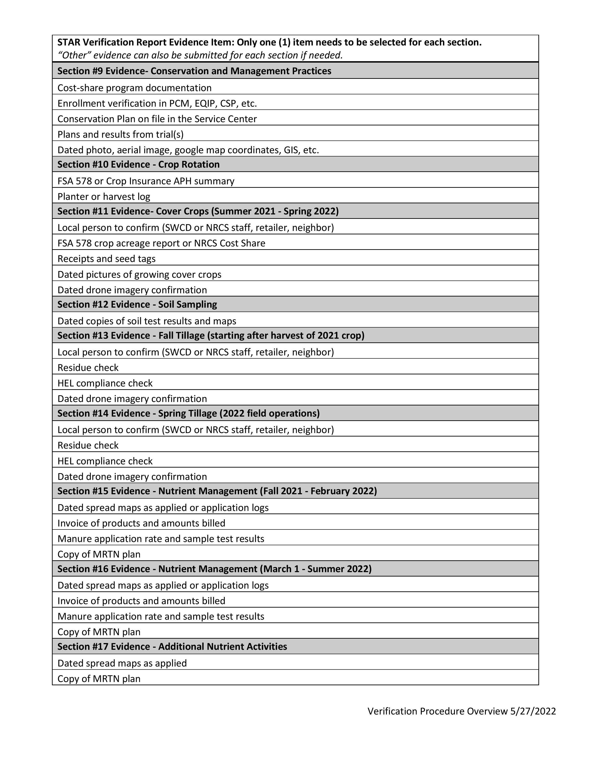
STAR Verification
Verification Period: 2/1/23 through 3/31/23
Very important that participants know their field or fields may be randomly selected for verification
General Process:
Square root of total fields randomly selected for verification
Volunteers email/call selected farmers and ask for documentation
Documents uploaded to Box file storage
IDOA involvement:
Reps can help remind SWCDs to remind PFC applicants of verification possibility
Notes:
STAR Verification is something that is still months out, but it’s important that we go over the overall process briefly today. Verification of fields is necessary to provide STAR’s credibility to its partners. It also gives us proof that the farmers are doing the practices that are giving them their STAR ratings as well. When farmers enroll in STAR, they agree to a statement that explicitly lets them know that their field has the possibility of being selected to verify practices. That is why it is important that SWCD staff who complete the Field Form/Web App for an applicant make this process clear!
Verification starts and ends between February and March after the end of the crop year and, hopefully, before planting begins. This means that the next verification period is February 1st until about March 31st .
At the end of the crop year, the square root of total fields is calculated, which is about 10%, and using a random number generator, that number of fields are randomly selected for verification. Typically, there are 4-6 volunteers from various SWCDs that assist in verifying a portion of the chosen fields independently. Volunteers call and/or email the farmer and ask for documents to be sent to them. This usually includes contacting the SWCD staff for that county where the field is located. Per field, there should be about 5-9 documents collected, one for each section like crop rotation or tillage. Types of documents can be testimonies, maps, nutrient invoices, or even photos. It largely depends on what evidence is being asked for. Once the documents are received, the volunteer will store them in a specified Box.com shared folder with STAR.
One issue we’ve had for past verification were some of the selected farmers being IDOA PFC participants who were not aware of their fields being potentially selected for verification. We encourage IDOA representatives remind SWCDs to let their farmers know about the potential selection. This can be a good way to circumvent this miscommunication issue for the next verification period.

Slide 12
Wrap Up – Thank You!
More questions?
Email David.Nguyen@AISWCD.org (Preferred) or call 217-721-5435
Or email BHenrikson@parkland.edu
Feel free to also contact us below:
Notes:
Okay, that’s all for the training. I hope it was informative enough for everyone. We should have a bit of time to answer any additional questions.
(2-5 minutes) (Personal note: Watch for Zoom session time limits!!)
Okay, that’s all the time we have. I’ll make sure to send these PowerPoint slides to everyone here soon. Thanks for logging in today! Bye :D

