Slide 1
STAR Training - CY22 Field Form Scoring
July 2022
David Nguyen, STAR Coordinator, AISWCD
Bruce Henrikson, STAR Assistant Coordinator, CCSWCD
*Narration notes below each slide!
1
Notes:
Hi everyone, welcome to the July training for CY22. If you’ve been trained on scoring field forms from CY 2021, then the process is exactly the same. If not, then don’t worry. Scoring and keeping track of field forms is very easy to do, and in fact, takes less time to do than reading through this presentation!

Slide 2
Agenda
Prep Work
Scoring the Field Form – Section by Section
Returning the Field Form
Uploading Scoresheets to Box
Notes:
In this training, we will cover the materials you need to prepare, how to score a submitted field form section by section, what to do when returning a field form to the recipient, and the process of tracking completed scoresheets.

Slide 3
Prep Work
On Box:
Download a blank CY22 Scoresheet
Folder navigation: All Files > STAR > STAR Licensee Materials > Crop Year 2022 – Field Form, FAQ, Scoresheet & Other
Have open on a computer tab your SWCD County tracking folder
Folder navigation: All Files > STAR Participation Files > Crop Year 2022 > CY 2022 General County Tracking > Illinois or Indiana (Depends on SWCD) > STAR CY 2022 Tracking_#### County
Notes:
I recommend that you have your Box folders open and a blank scoresheet downloaded and ready to fill in as you progress to each slide. Not only will you have practice filling out a scoresheet, but it will also familiarize yourself with Box. If you cannot find your Box folder for your County SWCD, please contact me immediately.

Slide 4
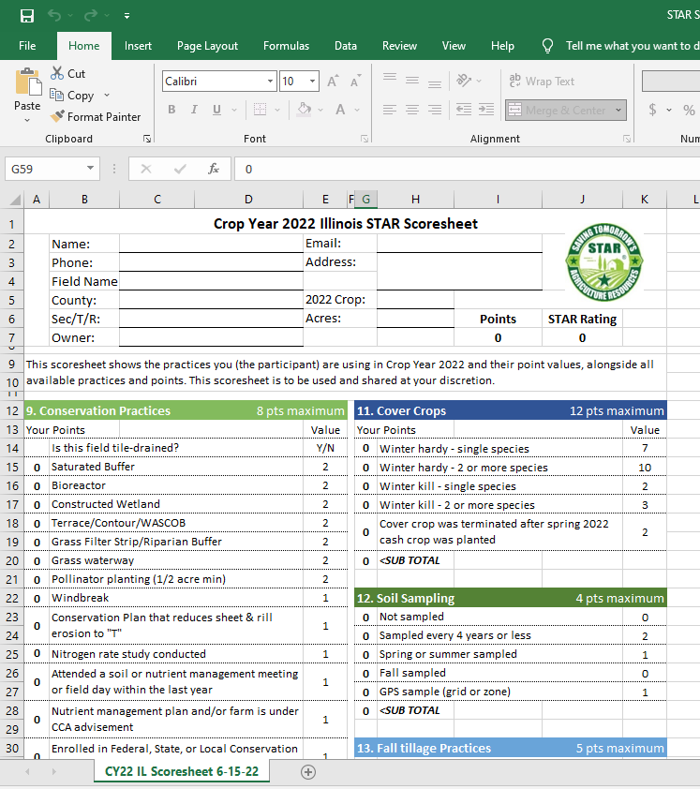
Prep Work
Scoresheet is an Excel spreadsheet ->
Uses drop down menus on the left side for scoring sections 9-17
Points automatically tallied as you go through each section
Process is like filling out a field form: takes less than 5 minutes to do!
Notes:
The STAR Scoresheet is a simple excel spreadsheet with everything already filled in, minus the actual answers. Whenever you receive a field form submitted by a farmer, you will use a blank scoresheet to grade their answers. It’s simply a matter of matching the answers from field form to score sheet. There is no need to calculate anything, as the excel scoresheet will tally points that you selected answers for in real time.

Slide 5
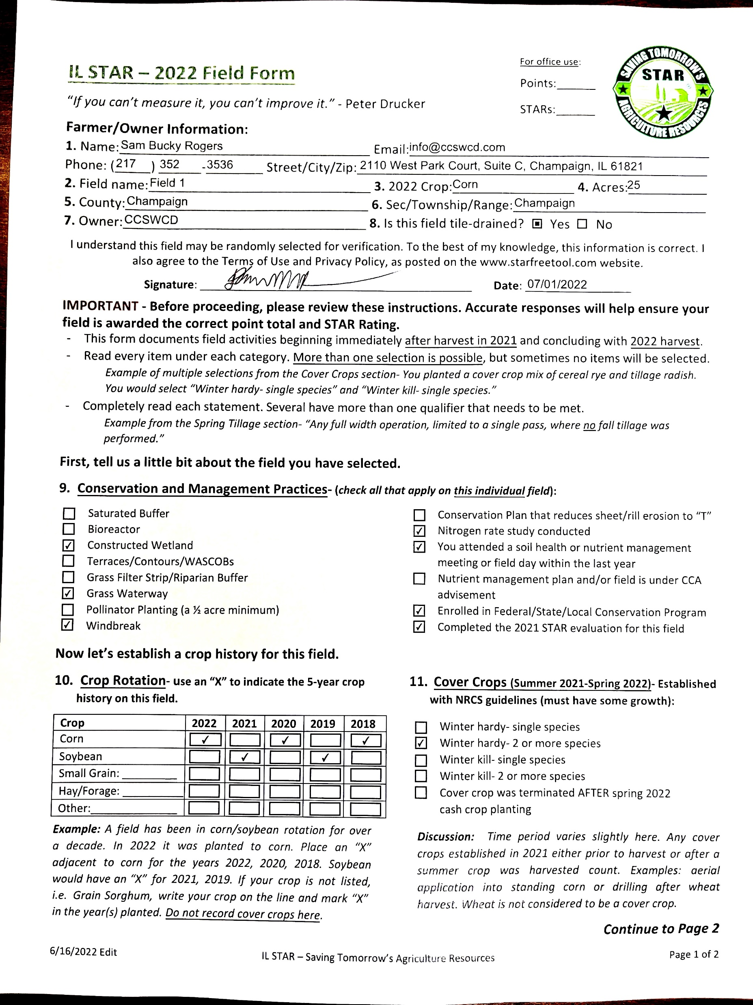
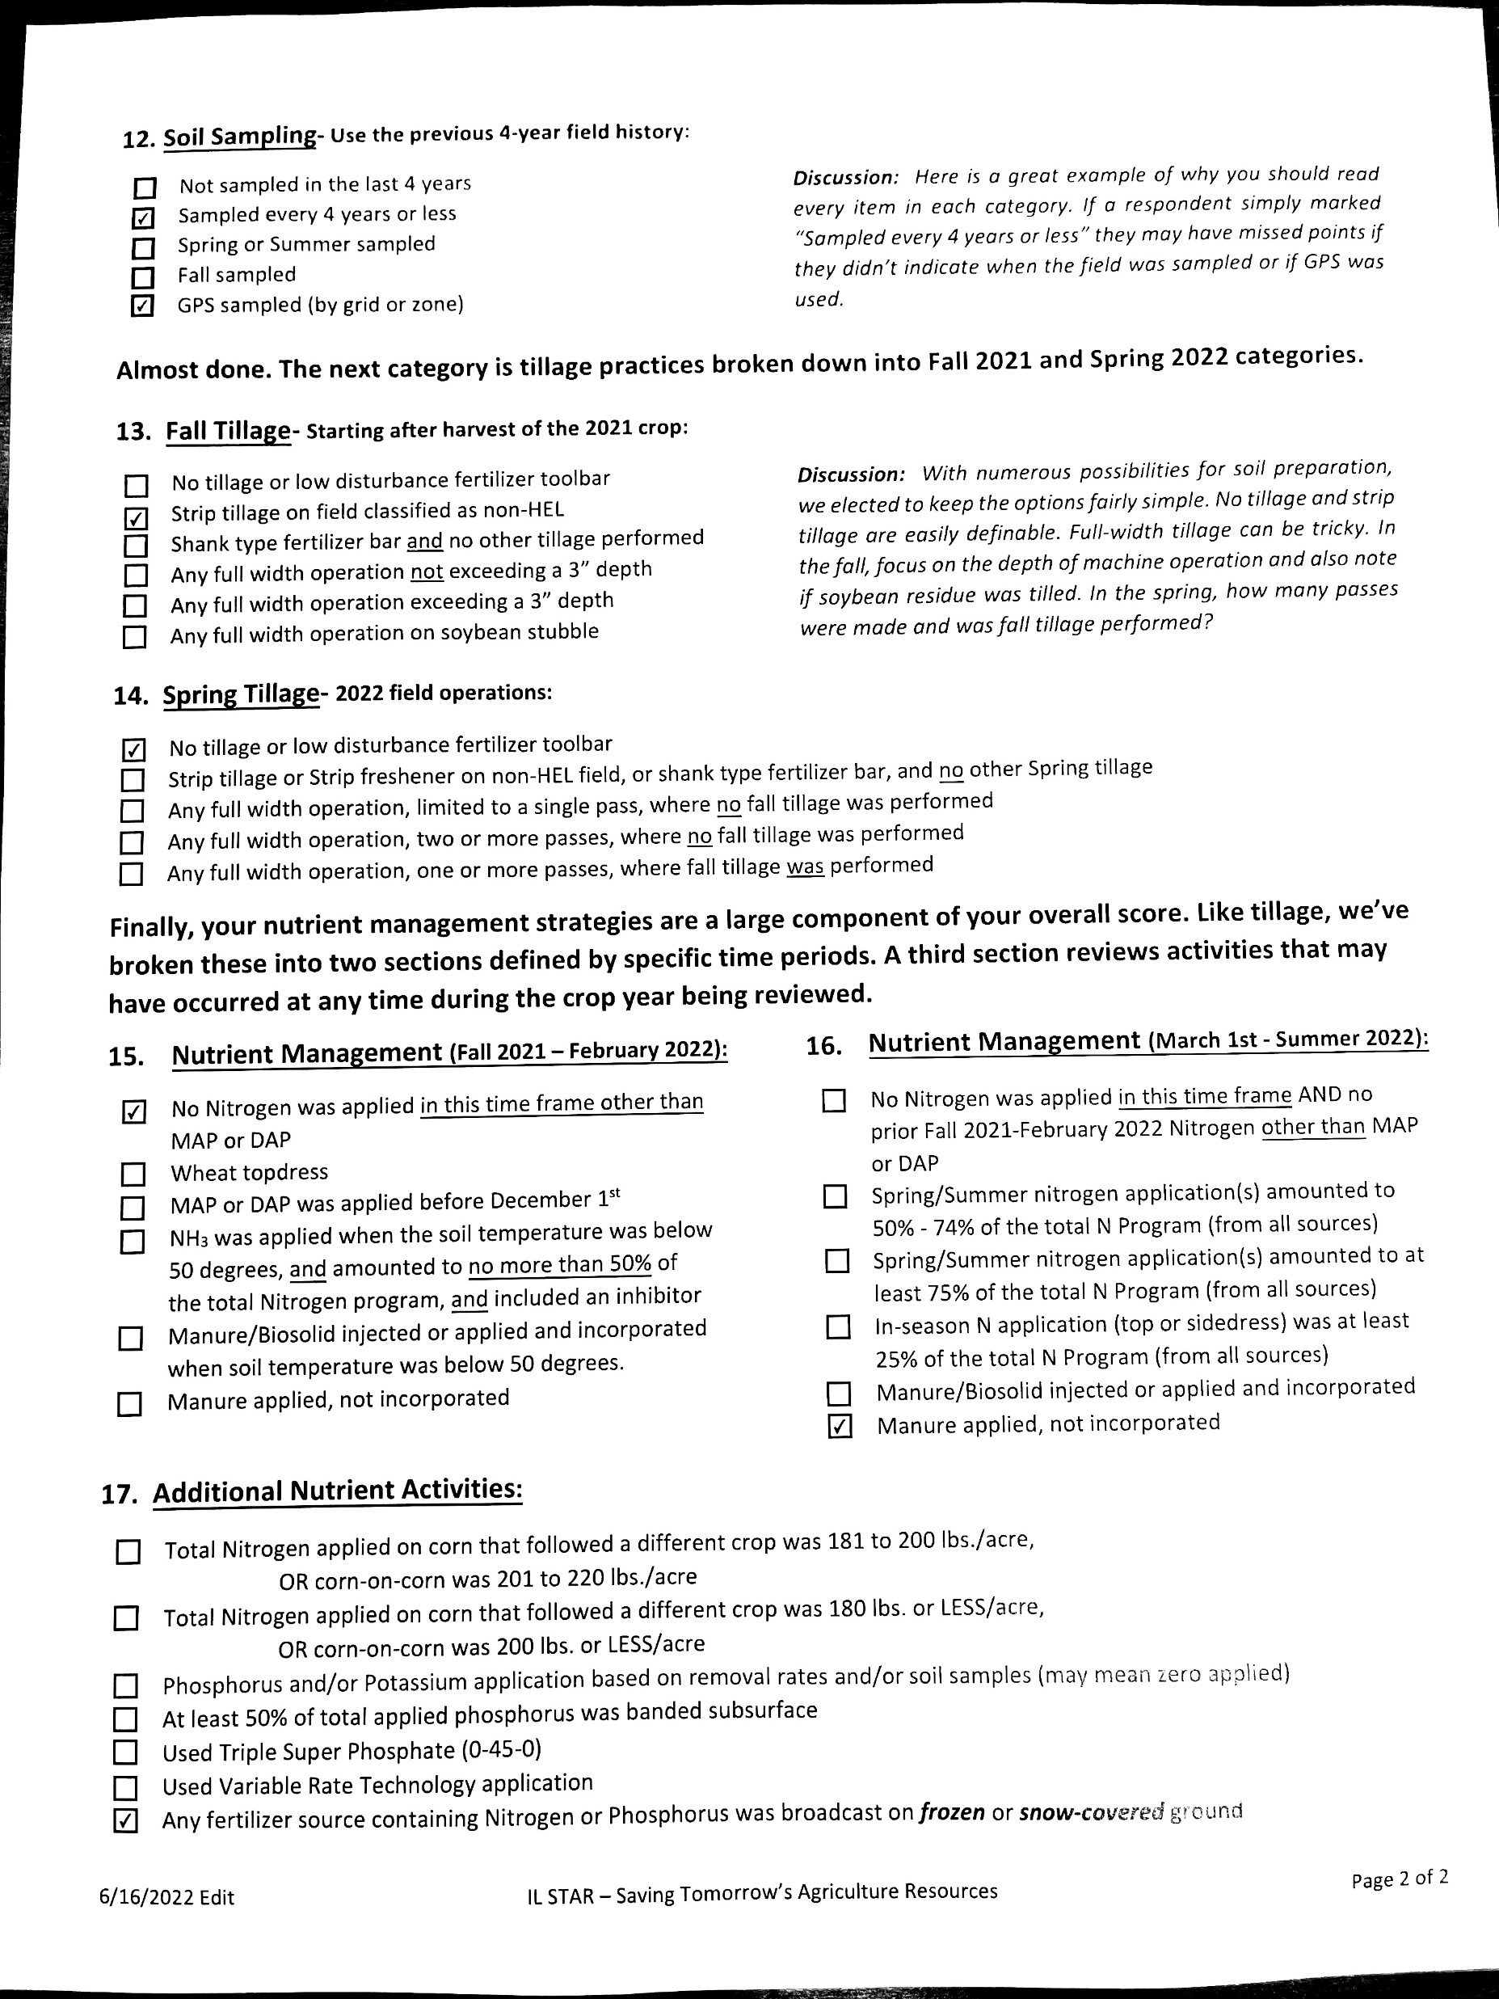
Example field form for this training:
Notes:
For this training, we will score this example field form. The farmer in this example may sound familiar, but he is a completely fictional entity strictly for training purposes. As you will tell when scoring this field form, the questions and answers are formatted similarly on both the field form and the scoresheet, so you, the reviewer, will not spend too much time trying to match the text between both documents.

Slide 6
Questions 1-8
8 is filled in next part of Scoresheet
Notes:
First, we need to copy the farmer info on the field form, to the associated place on the scoresheet. Look at the top section of the scoresheet to spot the blank farmer info.
Note that Question 3, the 2022 Crop, is the only part of this section that utilizes a drop down menu, and that Question 8, “Is this field tile-drained?”, is to be filled in just a bit later. The rest of the info here must be typed in manually.
Also, note that for some field forms, Farmers may leave sections blank, such as no email address. If that’s ever the case, then nothing to worry about, just leave the associated section on the scoresheet blank as well when you return it to them. However, it is very important to obtain the address and phone number in case the particular field is randomly selected for verification.

Slide 7
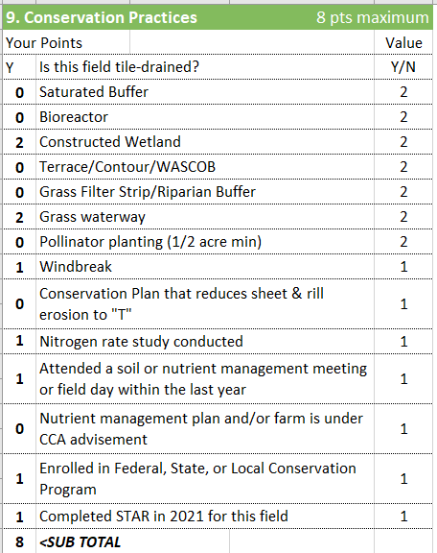
Note: tile drainage question from prior section
Drop down boxes have weighted point values for each option
Ex. Constructed wetlands 2 points, nitrogen rate study 1 point
Notice that Rogers technically reached 9 total points, but the scoresheet makes sure that he can only reach the 8 point maximum
The best 5-STAR farmers have a suite of good practices :)
Notes:
Now we can move on to the first question that actually asks about practices. All that needs to be done is to use the drop down menu on the scoresheet to correctly mark which practices have been done by the farmer as they listed on their field form.
For this example, Farmer Rogers has done a large number of conservation activities, but he is still limited to an 8 point maximum. STAR ratings are meant to be evenly weighted to accommodate a suite of diverse practices, so even if one checked ALL of the choices in this section, they would still only end up with 8 points maximum

Slide 8
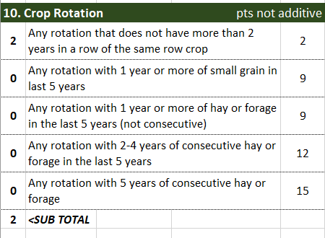
Notice the large amount of points that can be gained in this section
Although Rogers had the minimum points possible for this section, he still has many other chances to accumulate a high rating
Notes:
For the crop rotation section, most farmers in IL use the standard C-SB-C-SB rotation. In our example, this field earned 2 points with that rotation. Notice this section is different than others. Only ONE of the 5 choices can be used. The points are not additive. Example: If a field’s rotation was Corn & Soybeans, but had one year of wheat, the field would be given 9 points for the third choice.

Slide 9
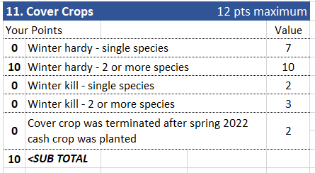
Rogers has planted 2+ winter hardy species, so he gets 10 points
Be aware that winter hardy and winter kill selections are mutually exclusive options
Ex. If farmer mistakenly puts down WH “single” + “2 or more species”, ignore “single species” selection and score only the “2 or more species option”
Notes:
For the cover crops section, if a farmer doesn’t plant any cover crops, then they get 0 points and this part in the scoresheet can be left blank.
Also note that some answers can be mutually exclusive or redundant. If a farmer selected 2 or more species of winter kill plants, but selected both options on the field form (Worth 2 and 3 points respectively), the field would NOT get 5 points, but only 3 points since the first Winter Kill option is already included in the second choice.
For this example, Rogers spared us the scoring headache and simply noted that he planted 2 or more winter hardy species. But if you notice the scoring, he could’ve gotten an extra 2 points if he terminated the cover crop after planting his cash crop.

Slide 10
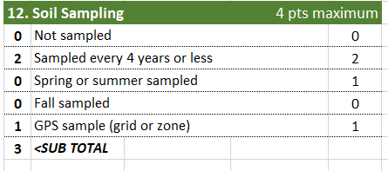
Rogers noted the soil was sampled every 4 years or less and noted that GPS was used to identify those locations.
However, he failed to identify what time of year the samples were pulled.
Thus, Rogers got 3 points in this section, but if he indicated the samples were taken in Spring or Summer, the field would have an extra point.
Notes:
Next up is the soil sampling section. This one is pretty easy to fill out both for the farmer and for the reviewer on their respective forms. But something to keep in mind, the field form should always include the timing of soil sampling. Pulling samples in the Fall earns no extra points but taking those during the Summer or Spring would have earned an extra point.
In this example, farmer Rogers sampled his soil every 4 years or less, and GPS was used to locate those samples, so he would get 3 points for this section.

Slide 11
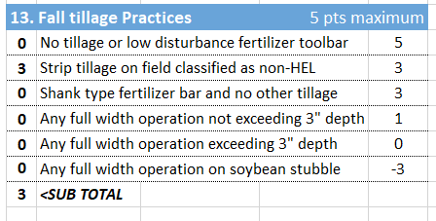
In this section onwards, please note how some answers will actually deduct points
For this example, Rogers only did strip-tilling, thus netting 3 points
Notes:
Tillage is the first section of the scoresheet where some answers have negative points attached to them. So a conventional farmer who uses tillage can actually hamper their STAR rating. Even so, there are other sections of the field form that will gain points back.
Please also note, that there should only be one answer in this question. If a farmer selects multiple answers, it might be helpful to contact the farmer and ask them for more specific details to possibly amend this choice.
Based on Rogers’ answers, he performed strip till, earning 3 points.

Slide 12
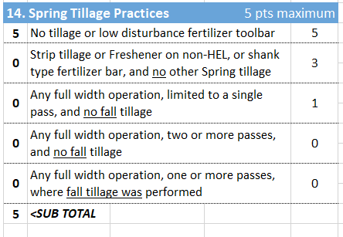
For this section, he did no-till for Spring, earning the maximum allotted points
Notes:
This is almost the same as the previous section, the main difference is that there are no answers the farmer can choose on the field form that will earn negative points. For our example, Rogers chose no tillage for his field, meaning that he received the maximum points possible for this section.

Slide 13
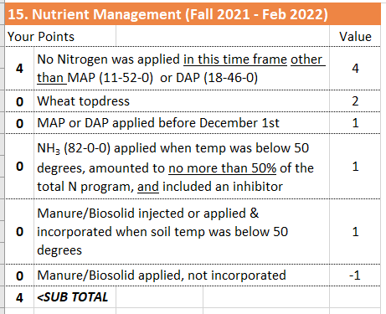
For this section, Rogers did not apply any nitrogen
But he could have also earned extra points by doing other practices
Notes:
Nutrient management has quite a few options for a farmer to choose in Section 15. Notice the common practice of using NH3 in the fall earns 0 points if it represents more than 50% of the total nitrogen.
It is also possible that NOTHING should be checked and scored in this section.
In this case, Rogers noted that he applied no other Nitrogen “other than” MAP/DAP, but also did not explicitly indicate in the field form if he applied MAP/DAP, which would be confirmed by checking the 3rd item down the list. Thus he would only get 4 points instead of 5.

Slide 14
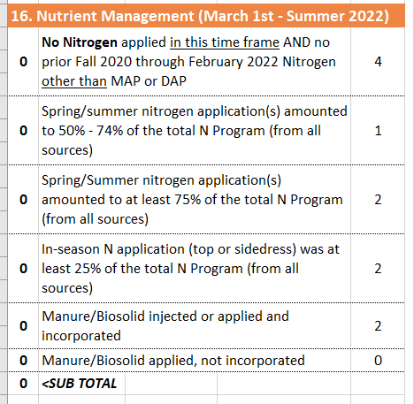
Rogers only selected the bottom option, which is worth 0 points in this section
Notes:
This is almost the same as the previous section, the main difference is that there are no answers the farmer can choose on the field form that will earn negative points. For our example, Rogers chose to only apply manure, which did not net any points for scoring.
Also notice the first item in this section is sometimes given points when it should not. If all the nitrogen for a corn field was applied in the fall, this item is awarded NO points. This section also requires the participant to know the percentage of the total nitrogen added in the spring and/or summer.

Slide 15
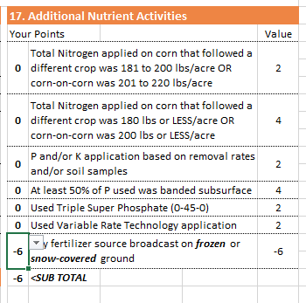
Last section to grade!
Unfortunately, Rogers selected an answer that deducted points
Thus he has (-) 6 points for this section
The STAR-rating and final score will be automatically calculated
Notes:
You’re almost done. Last section, #17 is about additional nutrient activities.
Notice that Rogers likely should have checked one of the first 2 items, depending on how many total pounds of nitrogen were applied on this field. Since neither item was checked, it implies that more than 200 pounds per acre were applied.
A common error is an omission in this section. Any farmer who is adding nutrients based on soil tests or is using only replacement rates should have checked that third item on the form and awarded 2 points. That applies to a field even if the nutrients are NOT added to that particular Crop Year. The other choices in this section are based on the particular Crop Year.
Unfortunately, farmer Rogers picked the only option in his field form that actually gives negative points for it! Somberly score Rogers’ final section as the final STAR rating is calculated when you’re finished.

Slide 16
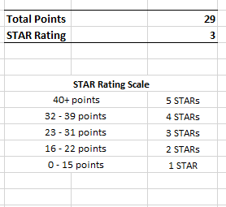
Final Scoring
Rogers scored 3 STARs, a VERY good score for his first time
But he was also just three points away from getting a 4-STAR rating!
If you were advising Rogers, what would you recommend he do to improve his practices?
Notes:
In this example, farmer Rogers scored 29 points, which means his field is rated 3-STARs total. A reminder, that a 3-STAR field is very hard to achieve. It signifies a good suite of established practices that support soil health and water quality.
But at the same time, he was very close to getting a 4-STAR field instead. If he lived in your district, what practices would you recommend he do or improve for next year’s attempt? Perhaps adding some hay or forage, or trying no-till management completely instead of strip-till. There are many different options for improvement!

Slide 17
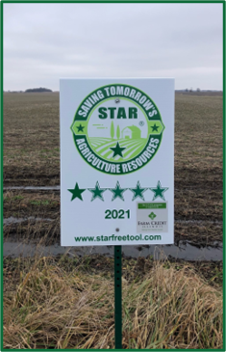
Returning the Field Form
Email or physically mail copies of the Field Form AND the Scoresheet back to the farmer
Study the FAQ, and understand how practices are weighed
Be prepared to respond to participant inquiries on how to improve their scores for next year
If receptive, ask the farmer if they’d like to use the Wep App next time!
Ask the farmer if they would like a field form sign, they’re provided free!
If yes, email BHenrikson@parkland.edu for assistance
Notes:
Once everything is scored, please return the field form AND the scoresheet to the farmer. That way, the farmer will know what practices earned him which points and what alternative practices can add to the point totals for that field. Be sure to keep a copy of the field form in case the field is selected for verification. Also ask if the farmer would like a FREE field sign with their STAR-rating. We have a treasure trove of field signs to offer.
Also, as you already know, farmers who fill out their field forms on the Web App bypass licensee review and get their scores immediately. If it’s possible, try to ask if your farmer would like to instead do their next attempt on the STAR Web App instead

Slide 18
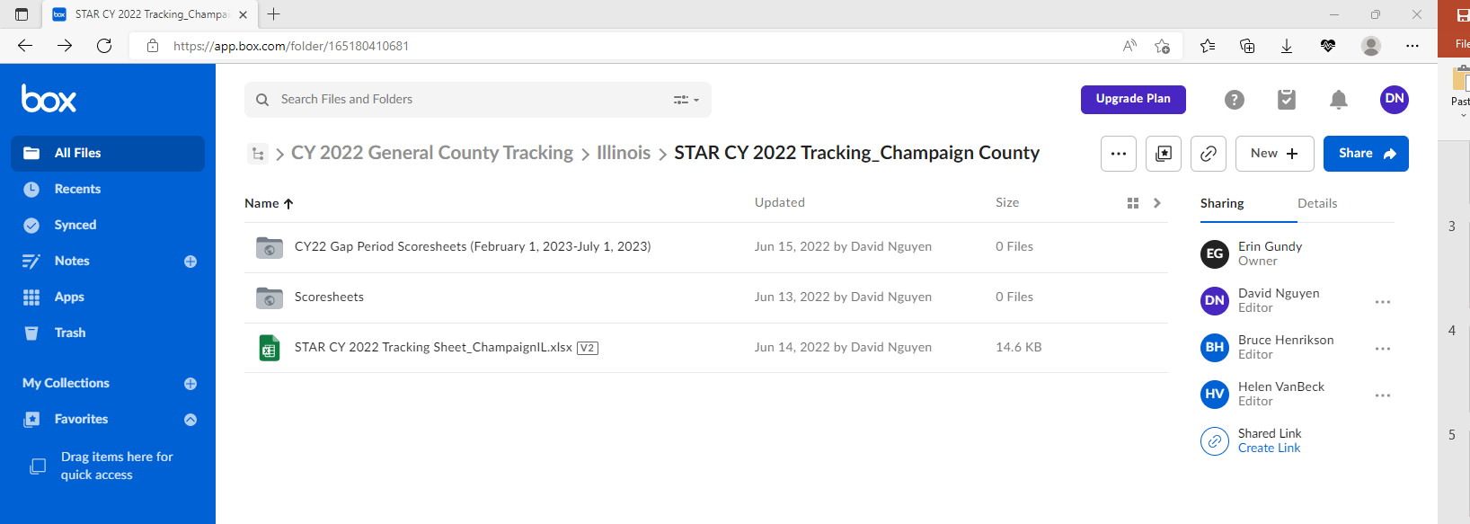
Uploading Scoresheets to Box
Folder navigation: All Files > STAR Participation Files > Crop Year 2022 > CY 2022 General County Tracking > Illinois or Indiana (Depends on SWCD) > STAR CY 2022 Tracking_#### County
Notes:
Make sure to always keep a copy of a completed scoresheet for uploading to Box. Every SWCD has access to their own county folder on Box. When you navigate folders, it should look like the shown image, but of course with your own county files

Slide 19
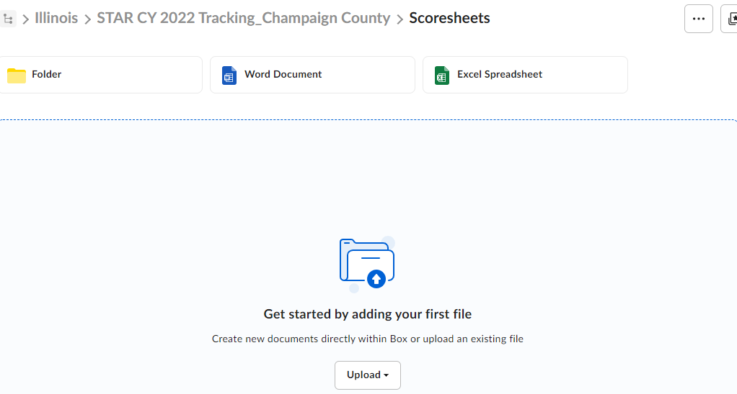
Uploading Scoresheets to Box
Click on “Scoresheets” subfolder and upload scoresheet
IMPORTANT: Naming convention for scoresheet files should be:
Participant name_Field name.CountyState
So for the example scoresheet, it would be titled SamBuckyRogers_Field1.ChampaignIL
Notes:
When you upload scoresheets, make sure to set a proper naming convention as you rename your file. On rare occasions, you might get a company name such as “U of I Dairy”, to which you should do your best to rename in FirstnameLastname format (UofIDairy) with no spaces between the words

Slide 20
Uploading Scoresheets to Box
Exit out prior folder, click on “STAR CY 2022 Tracking Sheet_CountyState.xlsx”
Add in scoresheet info as described at the top of each column. “John Doe” example is the first entry on the tracking sheet
STAR numbers automatically tally on the right hand tables as you add in scoresheet points and ratings
Notes:
Final step! Go to the excel file located within your county tracking folder. There is an excel tracking sheet. Make sure to correctly fill in that spreadsheet with each new scoresheet you do. All numbers and data will automatically tally on the right hand side if done correctly. If you are confident that you don’t need the “John Doe” example, you are free to delete it before we automatically remove it come end of CY22.
If you would like to practice uploading scoresheets, you are free to try with the scoresheet for grading the training field form written by “Rogers”. Just make sure to delete it when finished.
Important: When you edit any of the files online they will automatically be saved when you refresh or exit the folder.

Slide 21
Uploading Scoresheets to Box
Helpful tips:
Please do not upload field forms to the tracking folders on Box
Field form copies should instead be kept by the SWCD
May be useful for verification process next year to remind farmers that they filled out a field form with us
ALWAYS upload scoresheets in original .xlsx format
When a specific Box file needs to be edited, they need to click on the Microsoft Excel Online drop down, not the default download file option
Ex: if making an error in the scoresheet, fix it by doing a live-edit via Microsoft Excel Online, and then exit the file. Will be saved automatically
Notes:
Something that we’ve had organization issues with in prior years were scanned copies of field forms being sent to Box tracking folders. To avoid clogging up the folders, we ask that you keep copies of the field form to yourself. Only the scoresheet copies are what we need, to keep track of numbers for final calculations come annual outcomes in 2023

Slide 22
Wrap Up – Thank You!
More questions?
Email David.Nguyen@AISWCD.org
Or email BHenrikson@parkland.edu
Feel free to also contact us below:
Notes:
That’s it for the presentation, I hope it was informative for you! If you have additional questions or concerns, please contact us. If you’d like future trainings to be in this self-reading style or as a recorded video, feel free to let us know! Thank you, and have a great day.

