Slide 1
Illinois Urban Manual
Patrick J. McPartlan, CPESC
Kane-DuPage SWCD

Slide 2
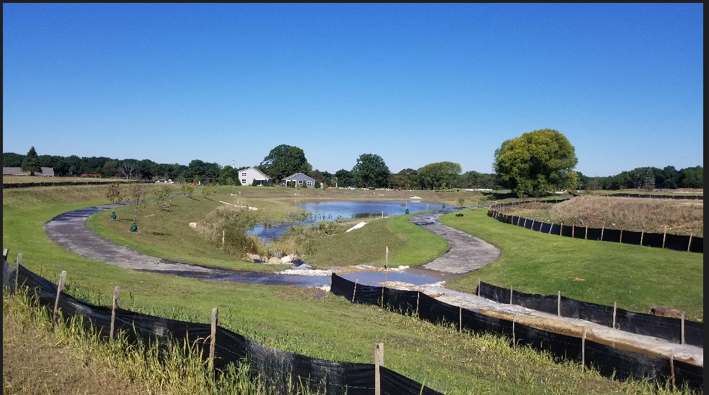
Presentation Layout
Soil Erosion and Sediment Control (SESC) Overview
Stormwater Pollution Prevention Plan
Illinois Urban Manual
Goal
Use Cases
Future
Closing Remarks

Slide 3
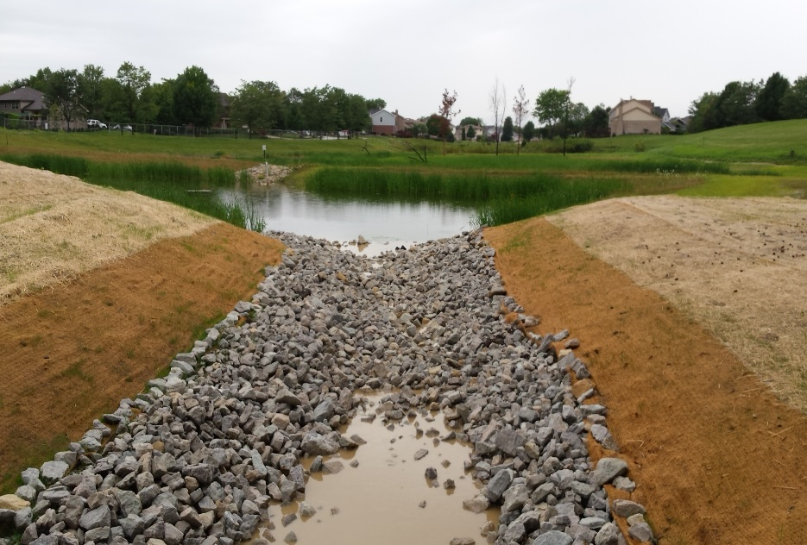
What is Soil Erosion and Sediment Control
Goal: Minimum impact from temporary disturbance
Maintain underlying soils if possible
Maintain off-site areas
Preserve downstream water quality
Develop a plan to achieve this goal with a series of tested best management practices.
Address soil erosion
Address sedimentation
Notes:
Sediment is the result of erosion .
Build up of eroded soil particles transported via run off

Slide 4
Applicable Regulation Permitting Construction
IEPA National Pollutant Discharge System (NPDES)
ILR40 for communities
ILR10 for individual projects (>1 Acre)
USACE Work Authorization
County Stormwater Ordinances
Notes:
NPDES Permit from IEPA

Slide 5
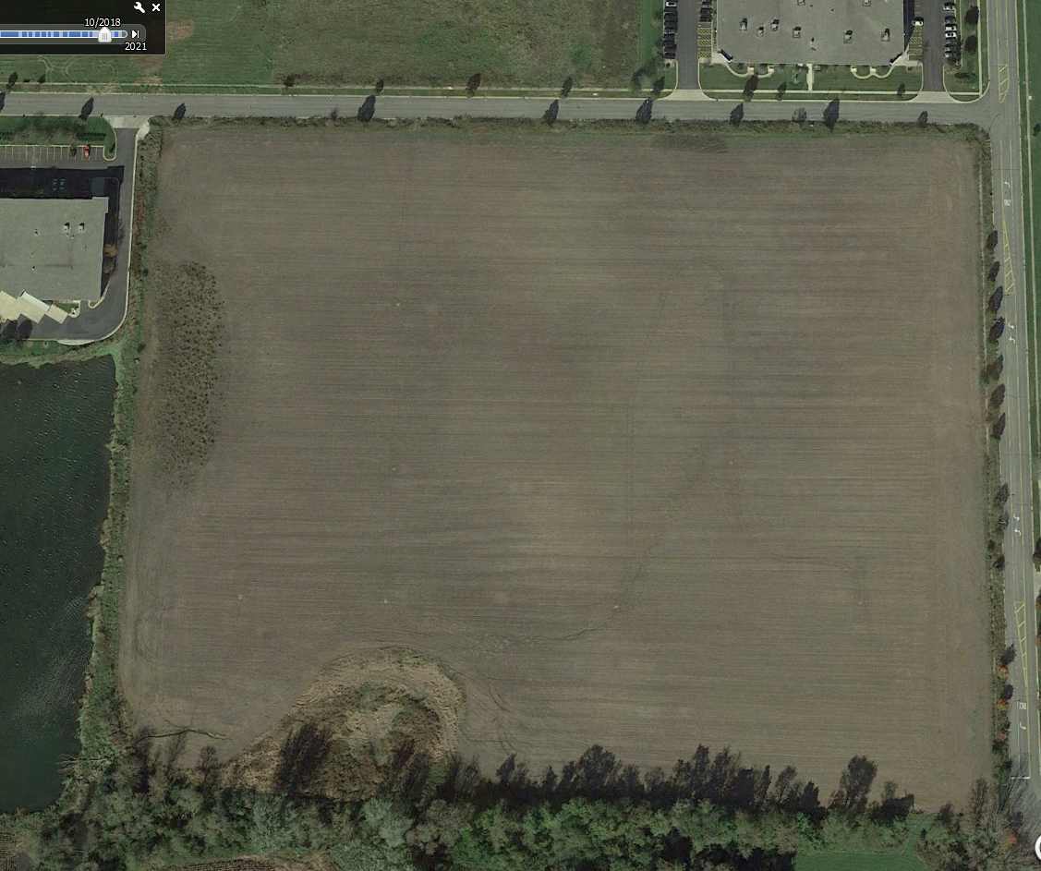

Slide 6
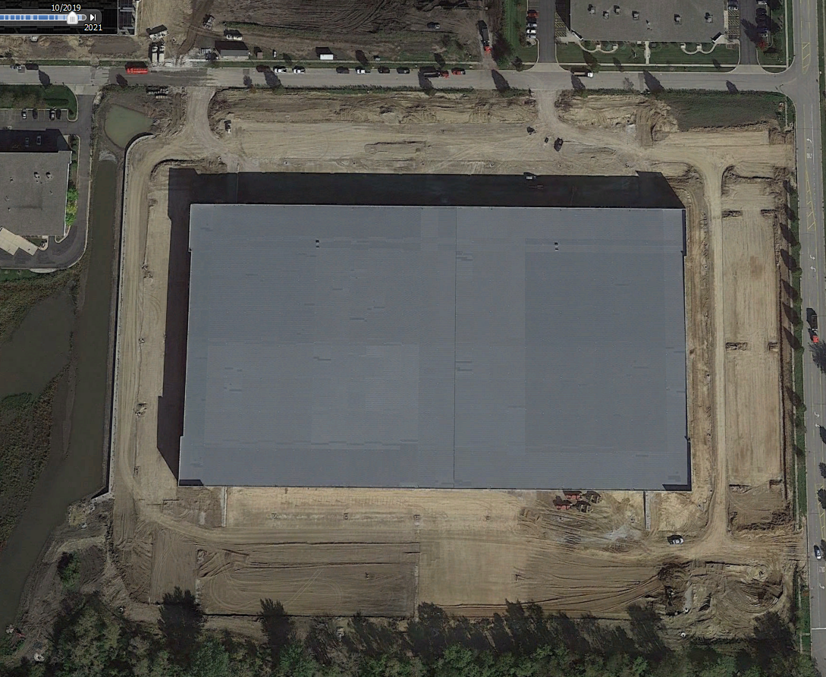

Slide 7
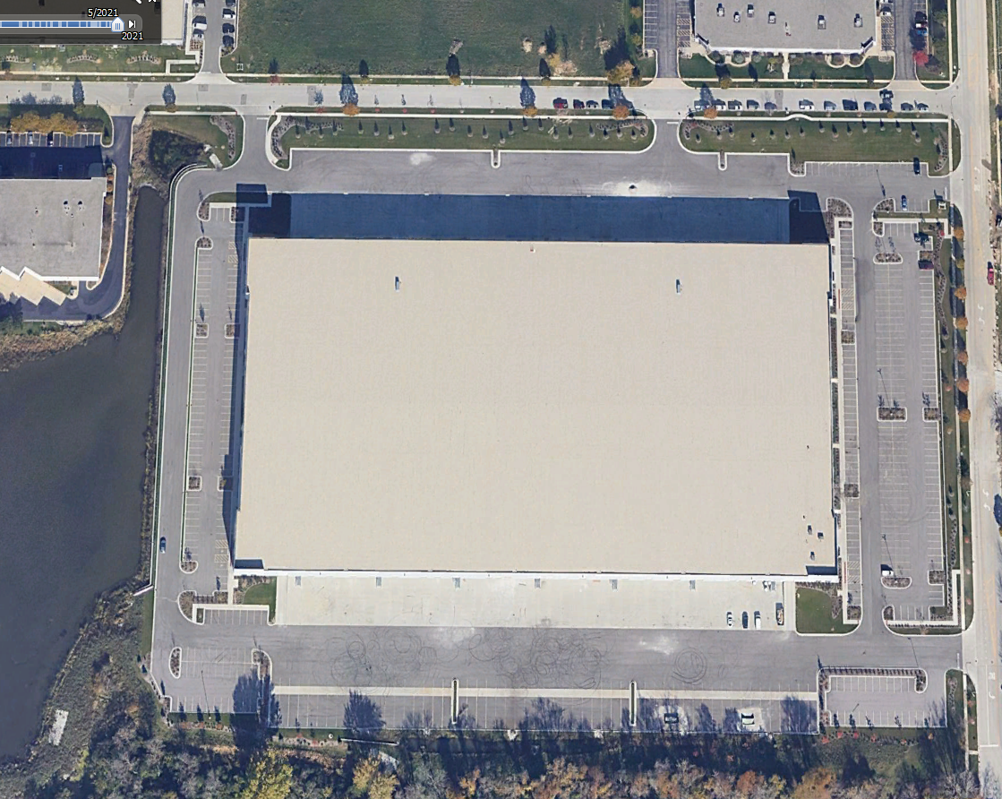

Slide 8
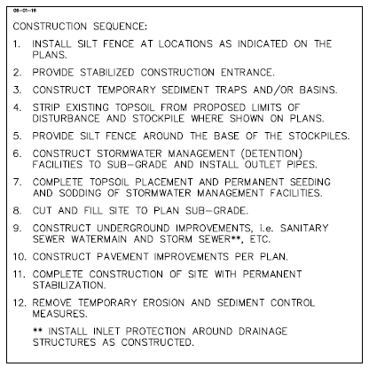
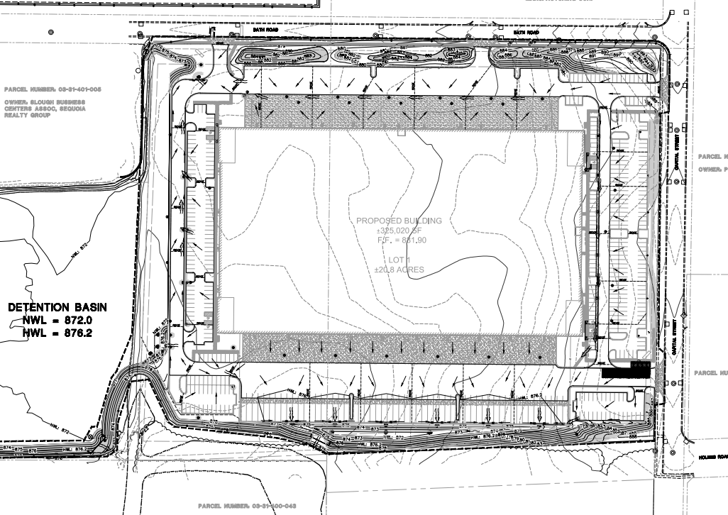
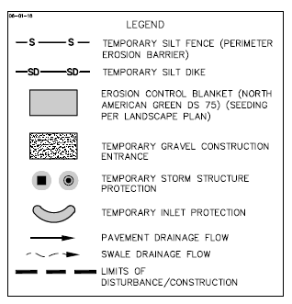

Slide 9
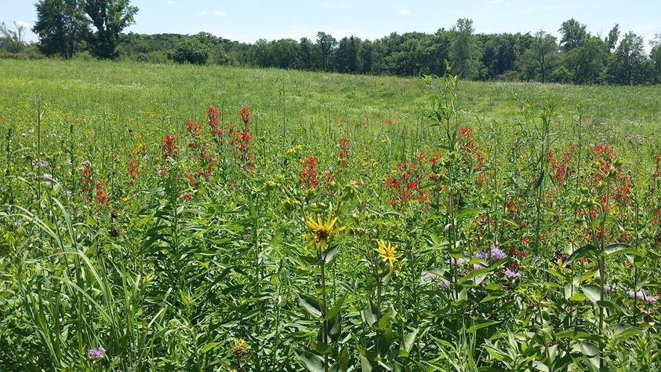
What is the IUM?
A manual intended for use as a technical reference.
Ecosystem protection and enhancement
Sets the minimum standard for BMP’s (Best Management Practices) in the State of Illinois
BMPs include:
Soil Erosion & Sediment Control
Stormwater Management
Special Area Protection

Slide 10
The funding source for the IUM Update Initiative is provided by the Illinois Environmental Protection Agency (IEPA) Clean Water Act, Section 604b grant funds.

Slide 11
The manual is a dynamic document
Steering Committee
Made up of SWCD’s, IEPA, NRCS, USACE, IDNR, IDOT, IDOA, AISWCD
Technical Review Committee
All of the above entities plus environmental consultants and engineers
Always excepting new committee members
Standards and specifications are ultimately approved by IEPA

Slide 12
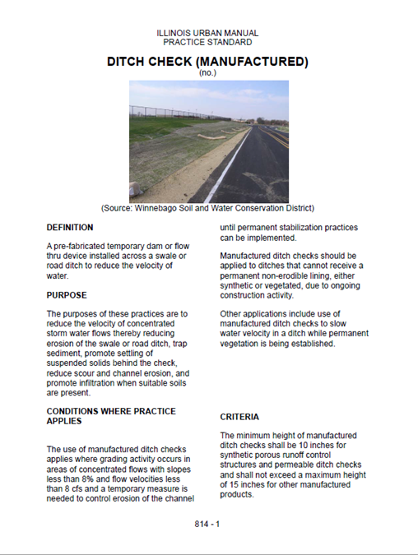
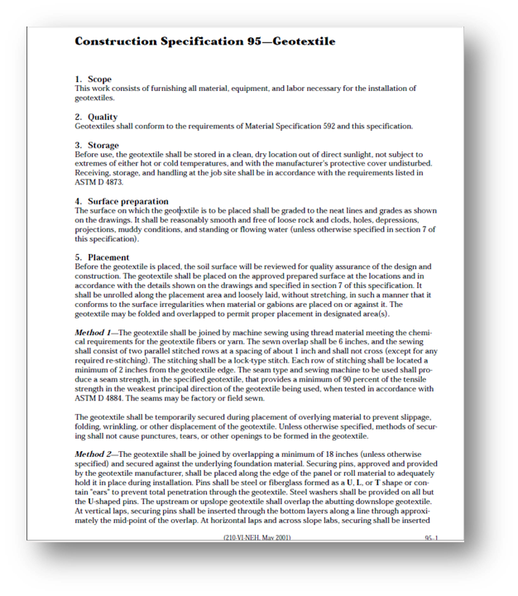
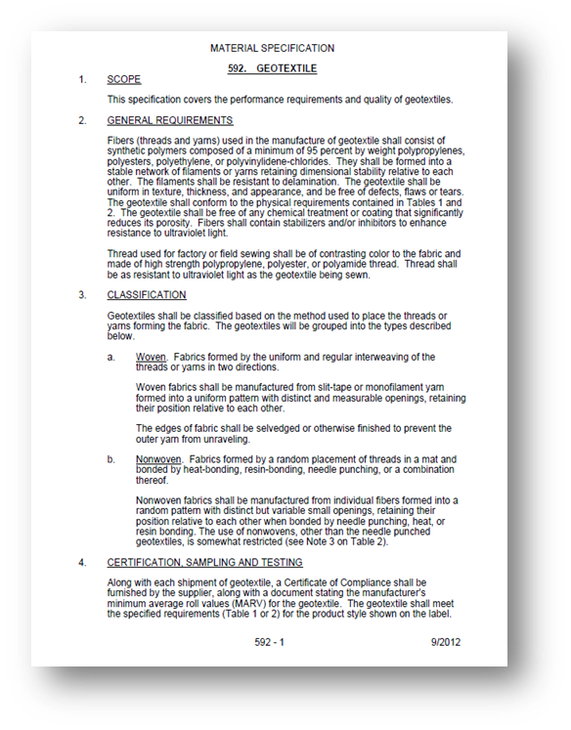
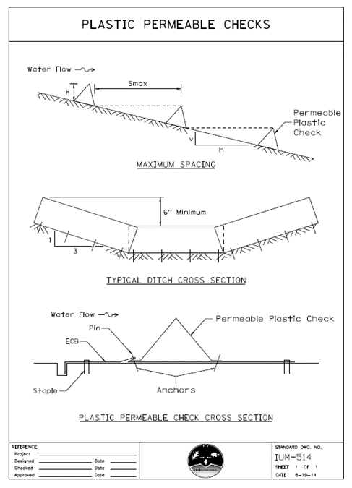
How to use the IUM?
Illinois Urban Manual
Practice Standards, Construction Specifications, Material Specifications & Standard Drawings

Slide 13
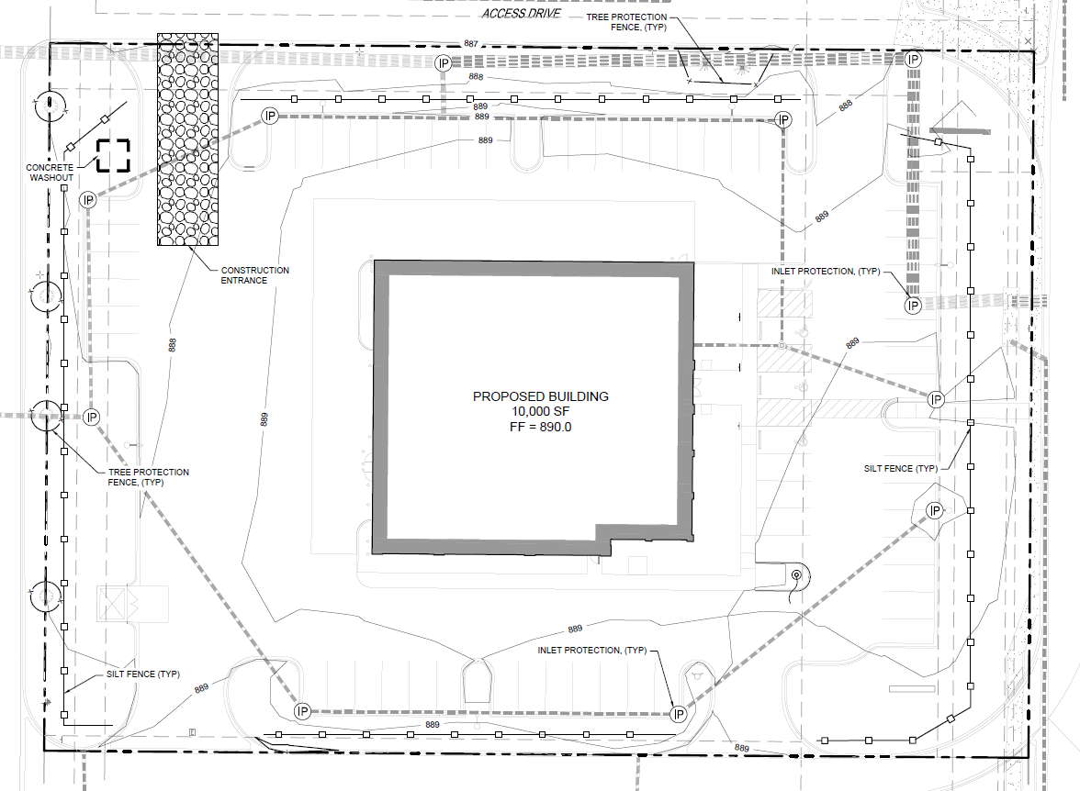
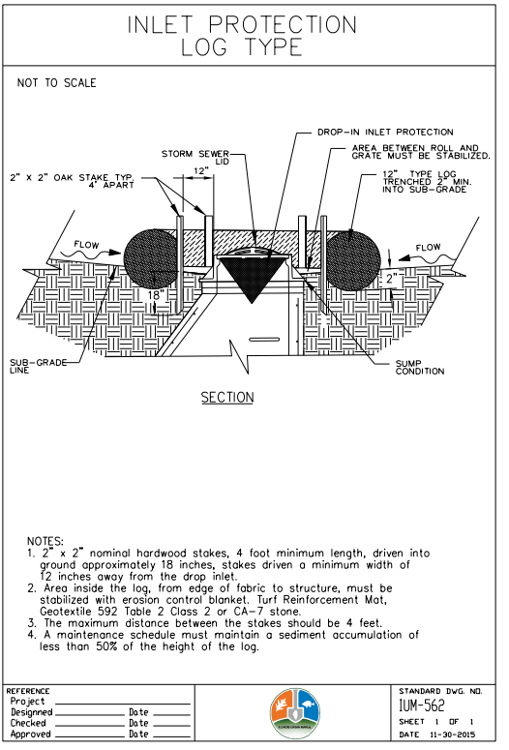

Slide 14
IUM User Overview: Where?
Website: www.illinoisurbanmanual.org
What is Available?
Illinois Urban Manual:
▫ Practice Standards
▫ Construction Specifications
▫ Materials Specifications
▫ Standard Drawings
▫ IUM Field Manual
Announcements
▫ Public Review
Upcoming Educational Opportunities
Resources
Sign up to Receive Updates

Slide 15
IUM User Overview: How?
How do I use the IUM to address erosion and sediment control on a construction site?
▫ IUM (standards & specifications):
Serves as a guide for proper selection, installation and maintenance of soil erosion & sediment control best management practices (bmps)
Selection – when developing the site plan (Storm Water Pollution Prevention Plan (SWPPP) or equivalent)
Installation – when implementing a practice onsite
Maintenance – is the practice adequate to address site conditions? Is the practice functioning properly? Is maintenance needed?
▫ During an inspection, use IUM Standard to assess practice performance onsite:
Is the practice being used properly?
Is the practice installed according to specifications?
Is the practice being maintained appropriately?

Slide 16
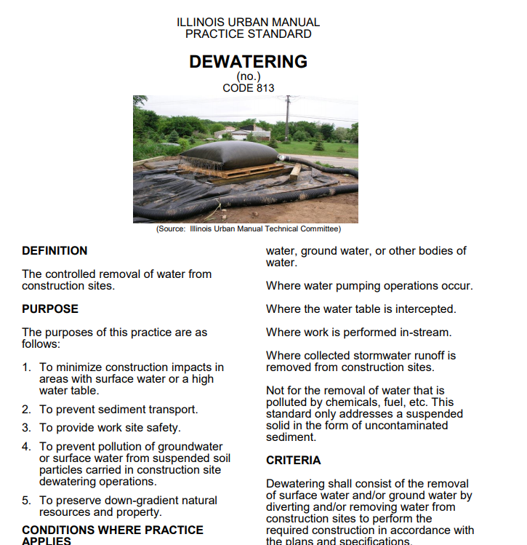
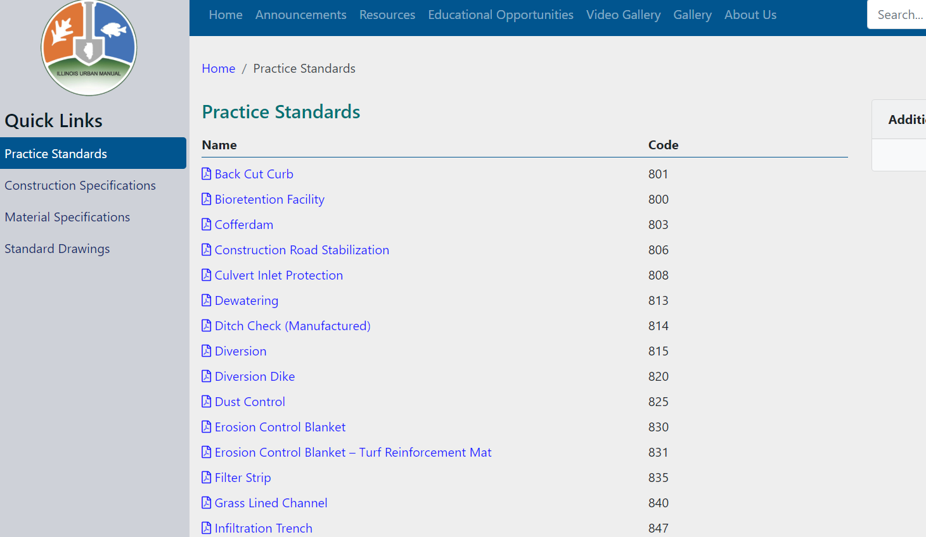
Practice Standards

Slide 17
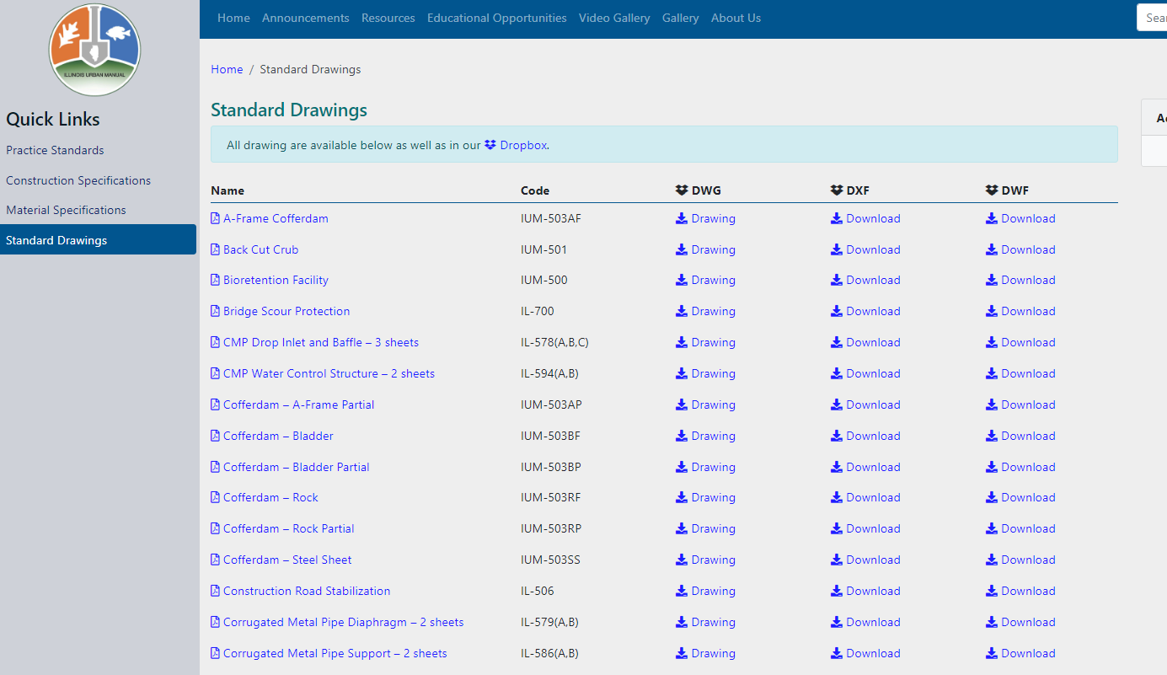
Mentioned how dwg and dxf are saved to 2019 version
Downloadable Standard Drawings
Notes:
Mention how dwg and dxf are saved to 2019 version and am taking specific requests through our email
DXF/DWG and DWF File Formats. DXF and DWG are two common file formats used to exchange information between different CAD and drawing programs. ...DWF is a format developed by Autodesk to allow efficient sharing of design drawings with colleagues who do not have access to AutoCAD or other design software.

Slide 18
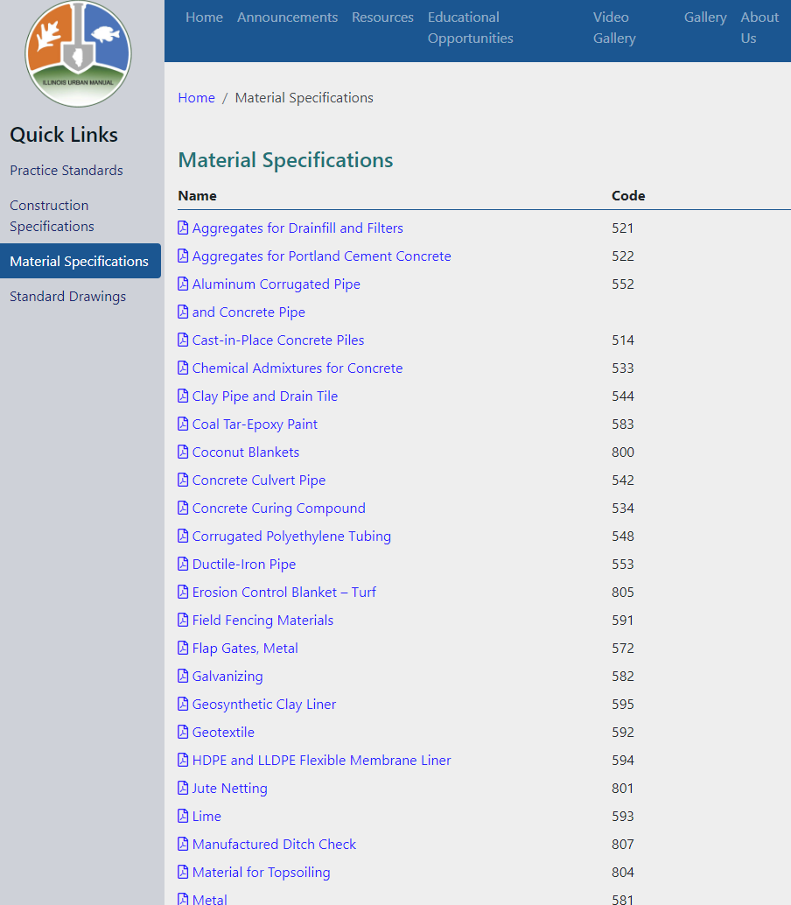
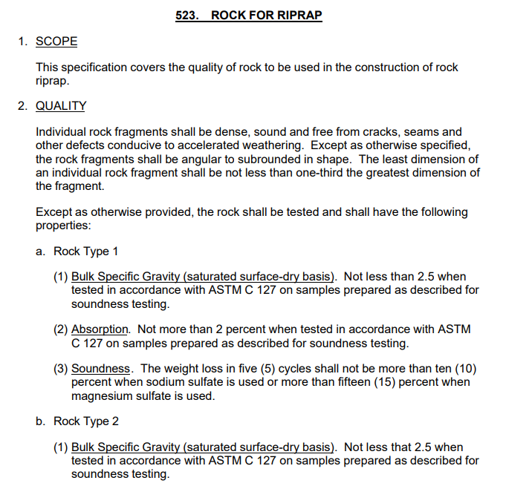
Material Specifications

Slide 19
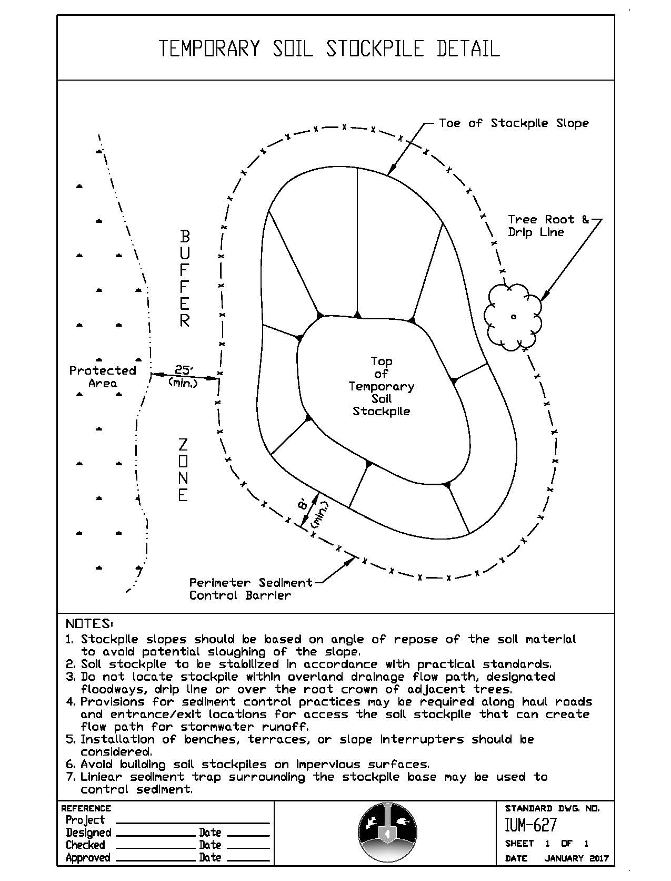
General Soil Erosion and Sediment Control BMPS
Silt Fence
Inlet Protection
Concrete Washout
Soil Stockpiles
Erosion Control Blanket
Stormwater Storage Facilities
Stabilized Construction Entrance

Slide 20
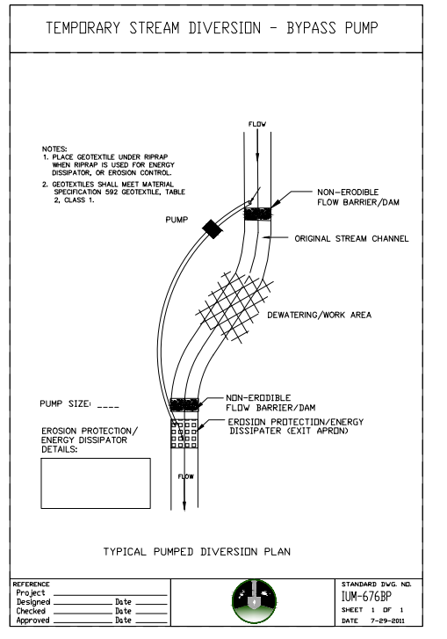
In-Stream Work Guidance
Dewatering
Cofferdam
Temporary Stream Diversion
Pump
Pipe
Channel
Causeway
Sump Pit
Silt Curtain
Temporary Stream Crossing

Slide 21
What’s wrong with this image?

Slide 22
Updates to the IUM
Rolled Perimeter Control
Streambank Stabilization (Structural, Vegetative, Bioengineering)
Wet Bottom Basin, Dry Bottom Basin, Extended Basin, Sediment Forebay)
Updates to: Back cut Curb, Sump Pit, Permanent/Temporary Vegetation
Coming soon
Causeway (new)
Culvert Inlet Protection (revised)
Bio-swale (new)
Guidelines for Concrete Slurry Management

Slide 23
Examples of Existing Green Infrastructure Standards
Notes:
Presenter
2020-10-13 12:23:01
--------------------------------------------
Additional standards: Filter strip, standards for (wetland creation, enhancement, restoration), Vegetative streambank stabilization, tree/forest ecosystem preservation, permanent vegetation, mulching for seeding and soil stabilization,

Slide 24
Examples of Existing Green Infrastructure Drawings
Notes:
Presenter
2020-10-13 12:23:01
--------------------------------------------
Standard drawings not as simple to standardize into a schematic

Slide 25
Questions?
Special thanks to: Rick McAndless, Ashley Curran, Megan Andrews, Alyse Olson, IEPA, TRC/SC Members, DNR and SWCD employees.
Email: patrick.mcpartlan@kanedupageswcd.org
Kanedupageswcd.org

