Slide 1
SWCD Summer Training Conference Michelle Bloomquist Illinois Department of Natural Resources July 18, 2022

Slide 2
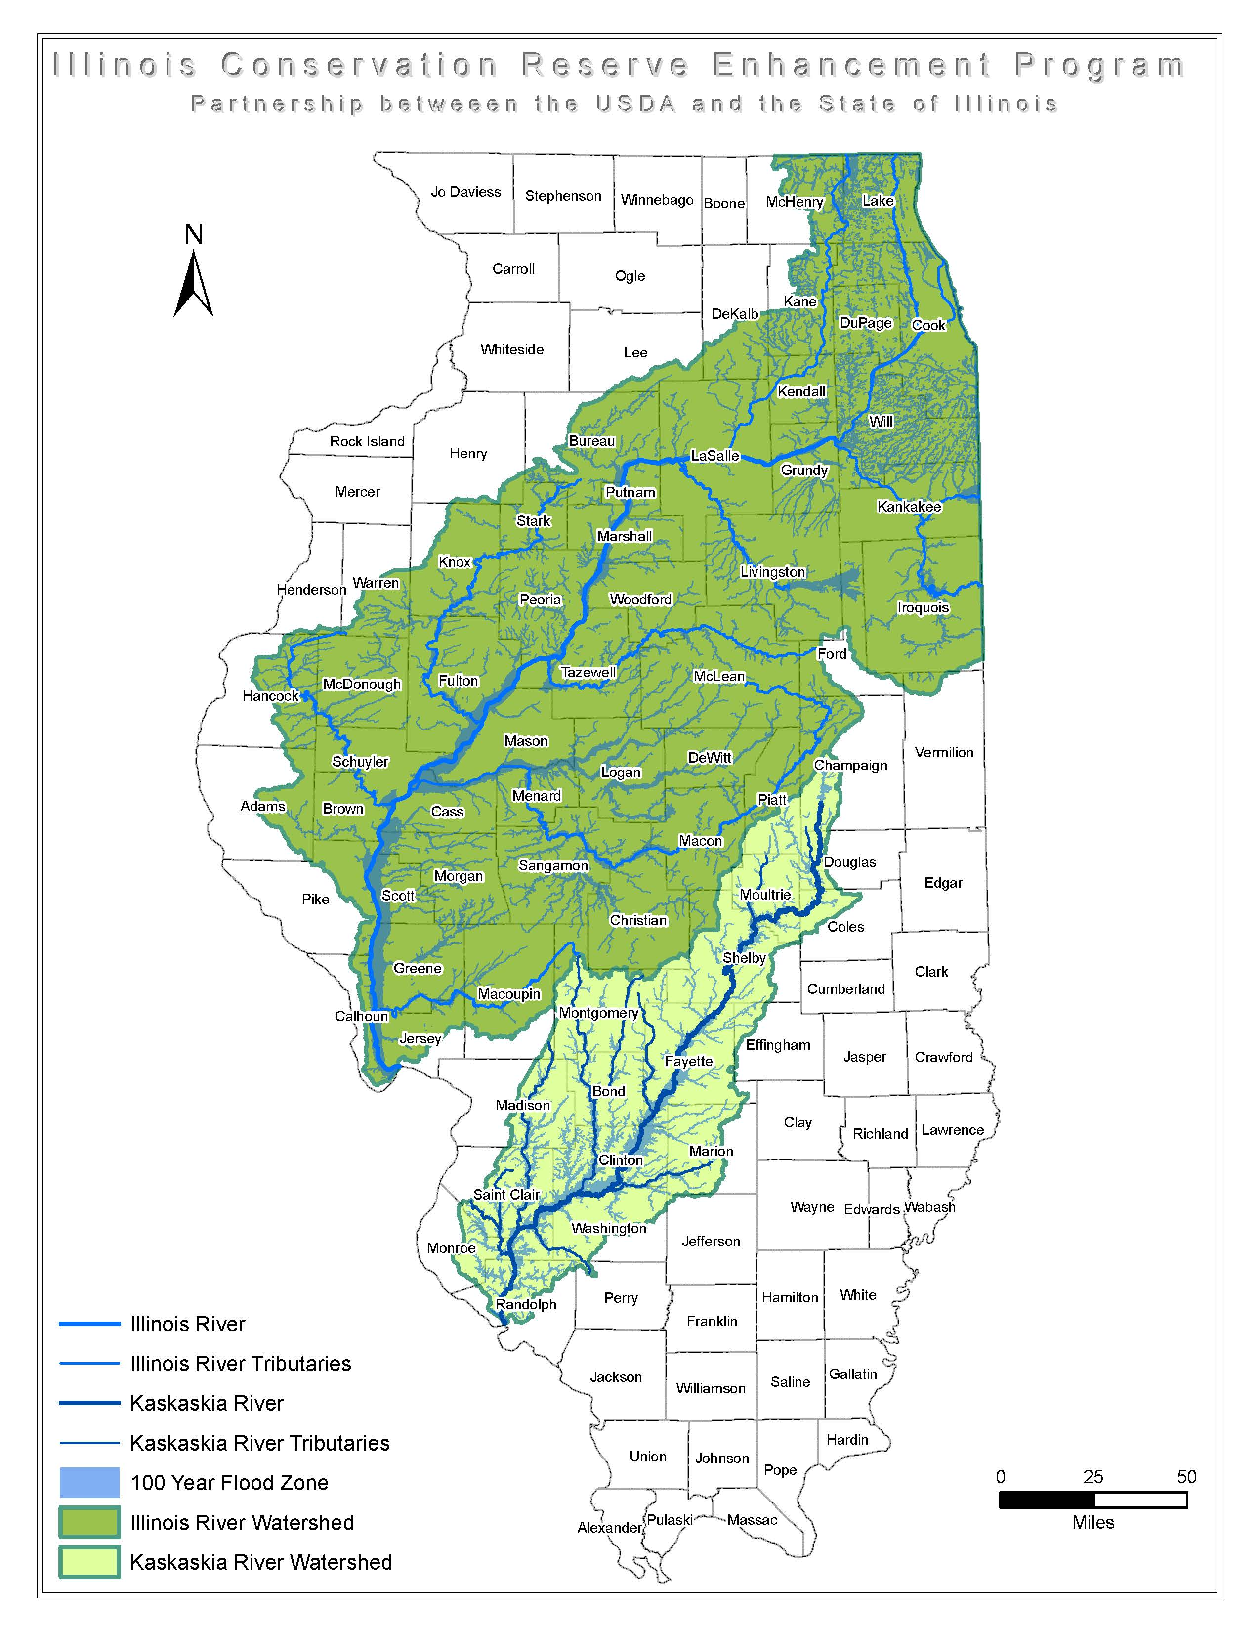
CREP Eligibility
To learn more, visit:
https://www2.illinois.gov/dnr/conservation/CREP

Slide 3
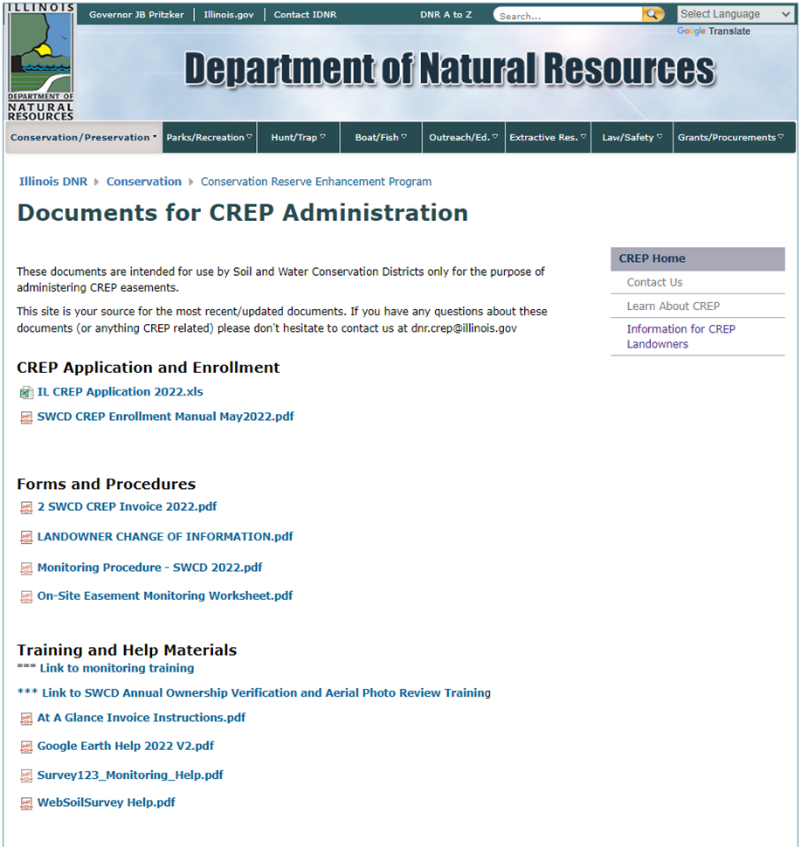
SWCD CREP Documents Website
https://www2.illinois.gov/dnr/conservation/CREP/Pages/8675309swcddocs.aspx
Notes:
This is the SWCDs one stop shop for all the CREP training, procedures and forms you will need. Our virtual trainings are posted here for your review as necessary.
Today I am going into some details on monitoring and enrollment that we have found that we have several questions on.

Slide 4
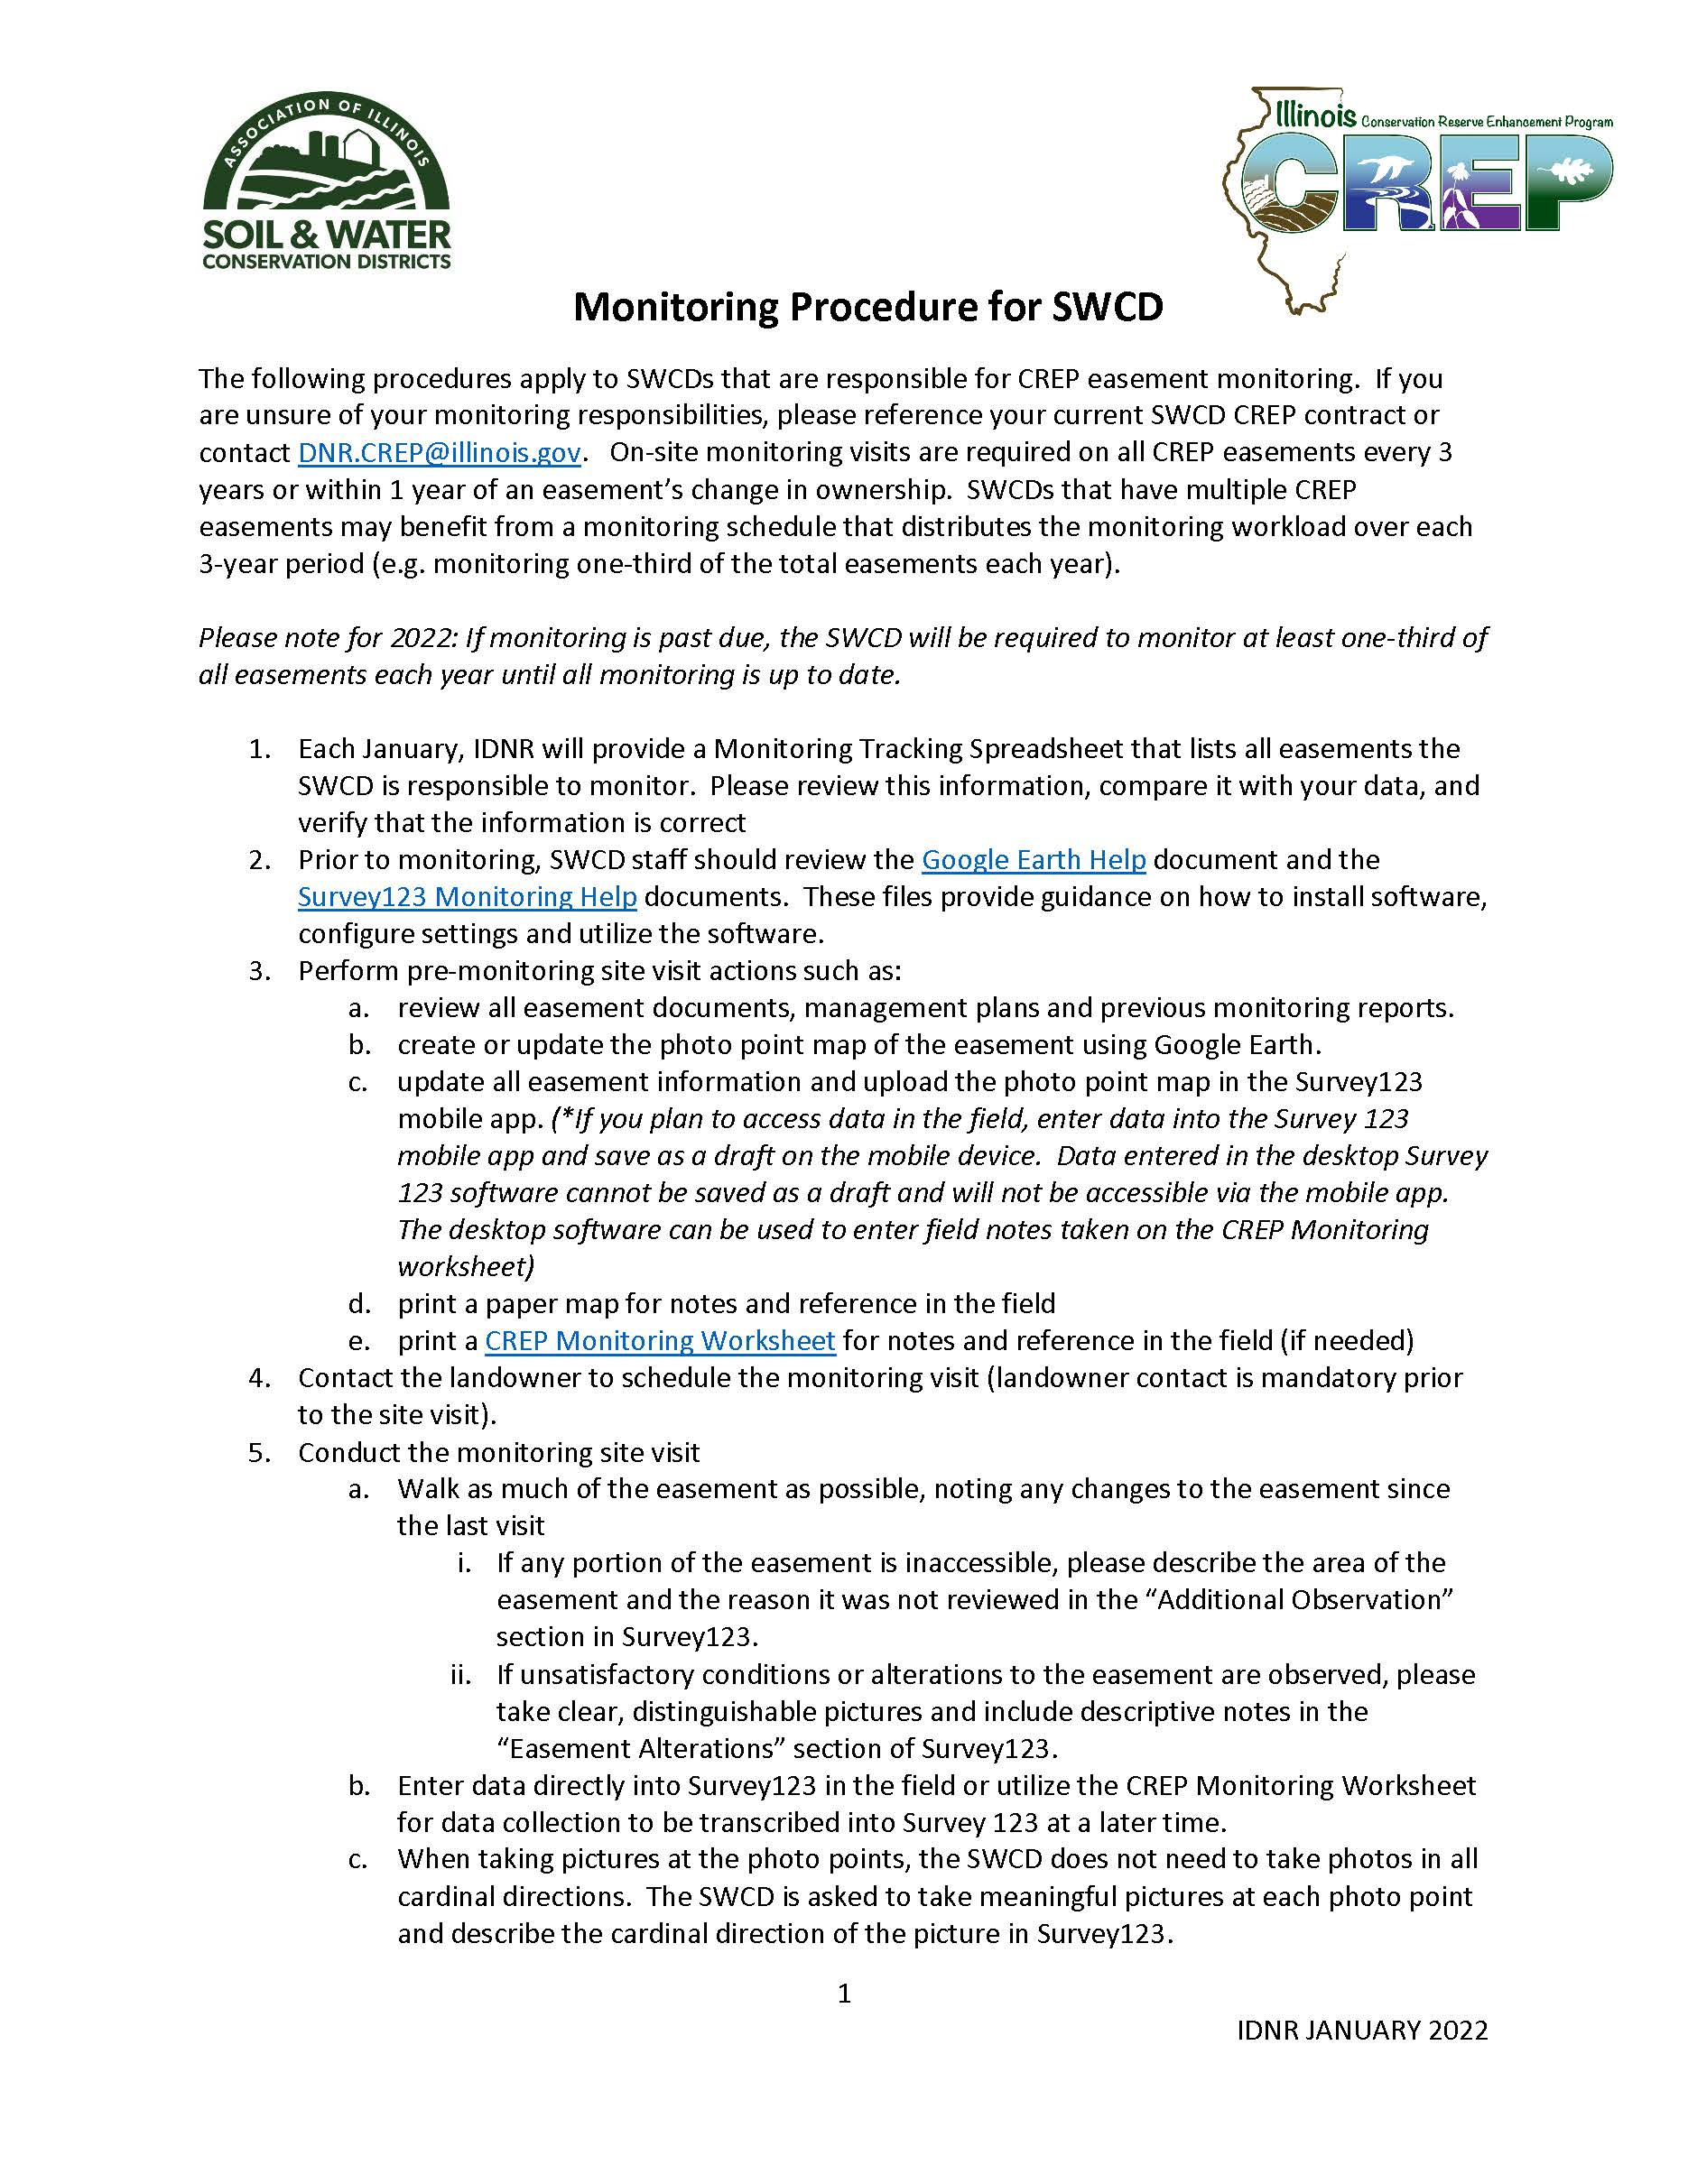
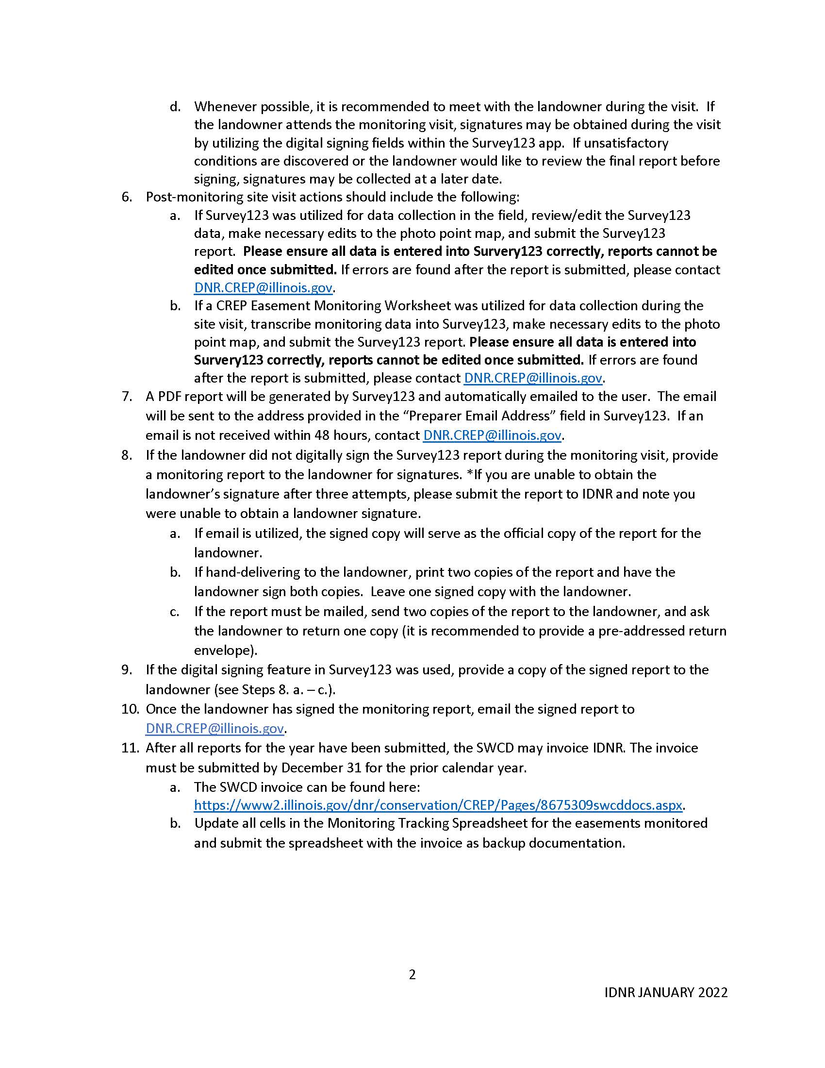
Notes:
This is on the website for reference. There is also a detailed training video on the website that Justin created. I’ve pulled a few key points from the training that we have had questions from.

Slide 5
On-Site Monitoring
Scheduled Monitoring - conducted every 3 years
Conducted by the SWCD or CREP Specialists
Monitoring conditions and easement alterations on current/expired Federal CREP/CRP Acres and Additional Acres
Alternate at least 1/3 of caseload each year
Exceptions that may require an unscheduled monitoring visit
Easement Ownership Changes
Easement Splits
Provide CREP Documents To New Landowners
Violations
Renewals or Extensions
Notes:
Cycle of monitoring, conditions and alterations and Fed acres and Add Acres (IDNR determines compliance); must monitor at least 1/3 of easements each year, can monitor all in 1 or 2 years if want to; exceptions to 3 year – ownership, violations, renewals

Slide 6
Monitoring Preparation
Review existing easement documentation: (What has happened prior to this visit?)
Review Annual IDNR Monitoring Tracking Spreadsheet
IDNR provided - Lists all easements the SWCD needs to monitor
Review all existing CREP easement documents and SWCD files.
Review previous CREP monitoring reports
Review any existing conservation management plans
Google Earth/Street View is your Friend
Review the Google Earth and Survey123 Monitoring Help documents.
These files provide guidance on how to install software, configure settings and utilize the software.
Review aerial imagery
Identify site ingress/egress, parking, trails, road conditions, etc.
Identify points of interest
CRP/CREP Federal Acres vs Additional Acres
Identify defined fields or areas
Identify potential easement alterations
Google Earth Pro Desktop version
Use the year slider
Leaf-on vs Leaf-off conditions
Notes:
Presented on this before, all the prep you should do prior to visiting the field

Slide 7
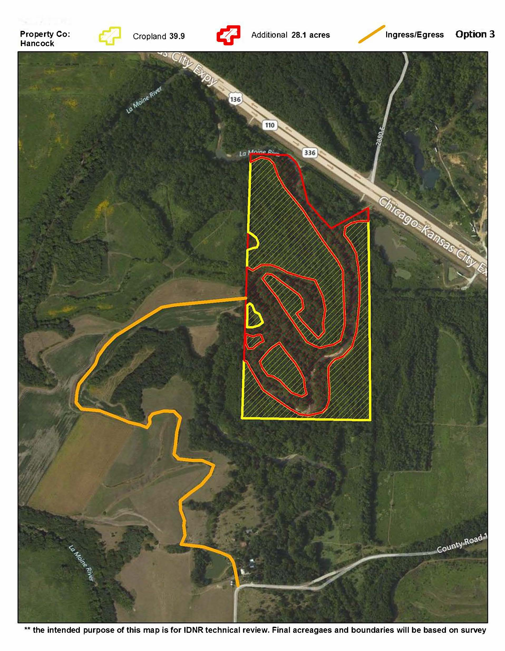
Ingress/Egress
If the easement is along a road, this is the ingress/egress
Check the folders for maps showing the ingress/egress
Easement document should have ingress/egress Exhibit B
Ask for help
Your local CRS can help
Notes:
Read slide; This is an example of a detailed ingress/egress. Most do not look like this, but this is also exhibit B in the easement document. This would be an easement you might want a UTV for.

Slide 8
Pre-Visit Landowner Discussion
Before going to the field, contact your CREP landowner to discuss the easement
Verify ownership status
Encourage landowner attendance
Discuss landowner goals and plans for management
Discuss landowner concerns
Discuss any question you have from your initial review
Where to park
Best places to access the entire easement
Best trails to use
UTVs allowed
Notes:
When you call to set up a time to visit the site, talk with your landowners to get more information on the property (parking, trails, gates, UTVs)

Slide 9
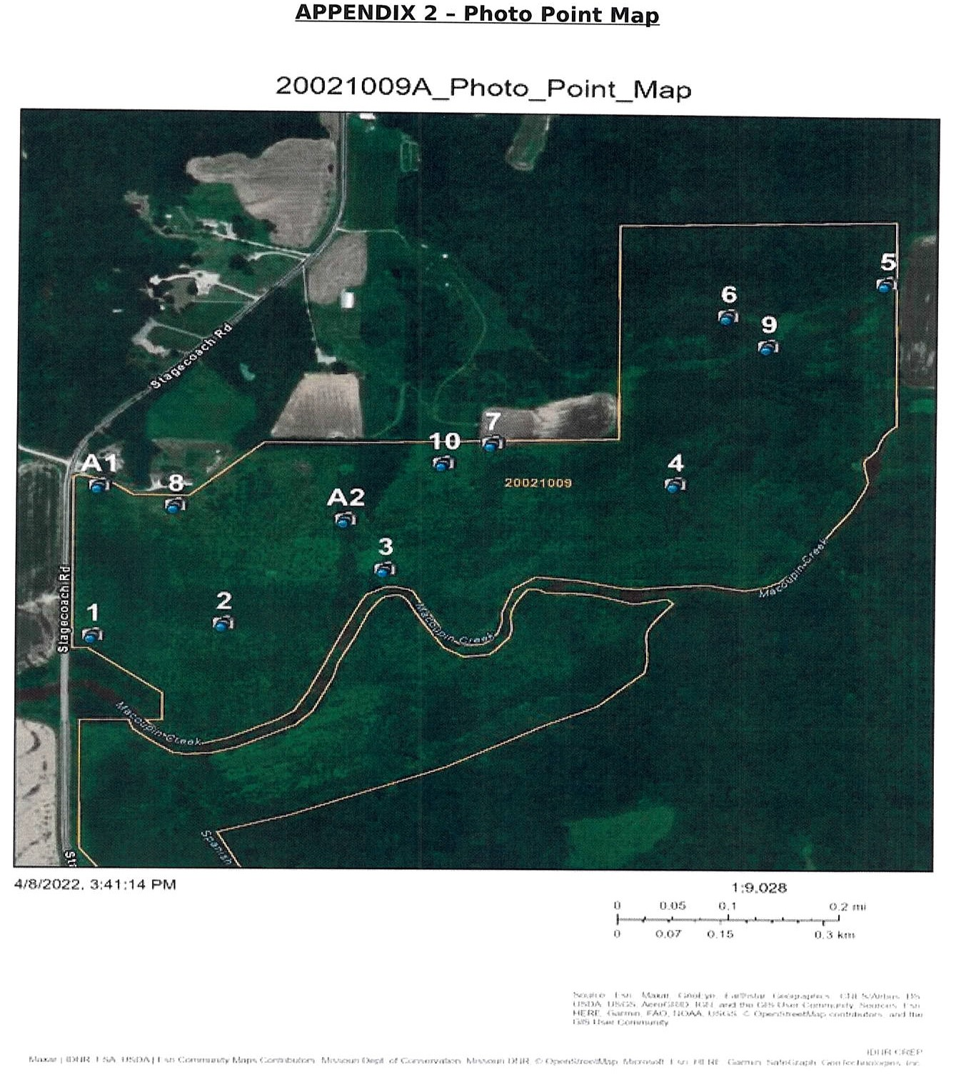
Photo Points
Photos Complement aerial imagery
Photos need to show detail of the primary conditions/practices from the ground
You can adjust or add additional photo points from previous photo point maps
Provide enough photo points to capture the conditions for each main section of the easement
Create additional photo points for alteration locations
Notes:
Read Slide; Map from a CRS. 10 photo points and 2 alterations that are reference in the report.

Slide 10
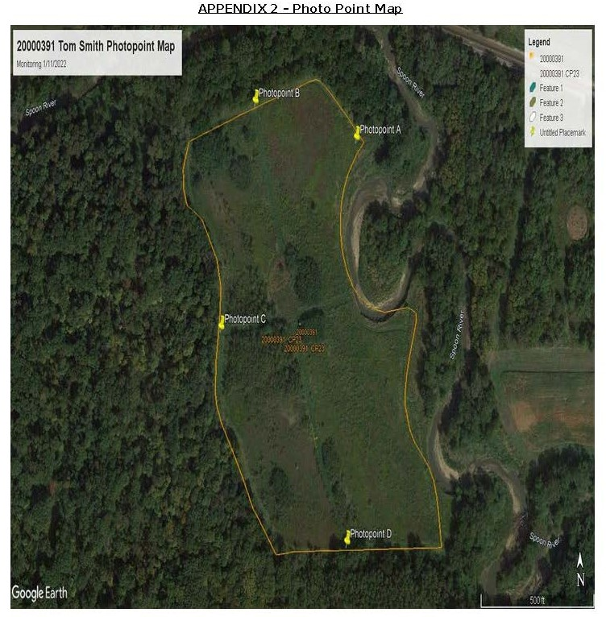
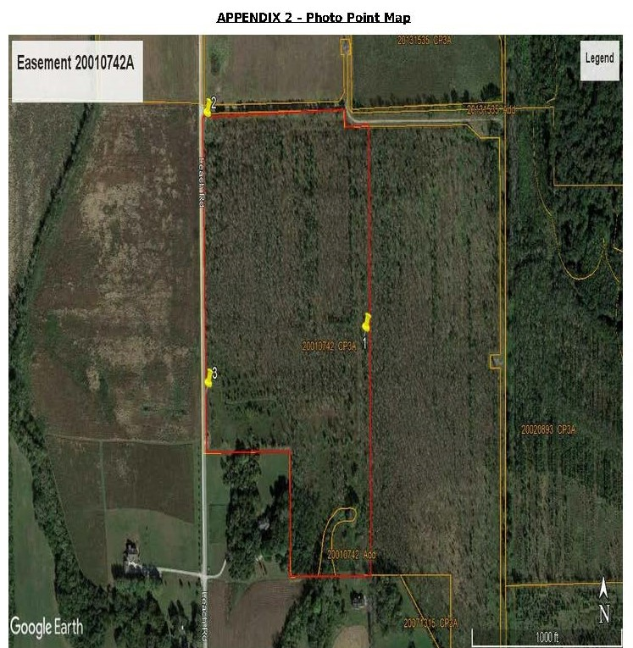
SWCD Photo Point Maps
Notes:
Actual SWCD reports from this year. Left 20000391 – 20 acres; right 20010742 – 35 acres

Slide 11
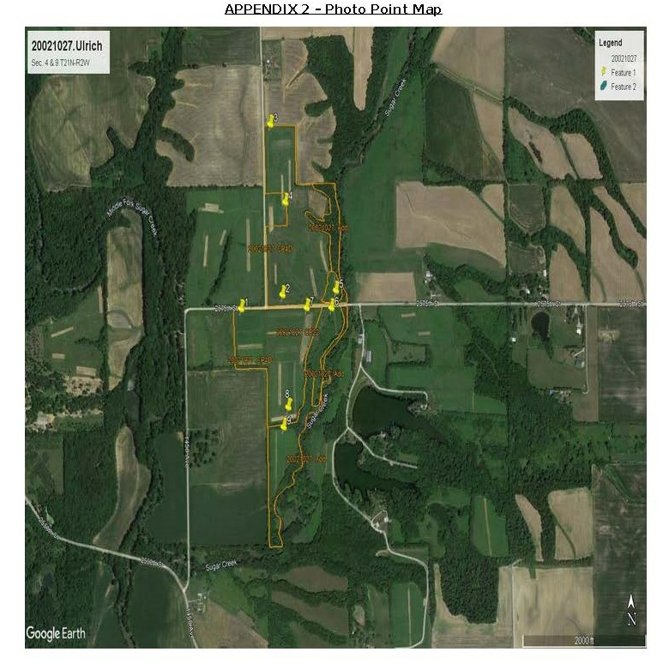
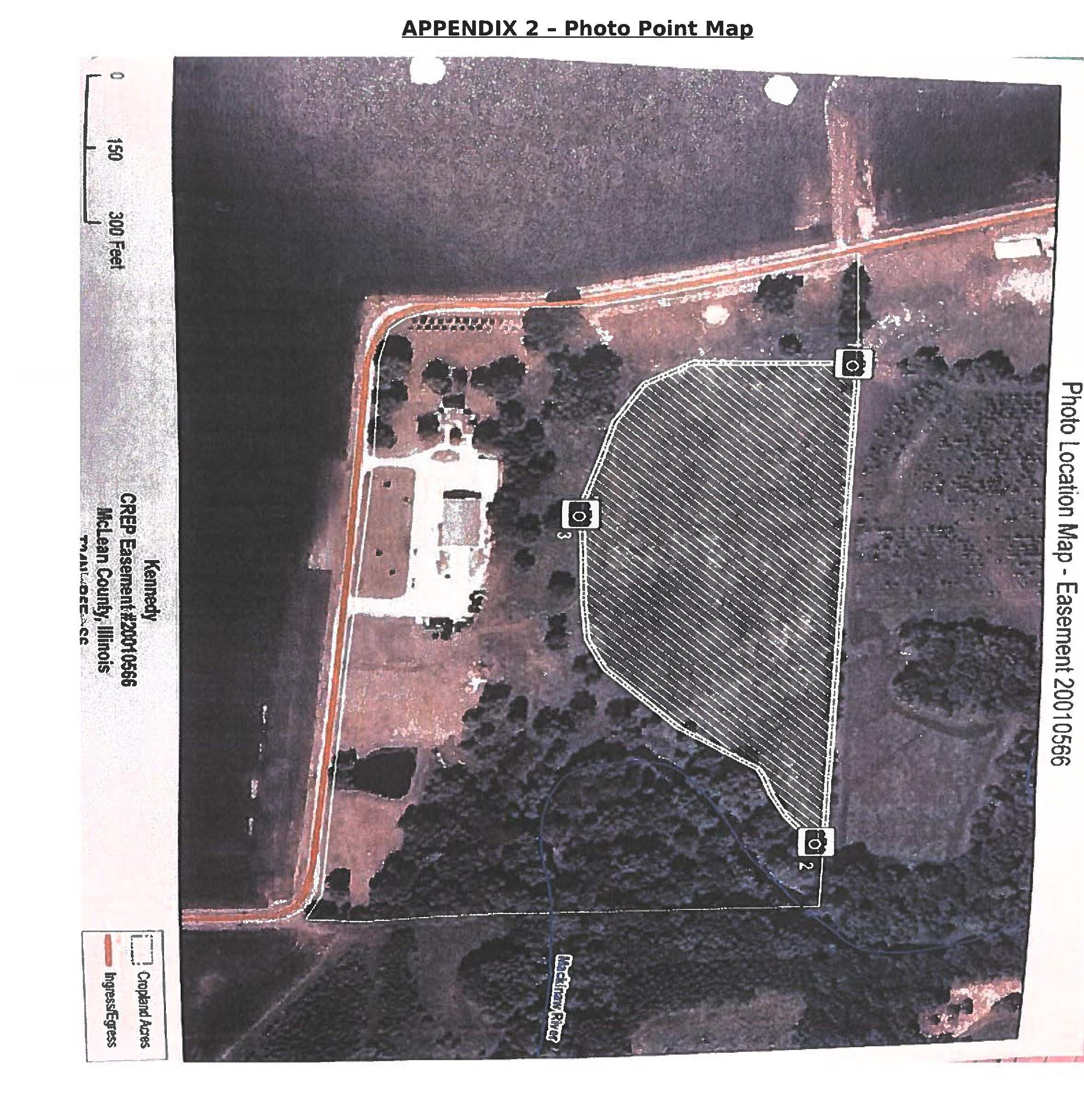
SWCD Photo Point Maps
Notes:
Left 20021027 – 92 ac; right 20010566 – 8 ac

Slide 12
Contractual Monitoring Requirements
The SWCD contract states that all easements must be monitored every 3 years
If monitoring is behind, the SWCD is required to monitor and submit reports to IDNR in 2022 for at least 1/3 of all easements
After report submittal, IDNR and/or CRS will review all reports
IDNR may ask for additional information and/or pictures if the report does not fully capture the easement conditions
Submit the invoice for all monitoring reports sent to IDNR:
Invoice for $100 per easement per year
Include the first page of the monitoring report as back up documentation
Submit the invoice when finished monitoring for the year
Due by 12/31 of each year

Slide 13
SWCD Contractual Changes
If the SWCD has determined that they are unable to perform monitoring as required, the SWCD board may request in writing to amend the contract to remove monitoring from the contract
The remainder of the contract will stay the same
The contract may be amended again in the future to add monitoring if circumstances change

Slide 14
Mock CREP Easement Enrollment

