Slide 1
CY21 STAR Updates
David Nguyen, IL STAR Coordinator, AISWCD
Morgan Cauble, Conservation Coordinator, CCSWCD
Tuesday, July 19th, 2022, 8:30 AM – 9:30 AM
Notes:
Both speakers introduce themselves

Slide 2
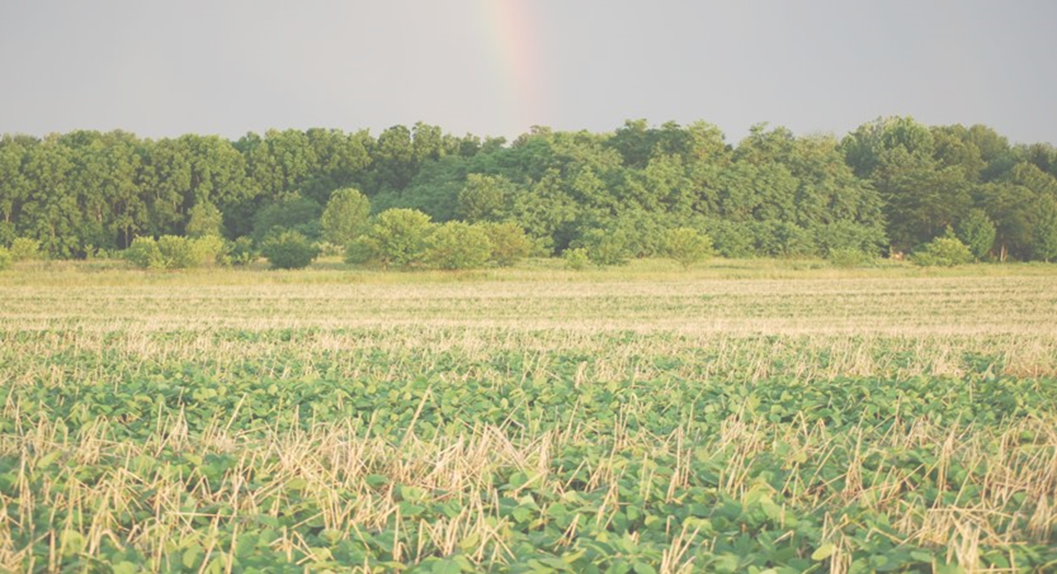
Agenda
STAR Introduction
STAR Year in Review
STAR Results
STAR in the Future
Notes:
Morgan speaks

Slide 3
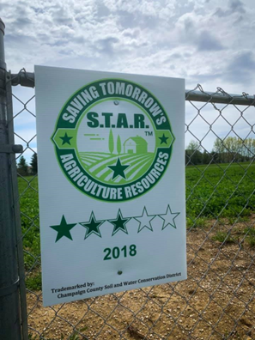
STAR Introduction
STAR is a free, accessible, and voluntary nationwide tool to assist farmers in evaluating their nutrient and soil loss management practices on individual fields
Based on practices, a field is scored and rated from 1 to 5 STARs
STAR ratings encourage farmers to use management practices that reduce nutrient and soil losses from their fields
Program will help reduce the nutrient and soil losses from farmland over larger areas in addition to showcasing improved soil health on the same scale
Notes:
David speaks

Slide 4
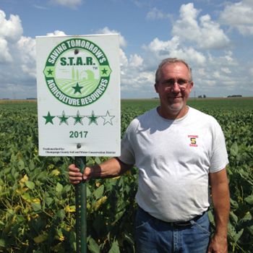
STAR Introduction
STAR was created by the Champaign County Soil and Water Conservation District
Developed in 2017 as a means to contribute to the important goals outlined in the state's Nutrient Loss Reduction Strategy (NLRS)
Since its creation, STAR has been adopted in many county soil and water conservation districts as STAR Licensees
Other states have also adopted STAR, including Iowa, Missouri, and Colorado to administer STAR in their area
Joe Rothermel
Champaign SWCD Director & STAR Co-founder
Notes:
David speaks

Slide 5
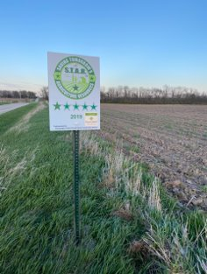
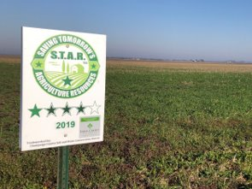
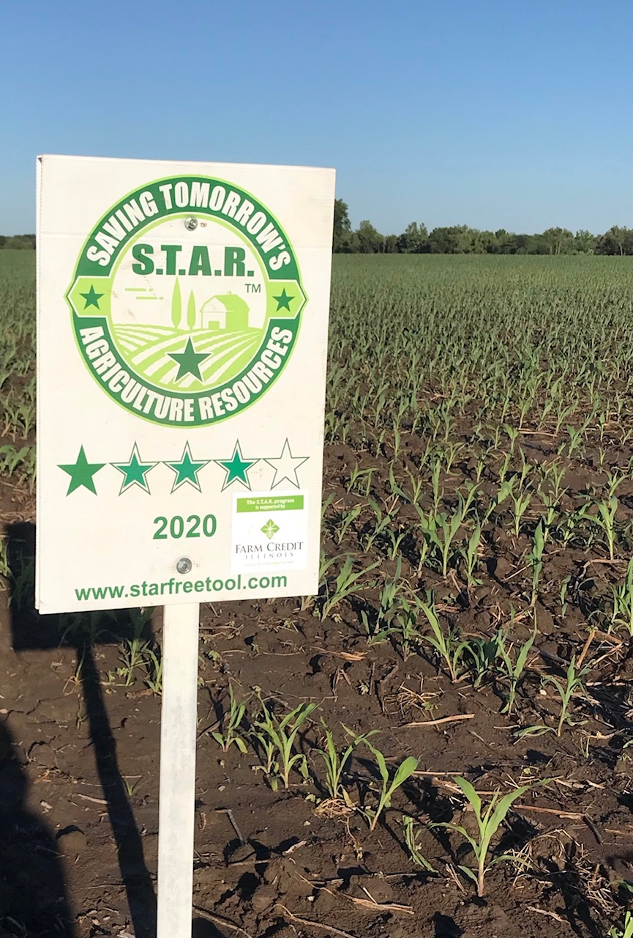
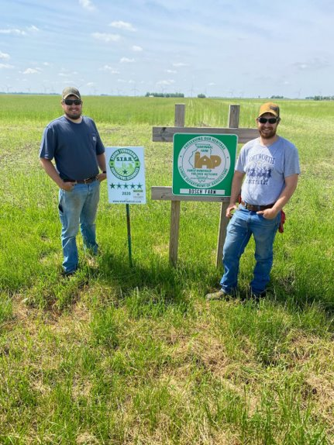
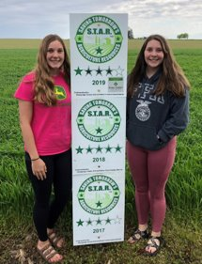
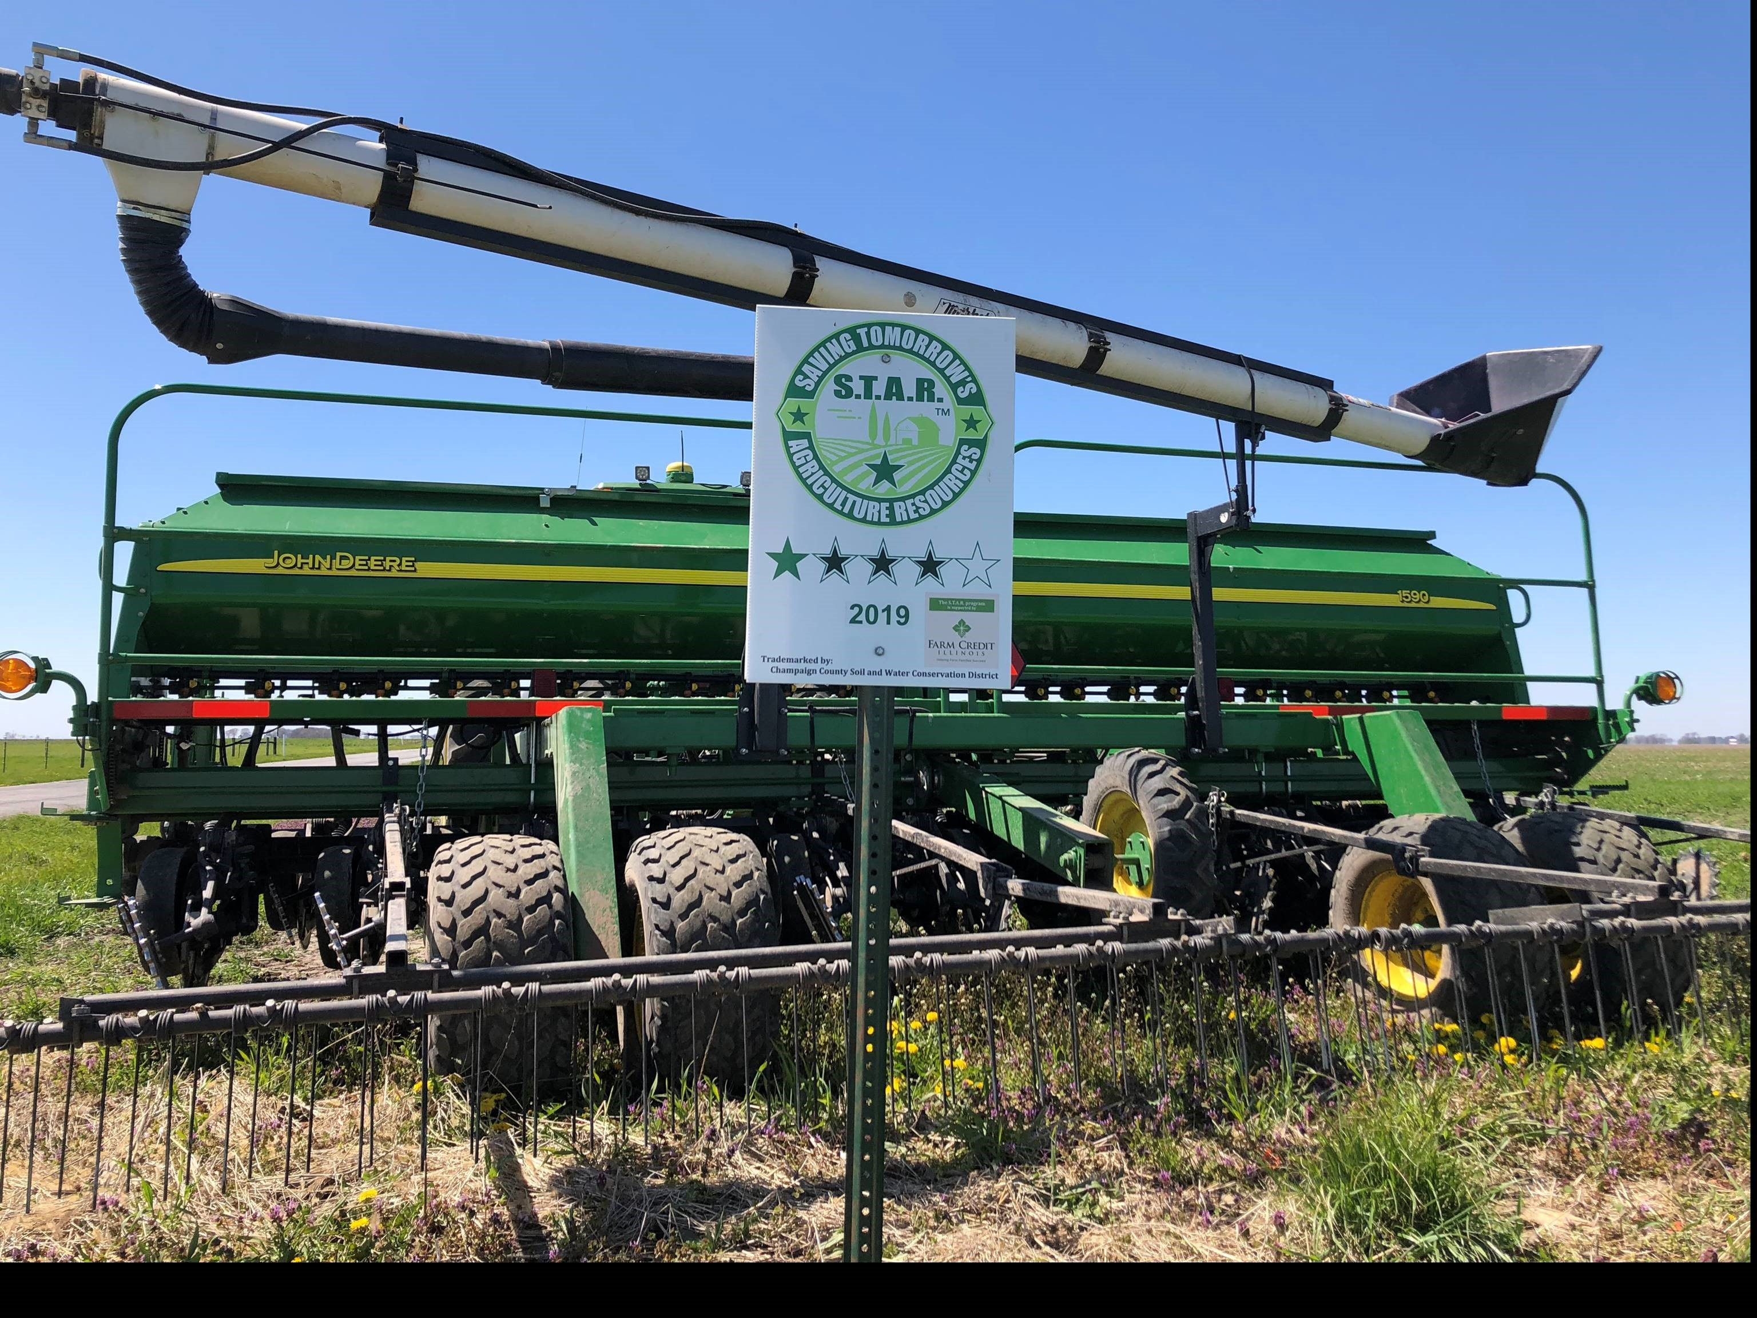
STAR Introduction
Bonus: STAR Farmers can request free field signs!
Notes:
David speaks

Slide 6
STAR Year in Review
New Field Form!
Notes:
Morgan speaks

Slide 7
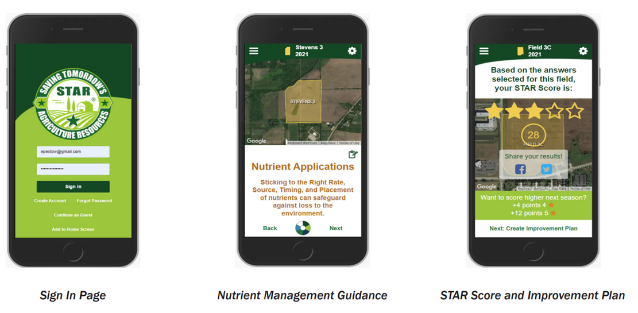
STAR Year in Review
STAR Web App made its debut in June 2021
Provides immediate scoring and offers improvement plans
Available on smartphone, tablet, or computer
Currently open for CY22 submissions!
Notes:
Morgan speaks

Slide 8
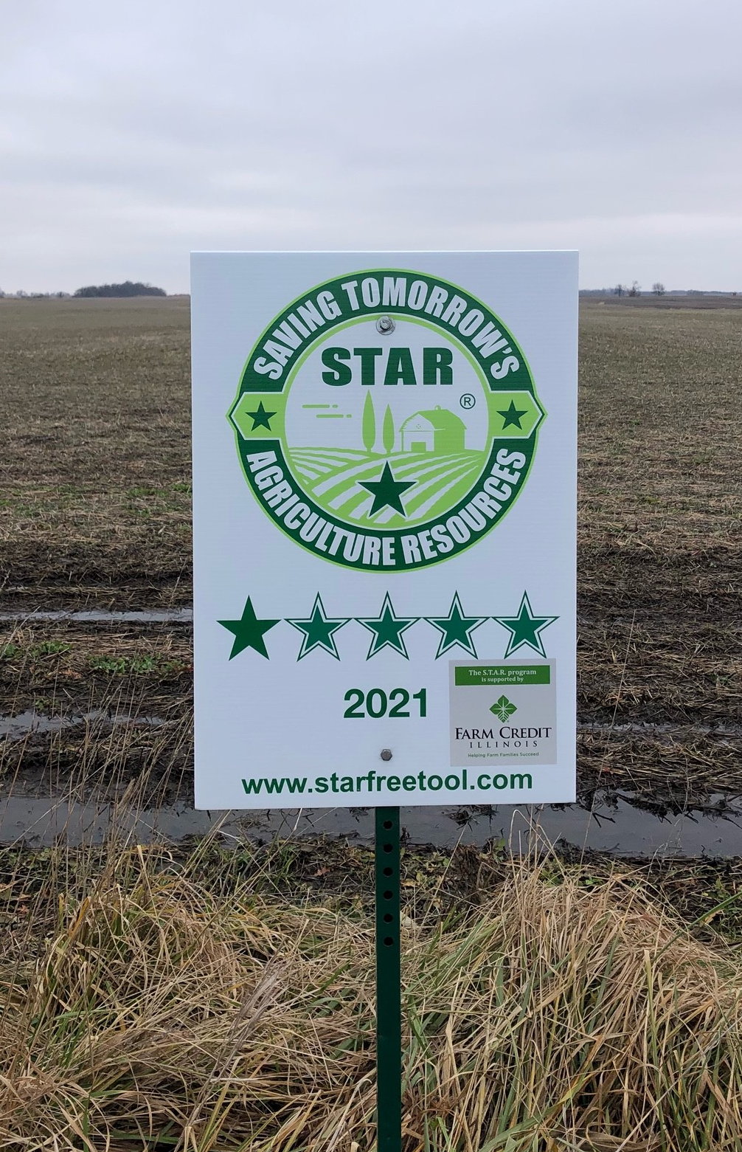
STAR Year in Review
Collaboration
Soil Health Incentive Program: Pilot in Champaign County to develop recommendations for a statewide climate program
Partners for Conservation: 373 STAR evaluations received to help IDOA track outcomes of the PFC program
STAR Affiliates
Iowa STAR: Launched in 2021, 25 districts collected 94 field forms covering 10,421 acres
Colorado STAR: Funding from the Colorado Department of Agriculture allowed for the creation of STAR Plus
20 districts provide technical and financial assistance to producers implementing new conservation practices
Rademacher Farms
Champaign County, IL
Notes:
Morgan speaks
SHIP: pilot with the Delta Institute and the Conservation Fund
PFC: IDOA used STAR forms to help track outcomes of the program
Iowa: 25 districts used STAR in CY21
Colorado: Colorado Department of Ag funded STAR Plus to provide technical and financial assistance to producers implementing new conservation practices

Slide 9
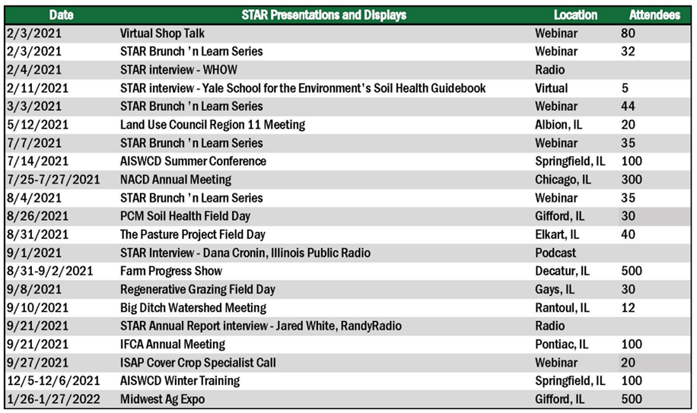
STAR Year in Review
Education/Outreach
20+ STAR presentations between February 2021- January 2022
Total attendees reached ~2,000!
Notes:
Morgan speaks

Slide 10
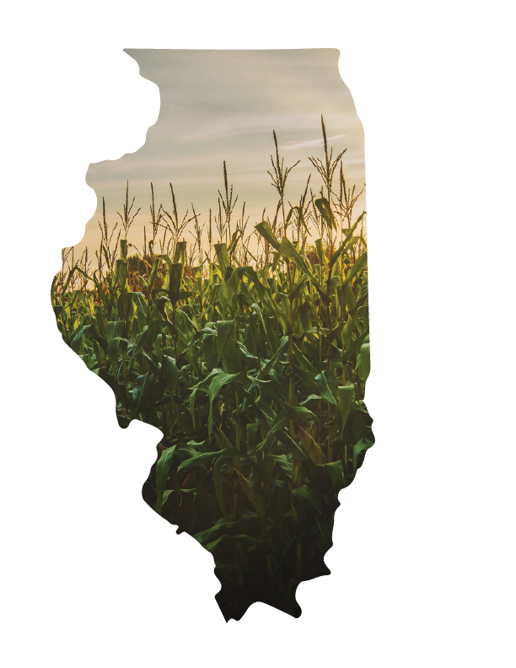
Illinois STAR Results
In Crop Year 2021:
460 Participants
1,442 Fields
83,616 Acres
69 Licensees
Notes:
David speaks - Licensees cover 70% of IL counties. Any IL farmer can utilize STAR, but Licensees provide technical support locally.

Slide 11
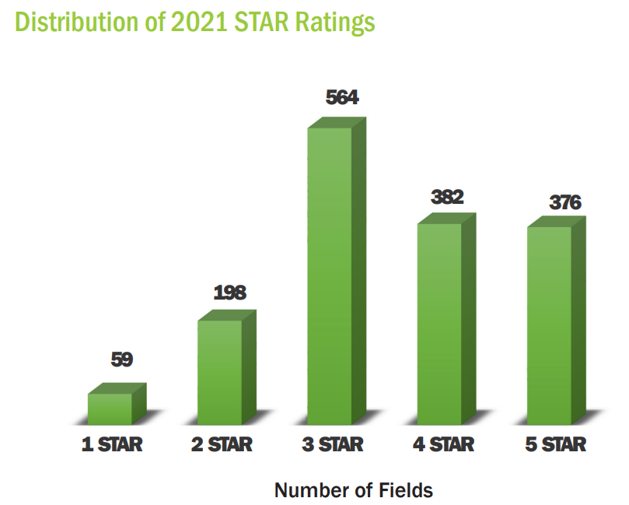
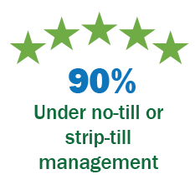
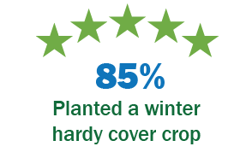
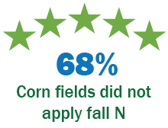
STAR Results
Most Common Practices from 5-STAR Fields:
Notes:
David speaks

Slide 12
STAR Results
Notes:
David speaks

Slide 13
STAR Results
Notes:
David speaks

Slide 14
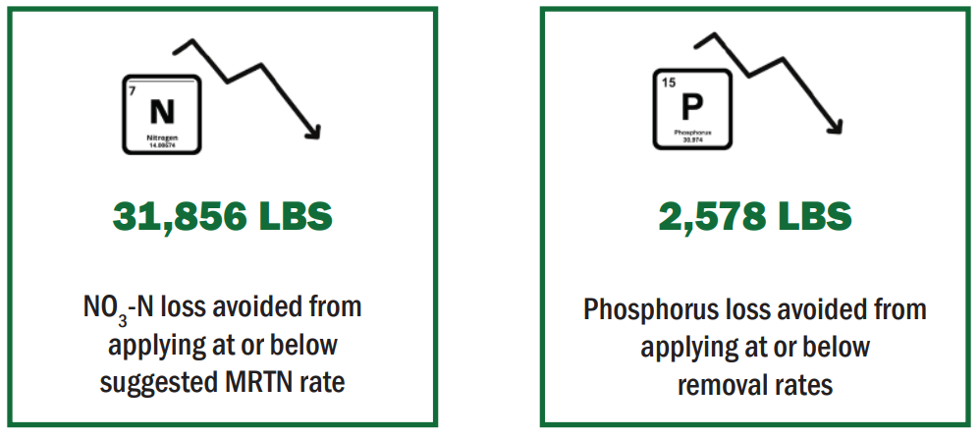
STAR Results
Usage of cover crops by STAR farmers:
Kept 11,66t tonnes of GhG emissions out of the atmosphere for one year
Kept 5,903 lbs of P in the field
Kept 25,940 tons of sediment out of IL waterways
Kept 78,182 lbs of NO3-N in the field
Usage of No-till & strip till by STAR farmers:
Kept 27,276 tonnes of GhG emissions out of the atmosphere for one year
Kept 47,752 tons of sediment out of IL waterways
Kept 14,159 lbs of P in the field
Notes:
David speaks

Slide 15
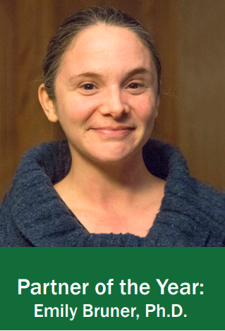
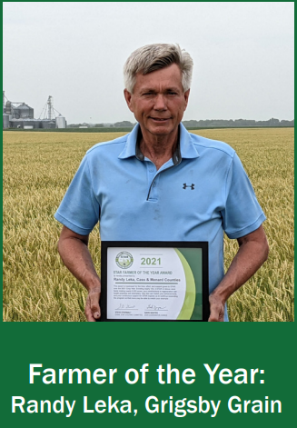
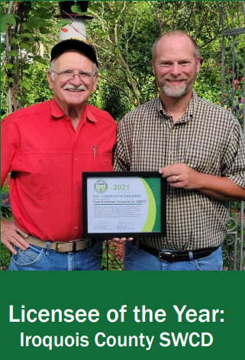
STAR Results – Award Winners!
Emily Bruner – Made significant contributions to STAR's Steering and Science Advisory Committees, as well as Web App functionalities
Randy Leka- Enrolled ~100 fields in STAR, of which 90% of which were 3-STARs or above
Iroquois County SWCD – Enrolled 20+ producers with 3,000 acres between them in CY 2021
Notes:
David speaks

Slide 16
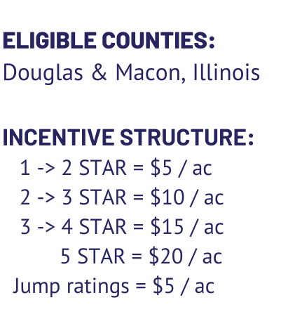
STAR in the Future
Pay for Performance Programs
Pilot with ADM
Incentives for increasing STAR Rating
Rewards those already involved in conservation
Eligible for fields enrolled in public programs
Notes:
Morgan speaks

Slide 17
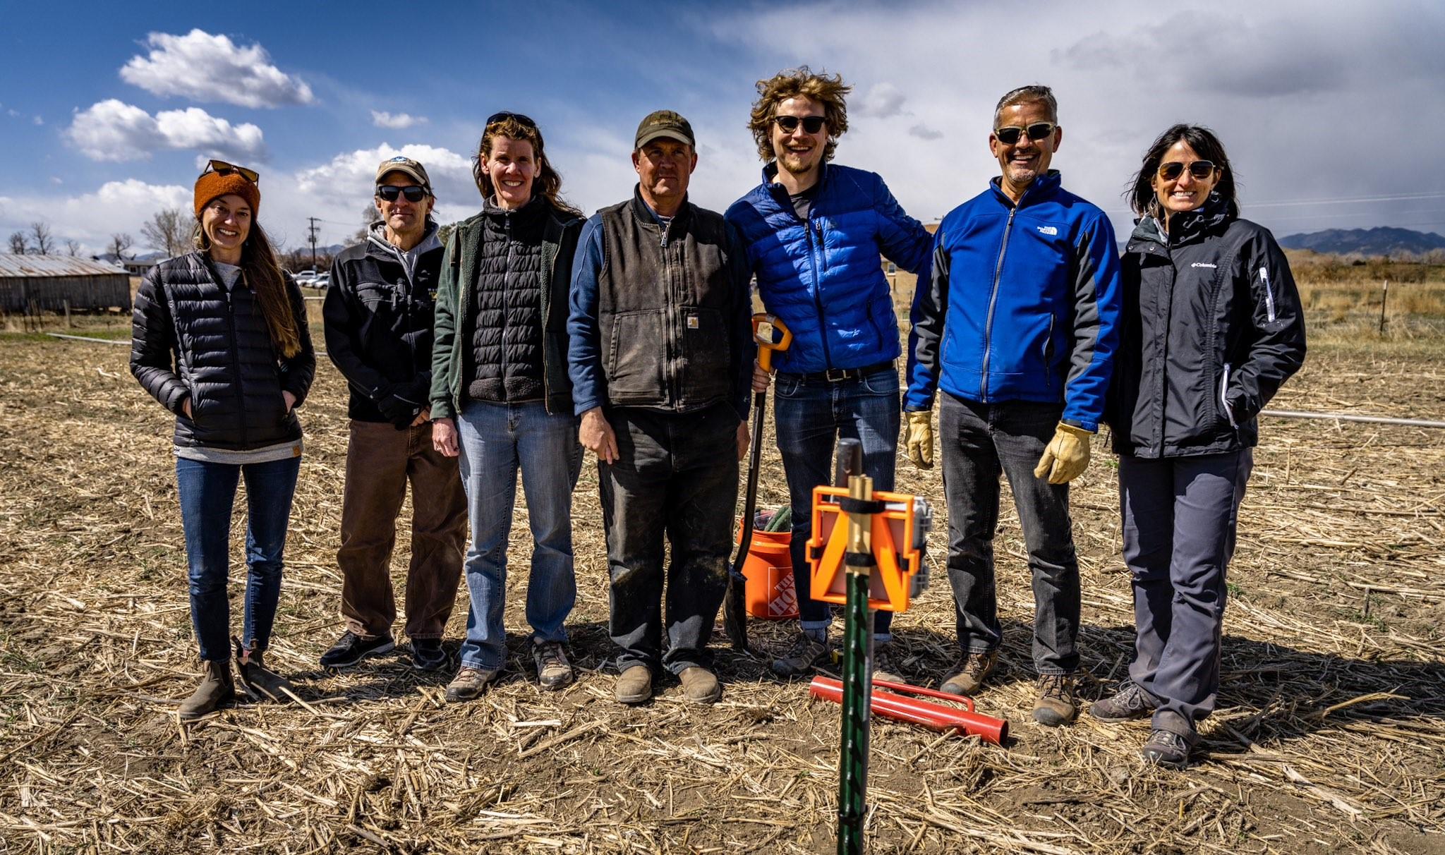
STAR in the Future
Web App Enhancements
Upgraded Improvement Plan
Connections to financial incentive opportunities
Additional field forms (forestry, grazing, etc.)
National STAR
Develop partnerships in additional states
to make STAR available nationwide
Colorado STAR Team
Notes:
Morgan speaks
Plans for STAR moving forward. Not set in stone yet, but long term goals for STAR.
Upgraded improvement plan: personalized recommendations for producers to increase their STAR Rating.
Connections to financial incentive opportunities: recommendations to public and private programs.
Additional field forms: grazing, forestry, other agricultural practices.
National STAR: make STAR available nationwide.

Slide 18
Thanks to Committee Partners
American Farmland Trust
Archer Daniels Midland Company
Association of Illinois SWCDs
Certified Crop Advisers
Centrec Consulting Group
Champaign Co. SWCD
Champaign Co. Farmers
CHS, Inc
Coles Co. SWCD
DC Analysis, LLC
DIGS Associates
Illinois Corn Growers Association
Illinois Department of Agriculture
Illinois Fertilizer and Chemical Association
Illinois Nutrient Research and Education Council
Illinois Soybean Association
Kankakee Co. SWCD Director
McHenry Co. SWCD
Natural Resources Conservation Service Illinois
Piatt Co. SWCD
Precision Conservation Management
The Nature Conservancy
University of Illinois
University of Illinois Extension
Wabash Valley FS
Notes:
Morgan speaks

Slide 19
Wrap Up – Thank You!
More questions?
Email David.Nguyen@AISWCD.org
Or email BHenrikson@parkland.edu
Or email info@ccswcd.com
Field Form/Scoresheet Training PowerPoint coming soon!
Feel free to also contact us below:
Notes:
Both speakers close out and stand by for a couple questions

