Slide 1
SUCCESFUL GRANT MANAGEMENT
Ashley Curran - Grant Manager
JULY 2022

Slide 2
CONGRATULATIONS! You got a grant!!! Now what….

Slide 3
TIPS FOR SUCCESS
Read the grant agreement! (legal document)
Highlight or make note of your responsibilities
Mark important dates/deadlines on your calendar
Save program contact information
Track your spending
Stay on budget
Keep track of in-kind time and supplies
Save all important grant related correspondence
Ask questions

Slide 4
MANAGING YOUR NRCS GRANT

Slide 5
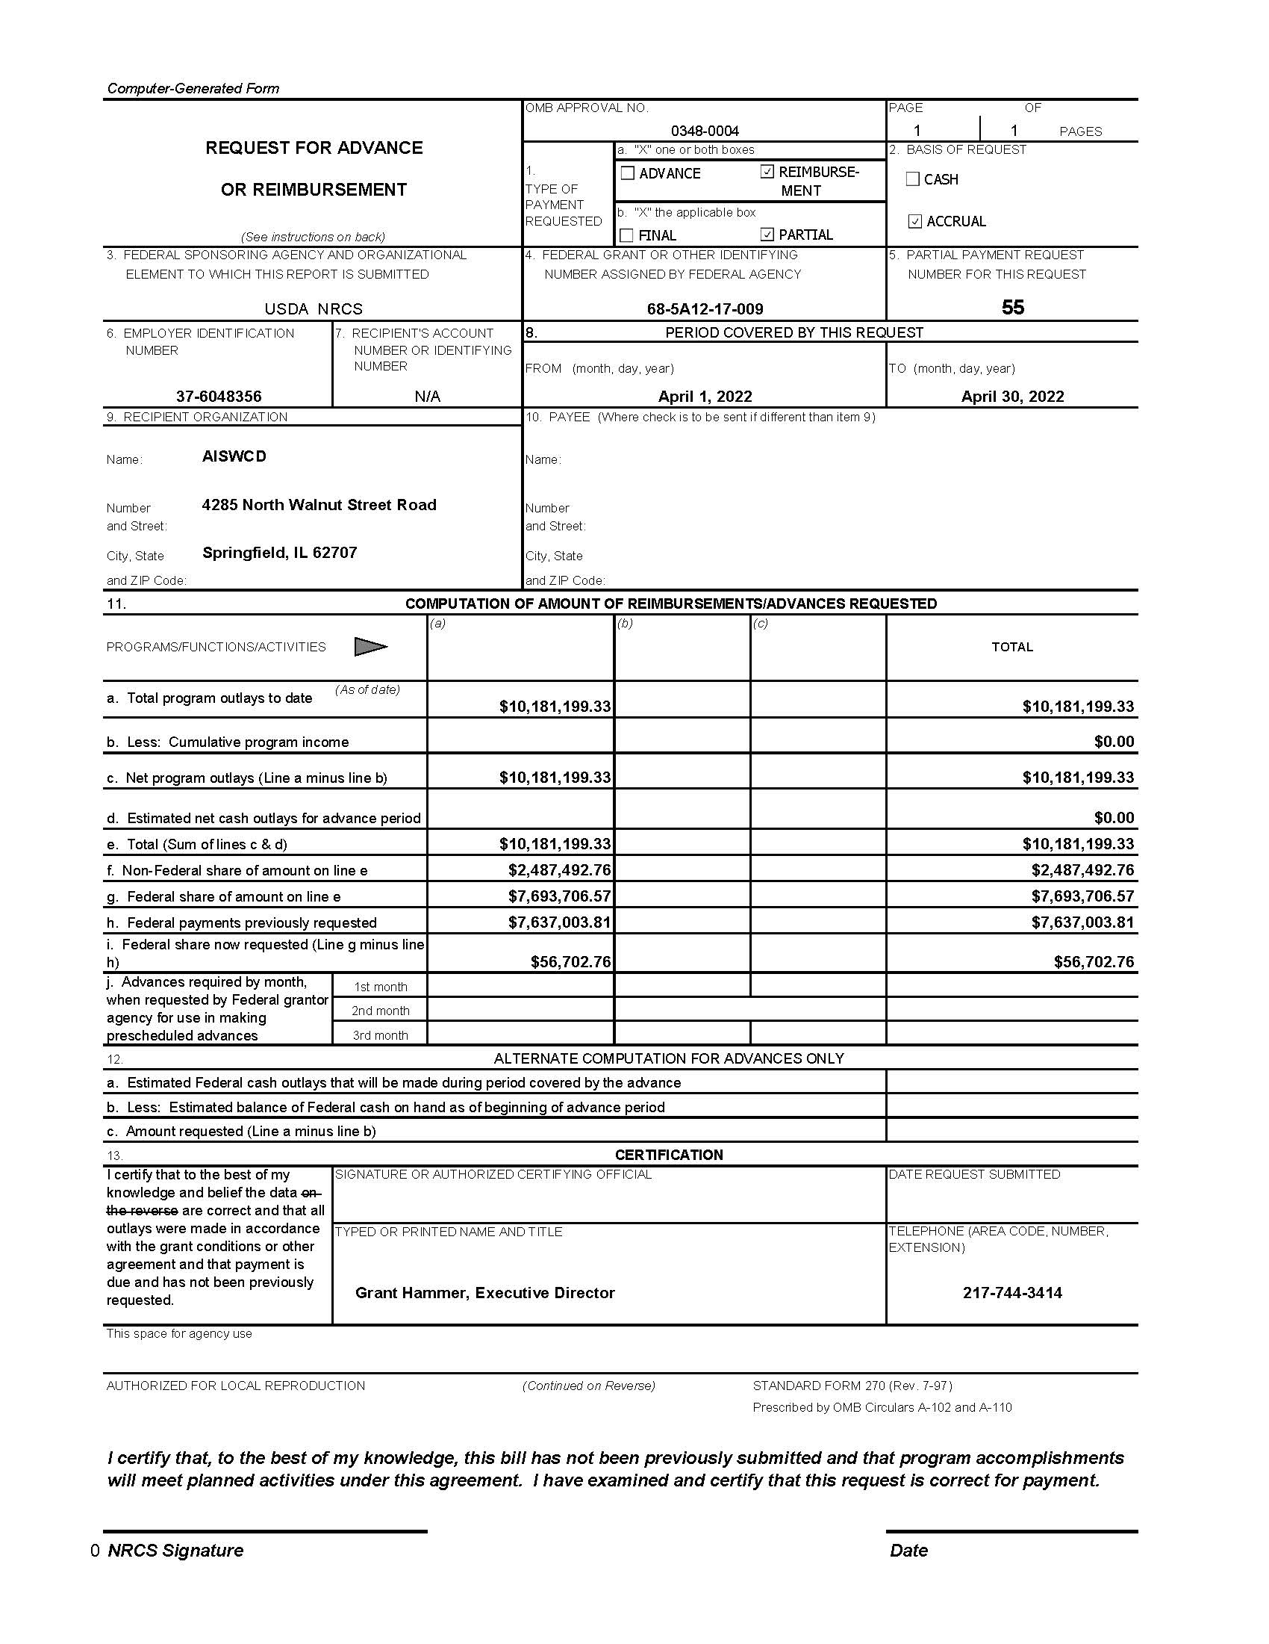
INVOICING
Invoice not less than quarterly
Request for Advance or Reimbursement form SF270
Keep track of previous invoice amounts
ezFedGrants for previous invoice amounts
Label email correspondence
Agreement #
Invoice #
Date submitted
Type of form
Send separate documents in separate emails
Send to FPAC.BC.GAD@usda.gov

Slide 6
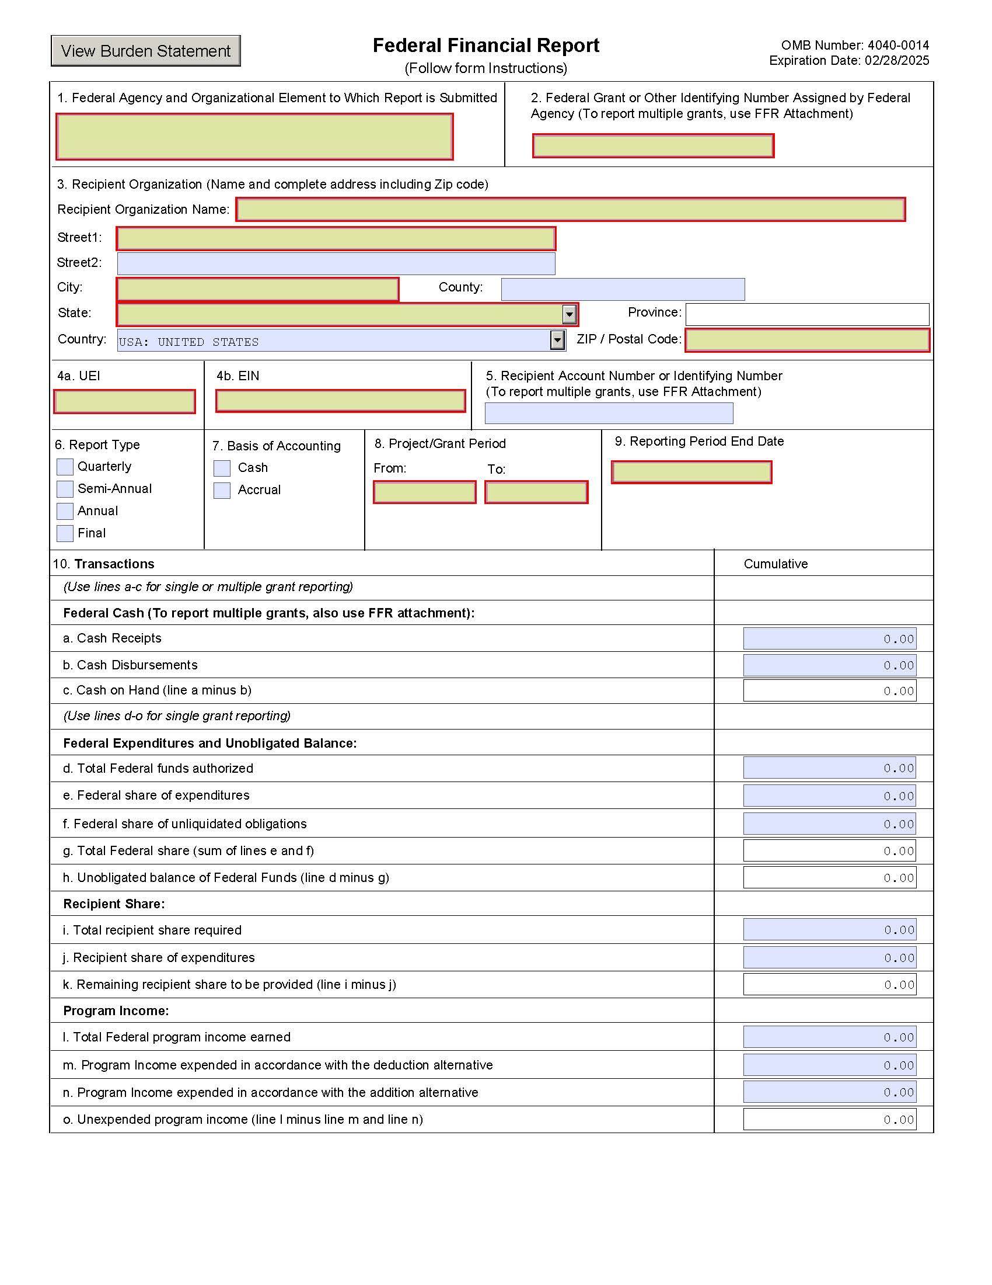
REPORTING
Report quarterly
No later than 120 days past period of performance end date
Federal Financial Reporting form SF425 (not zero dollars)
Performance reports should include at minimum:
Who is working on the agreement and what you accomplished that quarter
Comparison of accomplishments vs. agreed upon milestones and deliverables
Computation of costs per unit of output
Explanation if milestones and deliverables were not met and steps to fix
Label email correspondence
Agreement #
Report quarter
Date submitted
Type of form
Send separate documents in separate emails

Slide 7
NRCS-SWCD
Contribution Agreement Overview
Association of Illinois
Soil and Water Conservation Districts
Prepared by Ashley Curran

Slide 8
Administrative Support for EQIP and CSP

Slide 9
Overview of Responsibilties
NRCS
AISWCD
SWCD
Identify and delegate assignments to SWCD staff Communicate workload and training requirements to districts
Review and sign monthly invoices
Conduct quality assurance
Assist SWCD’s Reporting and invoicing Conduct quality assurance
Ensure 100% coverage statewide
Provide administrative assistance for EQIP and CSP
Maintain ProTracts permissions
Request reimbursement through monthly invoicing

Slide 10
Administrative Support for EQIP and CSP
TASKS & DUTIES

Slide 11
New Applications
Receive and check applications Date stamp
Check signatures
Enter applications into ProTracts Send letters
Run reports Maintain files
Invoice once all tasks have been completed List application number from ProTracts

Slide 12
Funded "Preapproved" Applications
Generate and mail letters Create 6-part folder
PII-personally identifiable information locked up Obtain SF-1199A information
Enter information in ProTracts
Scan and upload required documents into DMS Invoice once all tasks completed
List application number

Slide 13
Active Contracts
Send letters
Annual review of certifications Run reports
ProTracts- certify payments, enter dates DMS- scan and upload documents as needed Phone calls and emails
Obtain signatures Maintain files
Invoice for active contracts on November invoice (due December)

Slide 14
Web Portal Support
Producer support for Conservation Client Gateway (CCG) or Farmers.gov
$22.50 per hour
Promote the web portal and assist clients

Slide 15
Other Program Tasks
CSP and EQIP marketing and promotion Field days, presentations, media
Administrative support for EQIP contracts that are obligated and completed within the current fiscal year
$22.50 per hour

Slide 16
Technical Assistance for CRP

Slide 17
Overview of Responsibilties
NRCS
AISWCD
SWCD
Provide state-wide training and oversight Conduct quality assurance
DC’s communicate workload and training requirements to districts
Assist SWCDs Reporting and invoicing Conduct quality assurance
Obtain required certifications and job approval authority Provide technical support Request reimbursement

Slide 18
Technical Assistance for CRP
TASKS & DUTIES

Slide 19
SECTION A:
DEVELOP CONSERVATION PLANS
Use the Field Office Technical Guide – eFOTG Conservation Desktop
Field visit
Develop Cost List Agreement
Plan contains – job sheets, maps, fields identified Assess resource concerns through CART
CPA-52 – Environmental Evaluation Worksheet Discuss with landowner and get signatures Must be signed by a Level III Planner
Enter approval date
“Work performed by” needs to say your name
Invoice- List tract #, number of plans (should always be 1), plan approval date

Slide 20
Section B: Conservation Plans for Reenrolled Acres
Follow all requirements from Section A with a few exceptions: Status review should have already been completed 12 -24 months prior (Shouldn’t need field visit)
Review of CPA-52
New job sheets, maps should be needed
Invoice- List tract #, number of plans (should always be 1), plan approval date
*IF practices change then it’s a new plan and should be billed as a new plan

Slide 21
Section C: Establishment Reviews
100% of active contracts are reviewed in 2nd or 3rd year
Site visit
Complete the NRCS-LTP-13 to certify establishment Obtain landowner signatures
Copies to participant, FSA and then filed Enter into PRS monthly
CLEAN WATER,
HEALTHY SOILS.

Slide 22
Section D: Maintenance Reviews
100% of active contracts At least 12-24 months before contracts expiration
Site visit
Complete the NRCS-LTP-13 to certify establishment Obtain landowner signatures
Copies to participant, FSA and then filed Enter into PRS monthly

Slide 23
Section E: Practice Applications
Practice application includes but is not limited to: Field investigations
Topographic survey
Practice analysis and design, layout
Conservation Cover (327), Field Border (386), Filter Strips (393), Grade Stabilization Structures (410), Riparian Forest Buffers (391), Windbreak/Shelterbelt (380), Shallow Water Management (646), Tree and Shrub Establishment (612), Waterway (412), Permanent
Wildlife Habitat (645), Wetland Restoration (657)

Slide 24
NRCS Guidance: Requesting Reimbursement for Practice Standards
Seeding practices – select the practice and seed mix, prepare the job sheets and discuss plan implementation with the landowner
Filter strips, Windbreak/Shelterbelt, Tree and Shrub Establishment and Permanent Wildlife Habitat- all the items listed above for seeding practices plus the additional design component
Waterways, Grade Stabilization Structures, Shallow Water Management, and Structural Wetland Restoration Practices – Survey, design and layout the practice, plus discuss implementation with the landowner (includes new designs and re-designs)
You must also have the job approval authority required for the particular practice. If you do not have the job approval authority for that practice but have done the required work, you may have another district employee with job approval authority sign off on that work. In this instance, you still can add that item to your invoice, if you are in the “on the job training” phase of learning the practice. District staff should be continually working towards gaining the required job approval authority for that practice.

Slide 25
Section F: Practice Certification and Checkout
Site visit
Practice inspection
100% completion and certification Structural practices – per contract Agronomic practices – per contract
Enter date practice applied by landowner in CD

Slide 26
Questions?
??????
Ashley Curran, Grant Manager ashley.curran@aiswcd.org
Send invoices: grants@aiswcd.org
Cell: 815-901-7564

