Slide 1
Conservation Reserve Program (CRP)

Slide 2
Authorization of the Conservation Reserve Program
the Food Security Act of 1985, as amended
7 CFR Part 1410
annual appropriations acts.

Slide 3
Purpose of the Conservation Reserve Program
CRP Objective
CRP’s objective is to cost-effectively assist owners and operators in conserving and improving the nation’s natural resource base.
CRP Emphasis
CRP is a natural resource program that:
protects the nation’s soil, water, and wildlife resources
improves and preserves water quality
enhances fish and wildlife habitat
addresses issues raised by local, State, regional, and national conservation initiatives.

Slide 4
Administration of CRP
The Farm Service Agency (FSA) Administers CRP
The Natural Resources Conservation Service (NRCS) provides technical support to FSA for CRP

Slide 5
How does this partnership work?
CRP is Administered by FSA…
Technical Assistance provided by NRCS….
2-CRP Manual provide program guidance for both agencies.

Slide 6
National level CRP Memorandum of Agreement

Slide 7
NRCS provides technical support
Assists producers with the following:
• Evaluating eligibility of the practice by completing Suitability and Feasibility Worksheet
• Developing a conservation plan that contains all appropriate practices, including operation and maintenance
• Servicing all FSA-848B’s that NRCS has technical responsibility for (CP1, CP2, etc.)

Slide 8
NRCS provides technical support
Assists producers with the following:
• Ensuring that all conservation practices meet FOTG standards
• Obtaining Conservation District approval of conservation plans
• Assisting FSA to coordinate planning with the producer and State Forestry Agency representative for development of the tree planting plan
• Completing conservation plan modifications as needed and provide copy to FSA

Slide 9
NRCS provides technical support
NRCS also:
Certifies on approved forms that the conservation plan meets minimum requirements
Completes status reviews for all field visits and provides FSA a copy

Slide 10
FSA Administers crp
Issue FSA-848A to participants
send referrals for conservation planning to TSP or NRCS
prepare forms for C/S payments • compute C/S and rental payments
maintain and update changes in land ownership in MIDAS BP and MIDAS Farm Records file • renumber fields redefined for CRP according to 10-CM • maintain cropland classification for acres devoted to trees for the life of CRP-1
maintain cropland classification for acres devoted to trees for the life of CRP-1
determine value of refunds, interest, and liquidated damages, when applicable, and according to the provisions of this handbook

Slide 11
conserving and improving the nation’s natural resource base – CRP Purpose
Practice details in the 2-CRP handbook

Slide 12
conserving and improving the nation’s natural resource base – CRP Purpose

Slide 13
CRP practices – More details

Slide 14
General CRP

Slide 15
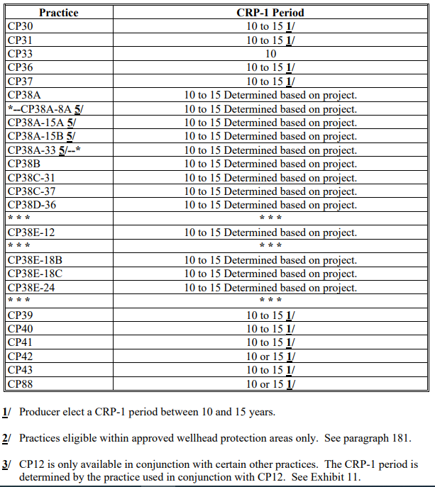
Continuous CRP

Slide 16
Guidance documents for NRCS
2- CRP Handbook, specifically Exhibit 11 (provided details that the program allows by practice.
Field Office Technical Guide (FOTG) provides Standards and Specifications that must be implemented for each practice, that supports the CRP practices.

Slide 17
2-Crp Exhibit 11

Slide 18
2- CRP Exhibit 11

Slide 19
Grasslands - CRP
Provides assistance to landowners and operators to protect grazing uses and related conservation values on eligible private pasture and rangelands.
Promotes maintaining and improving plant and animal biodiversity, and protecting grasslands and shrublands from the threat of conversion to uses other than grazing
Participants voluntarily limit future development and cropping uses of the land while retaining the right to conduct common grazing practices and operations related to the production of forage and seeding,
subject to *--certain restrictions during PNS.— Primary nesting season

Slide 20
Grassland - crp
Starting with signup 202 (FY21) only CP88 is authorized for CRP Grassland.
CP88 – Permanent native grasses and legumes
Existing contracts will continue to use practices CP42, CP87, CP87A, CP88, and CP88A if enrolled during signup 200 and practices CP87, CP87A, CP88, and CP88A if enrolled during signup 201

Slide 21
Grassland – crp
Signup work is completed primarily by FSA
Sometimes applicants have questions for NRCS wanting to know what is included in a grazing plan.
When offers are selected at the FSA national level for funding, NRCS develops a Grazing plan with the applicants.
Grazing plans must meet NRCS Standard and Specificaion, Conservation Practice Standard (CPS) 512

Slide 22
Clear 30 - CRP
CLEAR 30 first offered as a Pilot program in 2020.
Offered in all states in 2021
Allows some practices to be enrolled into CRP for 30 years.
Unknown if CLEAR30 will be offered in FY22

Slide 23
More details to know
SAFE areas
Forest management Incentives Program
Water quality Areas
Water quality and wildlife Zones
SAVE these for LATER Training

Slide 24
New ENROLLment & Re-enrollment
NEW ENROLLMENT
Offered acreage NOT currently under CRP-1 contract
New acreage currently being planted to an agricultural commodity
RE-ENROLLMENT
Offered acreage IS currently under CRP-1 contract
scheduled to expire in 6 months or less AND contract start date is October 1 immediately following contract expiration (no gap in contract periods).

Slide 25
Enrollment process for continuous crp

Slide 26
Step | Continuous Signup Activity
1 | Producer: expresses an interest in enrolling in CRP indicates the acreage they want to enroll on digital imagery and identifies the practice they want to enroll.
2 | County FSA office determines if all the following are met: producer eligibility requirements land eligibility requirements CRP county cropland limit has been exceeded CRP practice/initiative allocation has not been exceeded.
3A | If all requirements in step 2 are met, FSA creates a TERRA Scenario (Soils report for the acres being enrolled, upload infomraiton the FSA software system (COLS) and print CRP2C.
3B | If all requirements in step 2 are NOT met, STOP and do not proceed. Notify producer of unacceptable offer using CRP-26 letter

Slide 27
Step | Continuous Signup Activity
4 | FSA County committee (COCO or County Executive Director (CED) provides the following to NRCS or TSP: unsigned CRP-2C digital imagery identifying the acreage offered.
5 | NRCS makes a site visit. Based on site visit, NRCS/TSP determines, using the Documentation of Suitability and Feasibility Worksheet, if the: existing cover is functioning as the practice offered (if re-enrollment) practice offered meets the purpose of the practice according to 2-CRP handbook, Exhibit 11 the practice fits the site and is needed and feasible to solve the (existing) resource concern.
6 | NRCS or TSP: returns unsigned CRP-2C and digital imagery to FSA County Office provides the FSA County Office a signed and dated Documentation of Suitability and Feasibility Worksheet.

Slide 28
Step | Continuous Signup Activity
7 | FSA COC or CED reviews NRCS or TSP documents and findings. County office files copy of signed and dated Documentation of Suitability and Feasibility Worksheet in the CRP folder. If NRCS or TSP determined the practice and acreage offered is: not suitable, needed and feasible; STOP and notify the producer the practice is NOT acceptable suitable, needed and feasible without any changes; go to step 9 suitable, needed and feasible, but only if required changes are made; go to step 8. IF producer modifies the practice or acreage offered after NRCS or TSP has made the determinations in this step, STOP and go back to step 3.

Slide 29
Step | Continuous Signup Activity
8 | FSA COC or CED notifies producer of required changes needed to make the practice acceptable. If producer: agrees to make all required changes, update TERRA Scenario and COLS, then proceed to step 9. does NOT agree to make all required changes, STOP and notify producer offer is not acceptable using CRP-26. IF producer modifies the practice or acreage offered after NRCS or TSP has made the determinations in this step, STOP and go back to step 3.
9 | FSA County Offices shall ensure that the base limitation is not exceeded
10 | FSA County Office completes and prints CRP-2C and CRP-1.
11 | FSA County Office completes paid-for measurement service, if requested.
12 | Producer signs and dates completed CRP-2C and CRP-1, and provides the signed documents to the FSA county office.

Slide 30
Step | Continuous Signup Activity
13 | FSA County Office: notifies producer of acceptability of offer using CRP-23 provides producer a copy of signed CRP-1 and CRP-2C provides producer a copy of CRP-1 Appendix provides NRCS a copy of the letter of acceptability sent to producer provides NRCS a copy of signed CRP-1 and CRP-2C updates offer status in COLS to “submit to plan”
14 | NRCS develops conservation plan with the producer. NRCS provides FSA County Office with: NRCS signed conservation plan and all supporting documentation Plan must be signed by participants and Conservation Planner with proper planning certification. NRCS-CPA-52 with the NRCS portion completed.

Slide 31
Step | Continuous Signup Activity
15 | County Office: completes FSA’s portion of NRCS-CPA-52 completes all necessary consultations obtains copy of all permits or other permissions necessary to perform and maintain practices as provided by NRCS on NRCS-CPA-52 section G. County Office updates offer status in COLS to “submit to COC”

Slide 32
Step | Continuous Signup Activity
16 | If determined complete and acceptable, FSA COC or CED signs conservation plan.
17 | FSA County Office ensures that AGI determination is made for the FY of the FS COC/CED approval date.
18 | FSA COC or CED approves CRP-1 County Office notifies producer that CRP-1 is approved using CRP-24, and provides producer a copy of approved CRP-1.
19 | FSA County Office enters COC approval date and effective start date from CRP-1 into COLS.
20 | FSA County Office processes initial FSA-848A for all practices (except CP12), C/S, non-C/S, and management activities.

Slide 33
Enrollment process for General signup Slightly different

Slide 34
Documentation of Suitability and Feasibility Worksheet
Suitability and Feasibility Worksheets help the planner to document the following:
Determine if site conditions meet CRP CP program requirements, includes documenting the current cover type and current land use of the offered area.
Determine if there is a resource concern within the offer area, or adjacent area in some cases, that is targeted by the CRP CP according to Handbook 2-CRP, Exhibit 11. Use NRCS planning criteria as a basis to determine the condition of a resource concern.
Determine if the CRP CP will solve at least one of the identified resource concerns for the practice in Handbook 2-CRP, Exhibit 11.
Determine if the CRP CP and supporting NRCS conservation practice standard can be applied to the land. Are the offered acres suitable for installation of the conservation practice?

Slide 35
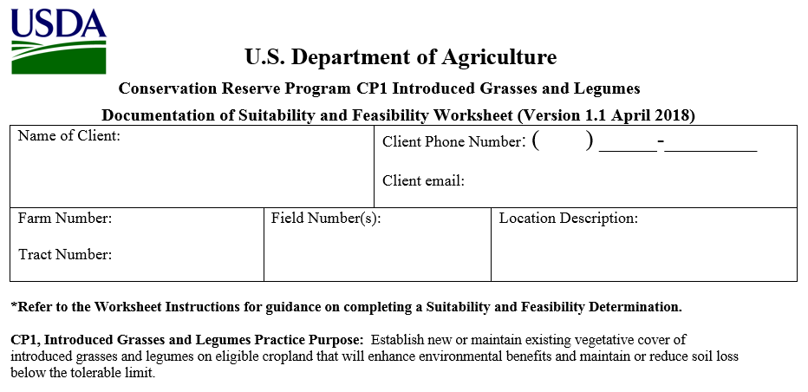
Documentation of Suitability and Feasibility Worksheet

Slide 36
Documentation of Suitability and Feasibility Worksheet

Slide 37
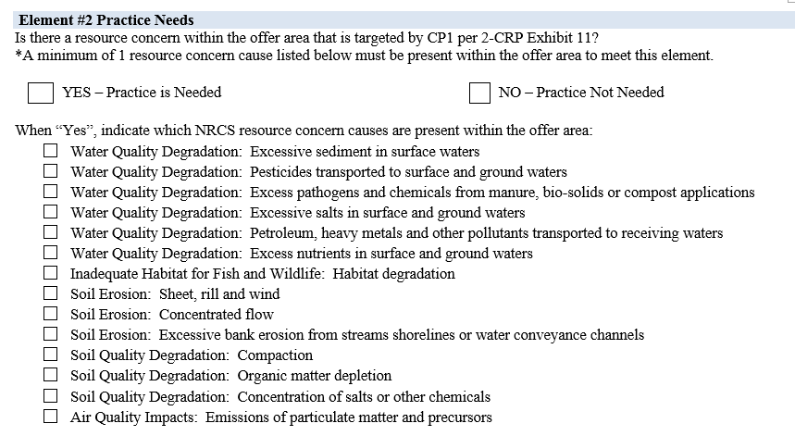
Documentation of Suitability and Feasibility Worksheet

Slide 38
Documentation of Suitability and Feasibility Worksheet

Slide 39
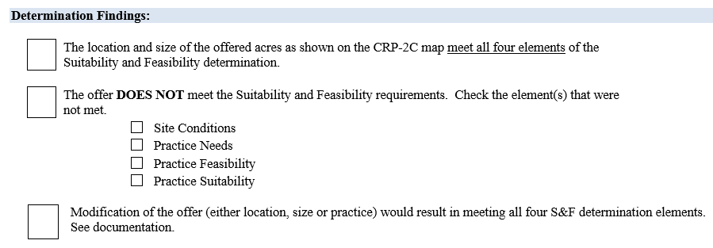
Documentation of Suitability and Feasibility Worksheet

Slide 40
Documentation of Suitability and Feasibility Worksheet

Slide 41
Conservation plan
Conservation plan is developed in Conservation Desktop
Assessed in CART
Applied in Conservation Desktop, just like all NRCS planning assistance

Slide 42
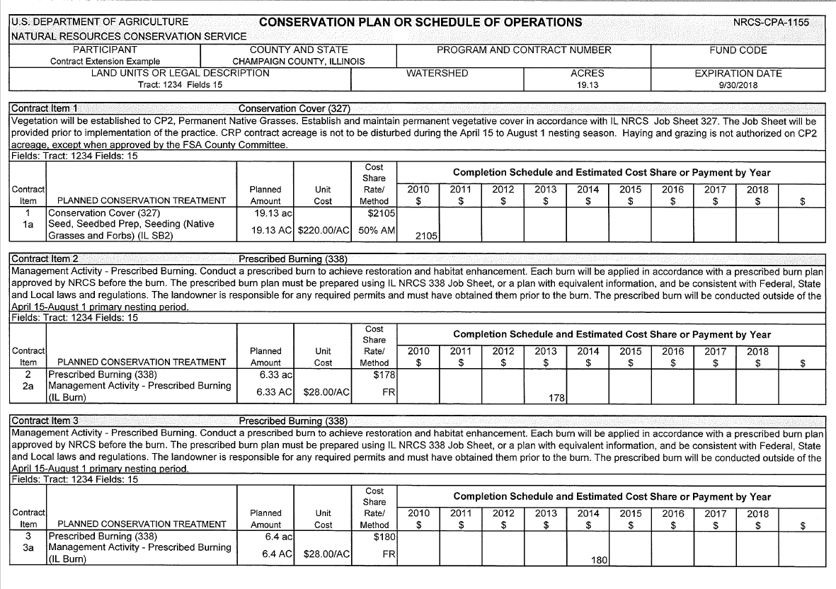

Slide 43
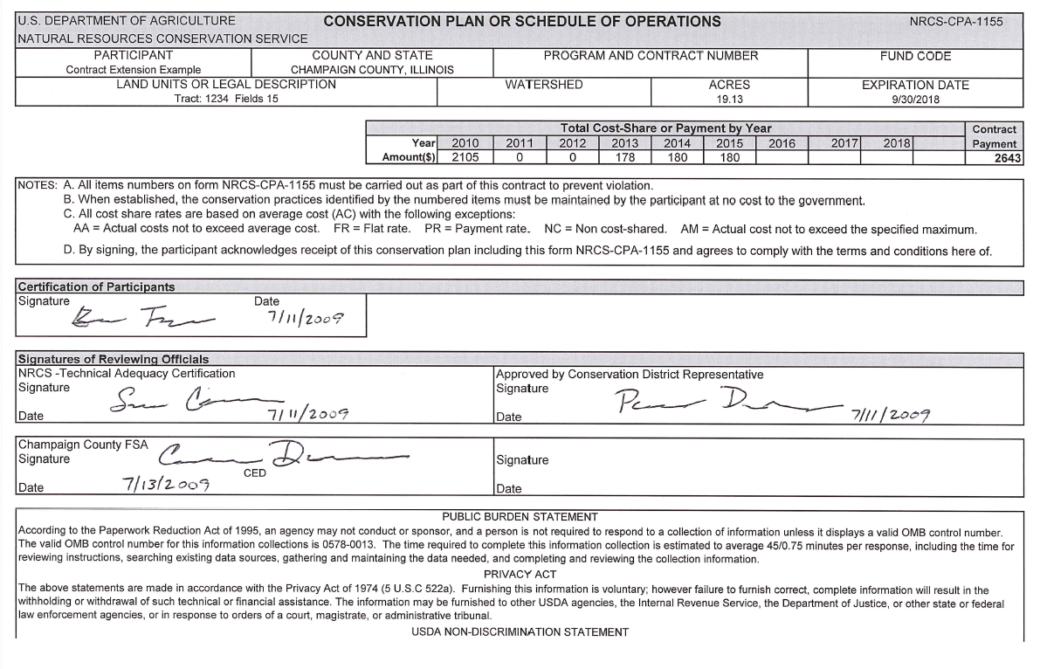

Slide 44
Additional Tasks for NRCS - CRP
NRCS* certifies that all practices are properly installed, according to NRCS standards and specifications
NRCS* conducts Status Reviews for FSA to ensure the practice is fully established and properly functioning. (Year 2 or 3)
NRCS* conducts Maintenance Status Reviews prior to the last 12 months of the CRP contract, to ensure the practice still functions properly and has been properly maintained.
* NRCS or a trained partner

