Slide 1





Photo: Layne Knoche

Slide 2
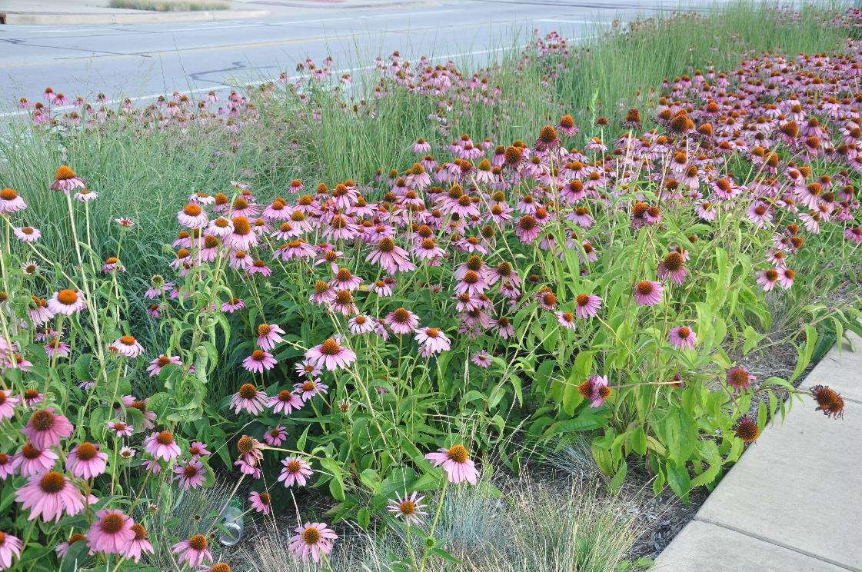
Key Points
Overview of Illinois NLRS
Gulf Hypoxia
Nutrient Strategy Framework
Illinois Process
  Science Assessment
  Policy Workgroup
  Priorities & Approach
Implementation of NLRS
2019 Biennial Report
Photo: C. Eliana Brown

Slide 3
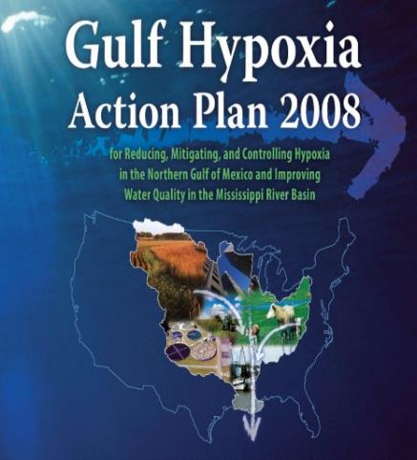
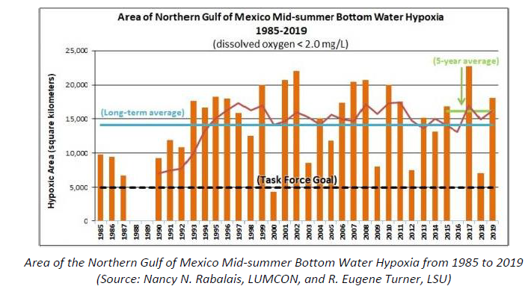
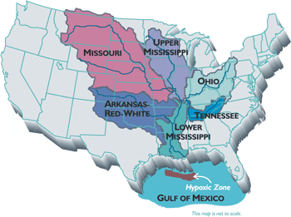
Gulf Hypoxia Task Force Study
GOAL:
Reduce Hypoxic Zone to 5,000 km² (1,930 mi²)
Reduce Nutrient Loading to Gulf of Mexico
Total Phosphorus and Total Nitrogen 45%

Slide 4
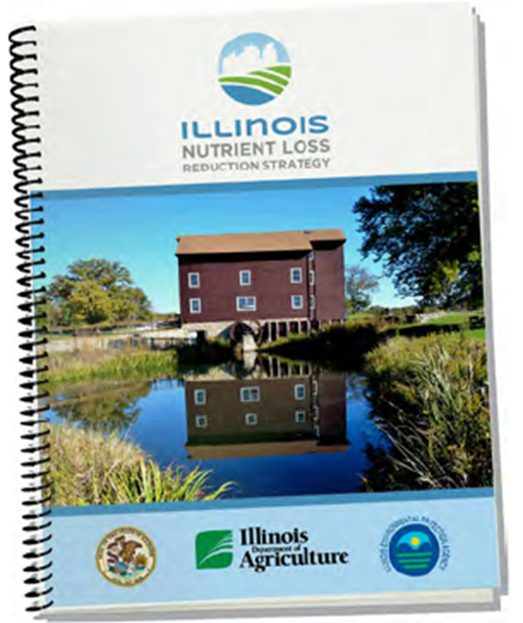
Illinois
Nutrient Loss Reduction Strategy
NLRS REPORT
RELEASED JULY 2015

Slide 5
Illinois Nutrient Loss Reduction Strategy
GOALS
Establishes 45% Reduction of Nitrogen and Phosphorus
Interim Milestone—2025
25% Reduction in Phosphorus Loads
15% Reduction in Nitrogen Loads
Trevor Sample
Illinois EPA

Slide 6
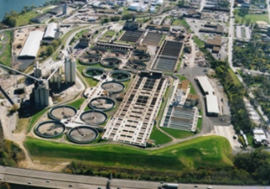
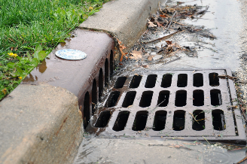
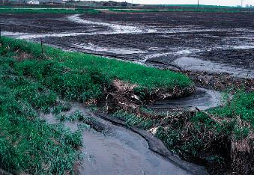
Illinois Nutrient Loss Reduction Strategy
Addresses nutrient loads from:
  Point Sources
  (wastewater treatment facilities)
  Urban Stormwater
  Agriculture
  nonpoint sources
Photo: MRWDGC
Photo: C. Eliana Brown
Trevor Sample
Illinois EPA
Photo: NRCS

Slide 7
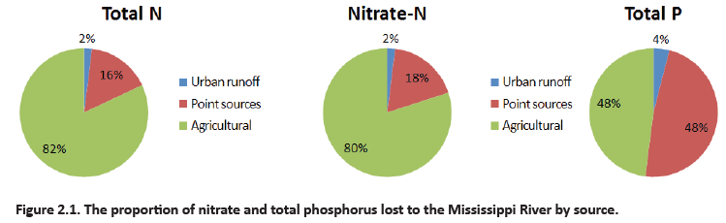
Illinois NLRS Science Assessment

Slide 8
NLRS Implementation Recommendations:
Agriculture
Practice Type | Nitrate | Total Phosphorus
In Field Practices | Nitrogen Management (MRTN, Inhibitors, Split Applications) Cover Crops | Reduced Tillage (no-till, strip till) Nutrient Management Cover Crops
Edge of Field Practices | Woodchip Bioreactors Stream Buffers (non-tile drained land) Constructed Wetlands | Stream Buffers
Land Use Change | Perennial/Energy Crops | Perennial/Energy Crops
NEW
Saturated Buffers and
Terraces

Slide 9
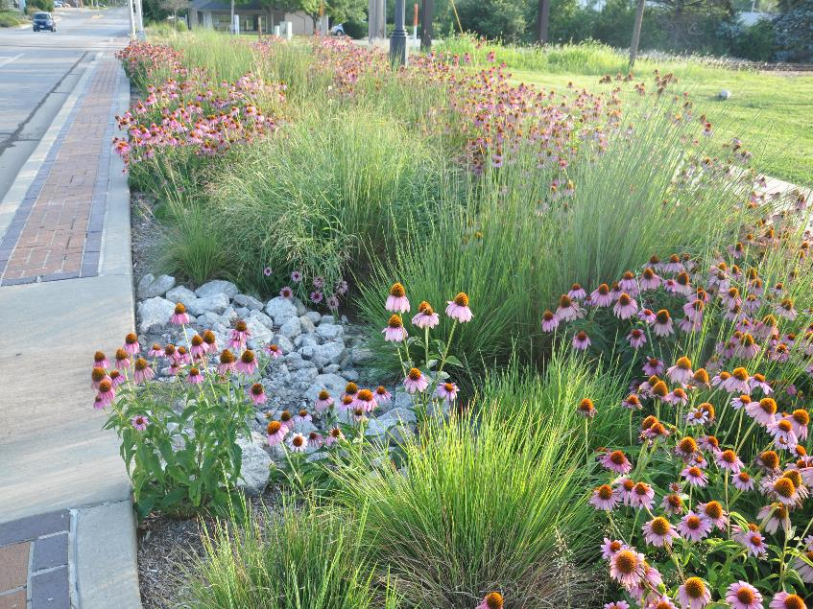
NLRS Implementation Recommendations:
Urban Stormwater
Municipal Separate Storm Sewer System (MS4) Permits
Prioritize Green Infrastructure
Technical and Financial Assistance for Green Infrastructure
Urban Streambank Stabilization and Restoration
Encourage Stormwater Collaboratives
Photo: C. Eliana Brown

Slide 10
NLRS Implementation Recommendations:
Point Sources
National Pollutant Discharge Elimination System (NPDES) Permits
  Total Phosphorus limits for major (> 1 MGD) wastewater treatment facilities
  Feasibility and Optimization studies for nutrient removal
  Nutrient Assessment Reduction Plans
    Facilities that discharge to waters determined to be impaired or at risk of eutrophication
    1.0 mg/L total phosphorus
    0.5 mg/L total phosphorus
Encourage Urban Watershed Planning Groups

Slide 11
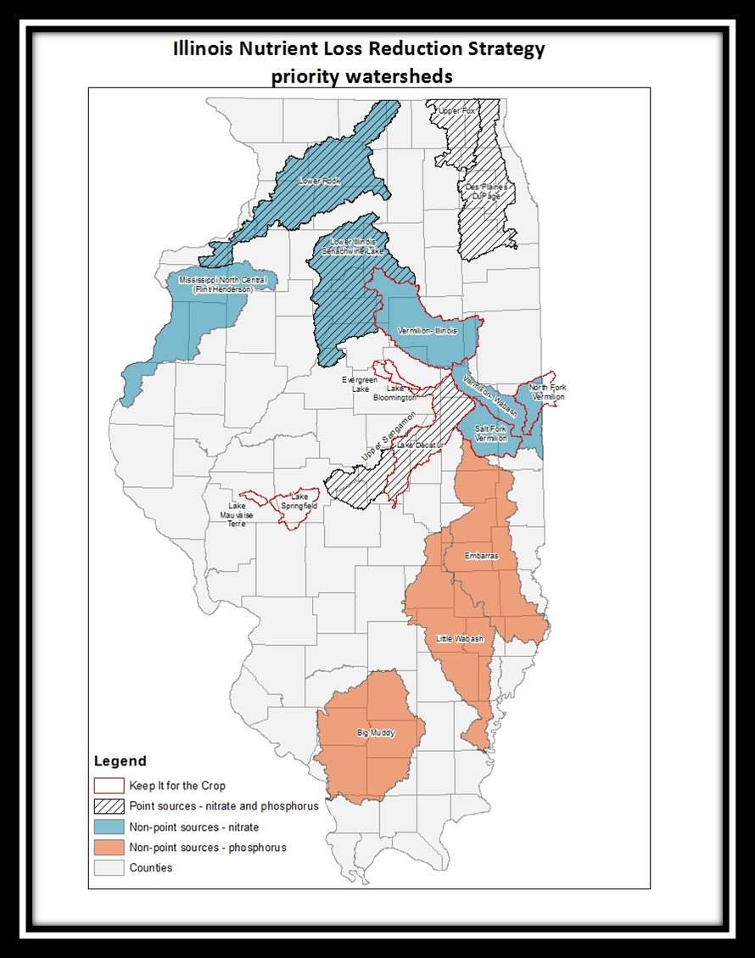
NLRS Priority Watersheds
Prioritized by:
Total loads (N or P)
Local water quality concerns
Active watershed plans

Slide 12
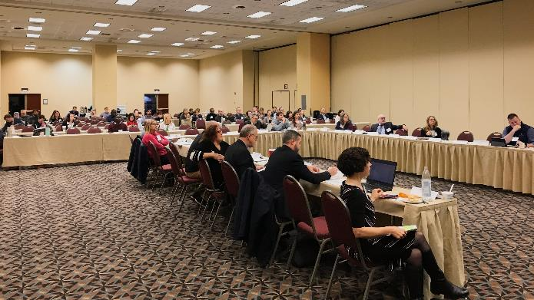
NLRS Committee Structure
  Steering Committee
    Illinois EPA, Illinois Dept. of Ag, Extension
  Policy Working Group
    Communications Subgroup
    Agriculture Water Quality Partnership Forum
      Technical Subgroup
    Urban Stormwater Working Group
      Education Subgroup
      Tracking Subgroup
    Performance Benchmark Working Group
    Nutrient Monitoring Council
Photo: Kate Gardiner

Slide 13























Illinois NLRS Policy Working Group Participants
Agriculture
Point Source
BNWRD
Stormwater and
Potable Water System
Government
Environment/Conservation

Slide 14
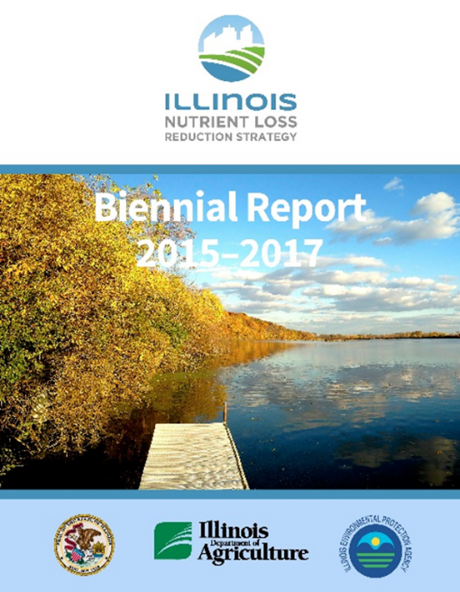
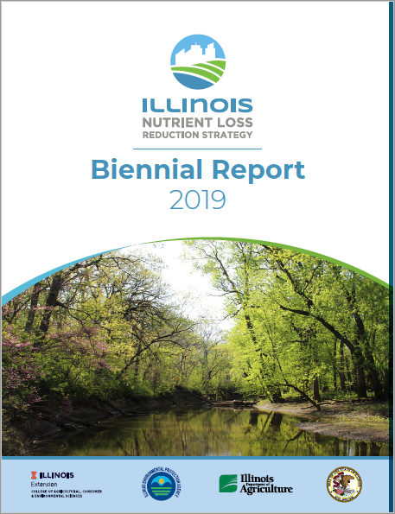
Biennial Reports
Every two years a Biennial Report will be written to document progress of implementing the NLRS.
2021 Coming Soon!

Slide 15
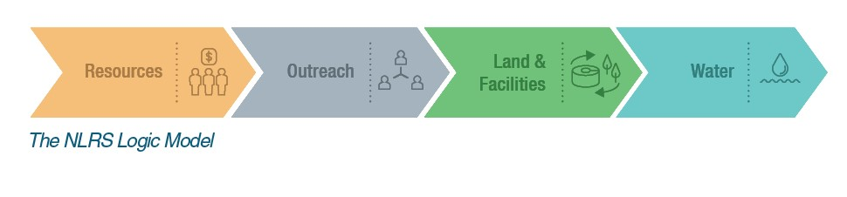
Tracking Measures
Biennial Reports are structured to report data on these tracking measures by each sector.

Slide 16
Biennial Report
Reporting Metrics

Slide 17
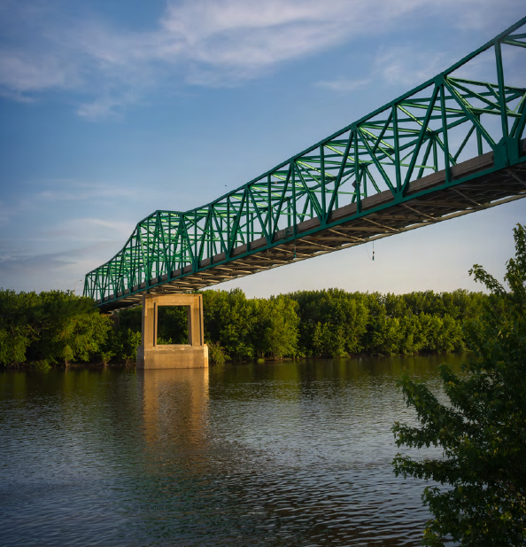


Slide 18

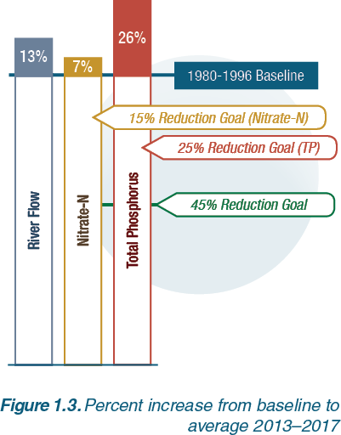
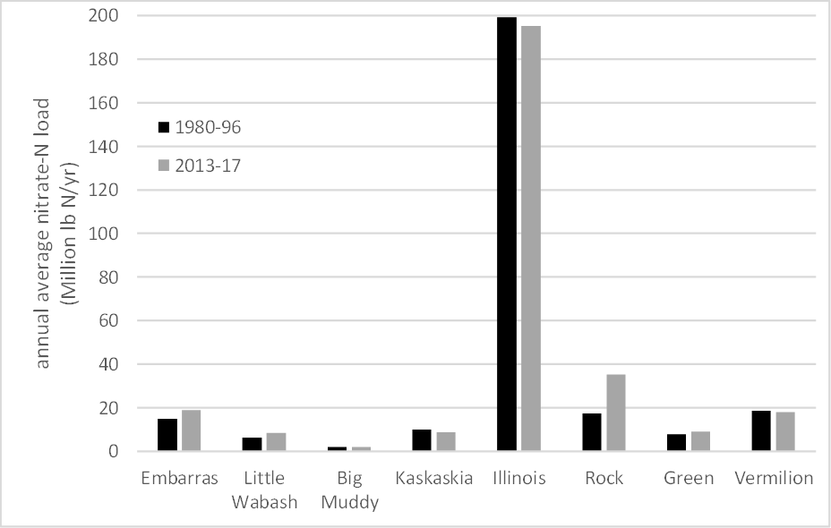
Water Quality Analysis

Slide 19
Estimated Average Annual Nitrate-N Yields by HUC 8 (lb N/ac-yr)
1997–2011
2012–17
Aaron Hoyle-Katz, NCSA

Slide 20
Estimated Average Annual Total P Yields by HUC 8 (lb N/ac-yr)
1997–2011
2012–17

Slide 21
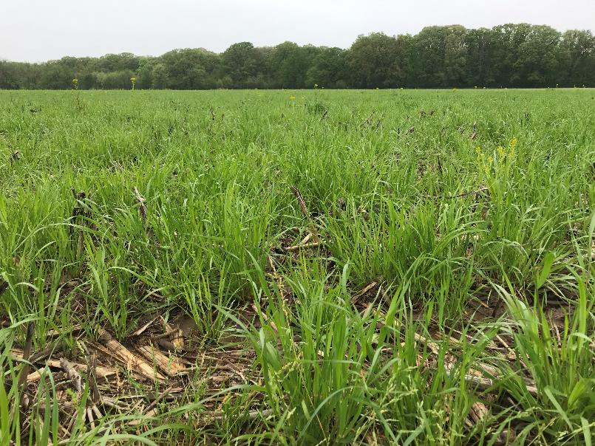

Photo: Jennifer Woodyard

Slide 22

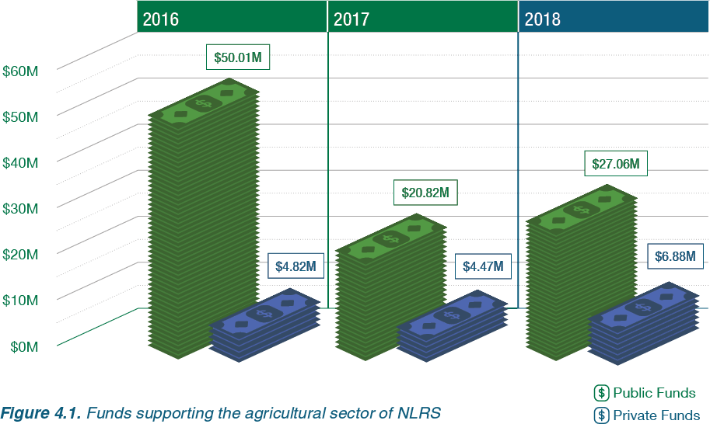

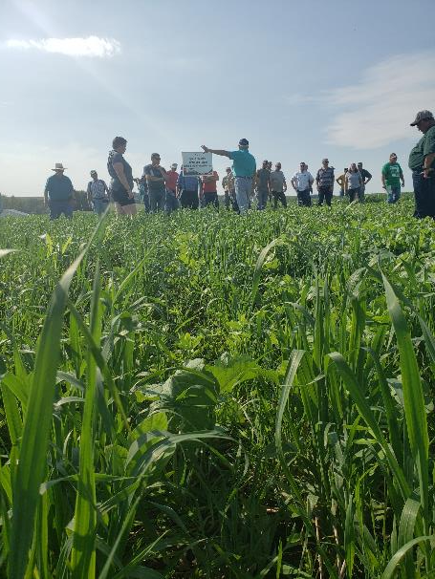
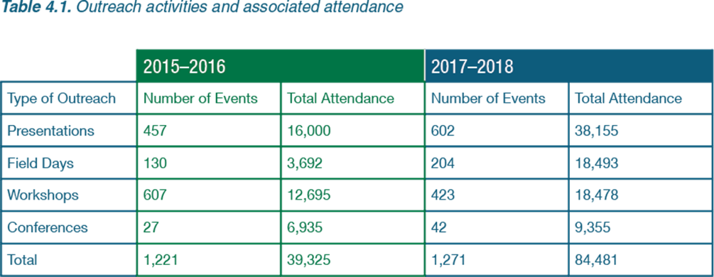
Photo: Haley Haverback-Gruber

Slide 23

NLRS NASS Survey
Conducted in 2017, 2019, and 2020

Slide 24
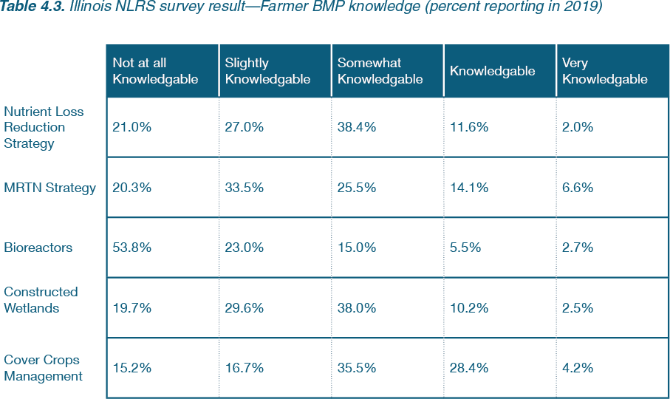
NLRS NASS Survey 2019

Slide 25

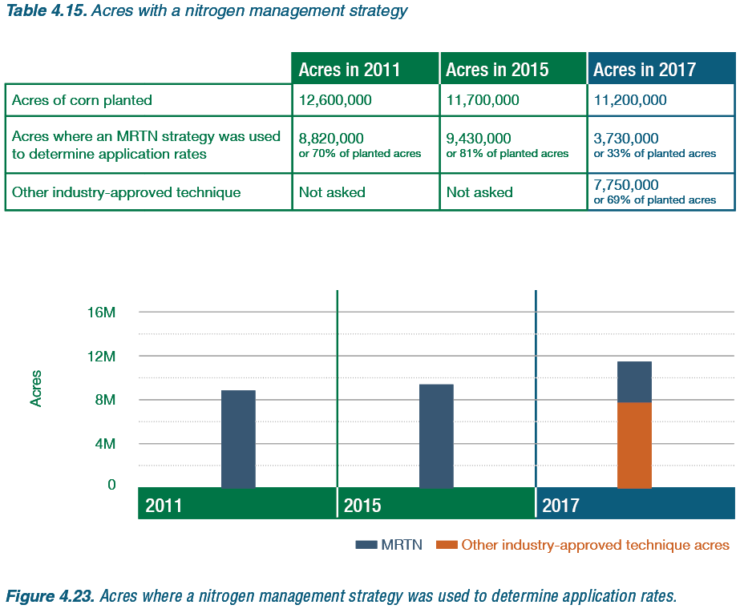
NLRS NASS Survey 2019

Slide 26
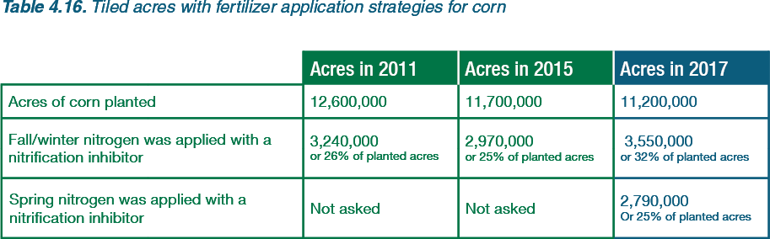
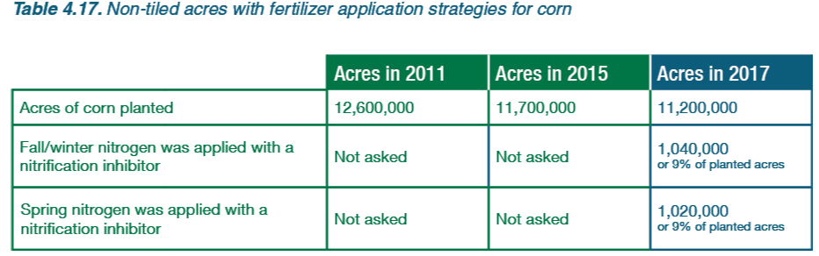
NLRS NASS Survey 2019

Slide 27
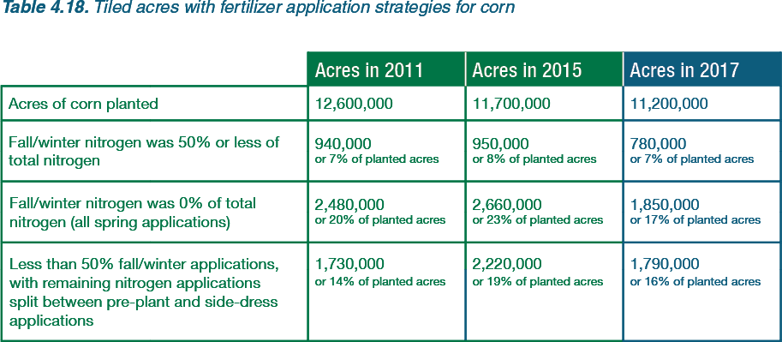
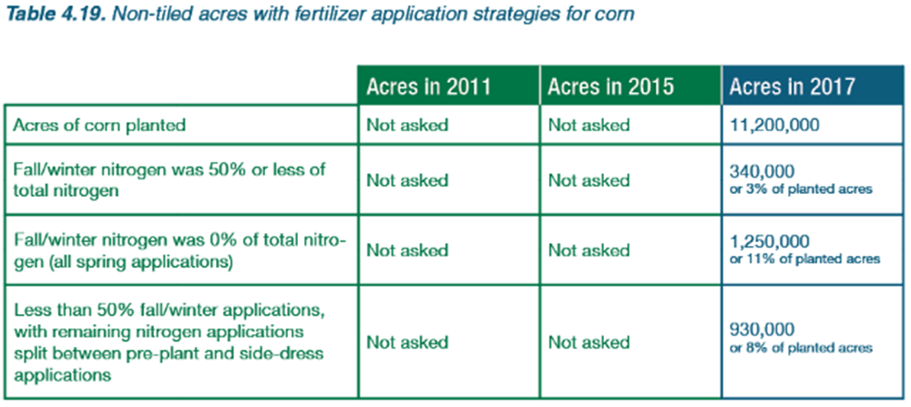
NLRS NASS Survey 2019

Slide 28
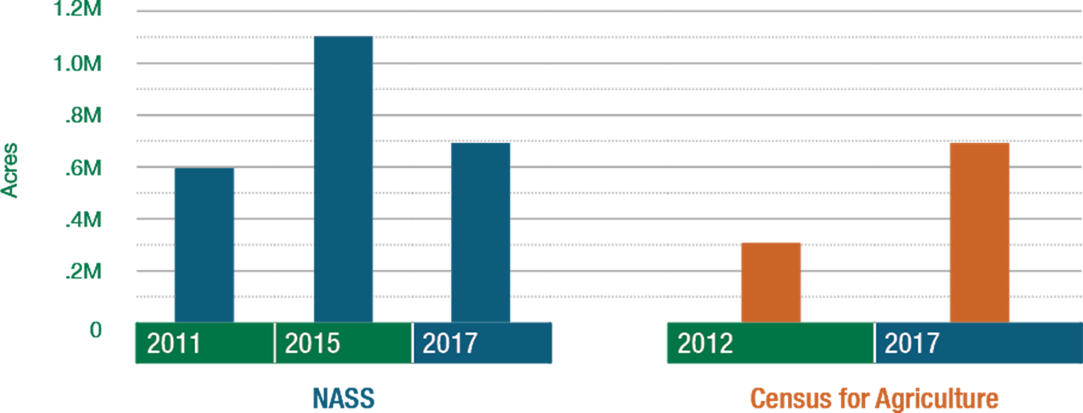
NLRS NASS Survey 2019

Slide 29
Agriculture Sector:
State and Federal
Cost-Share Programs

Slide 30

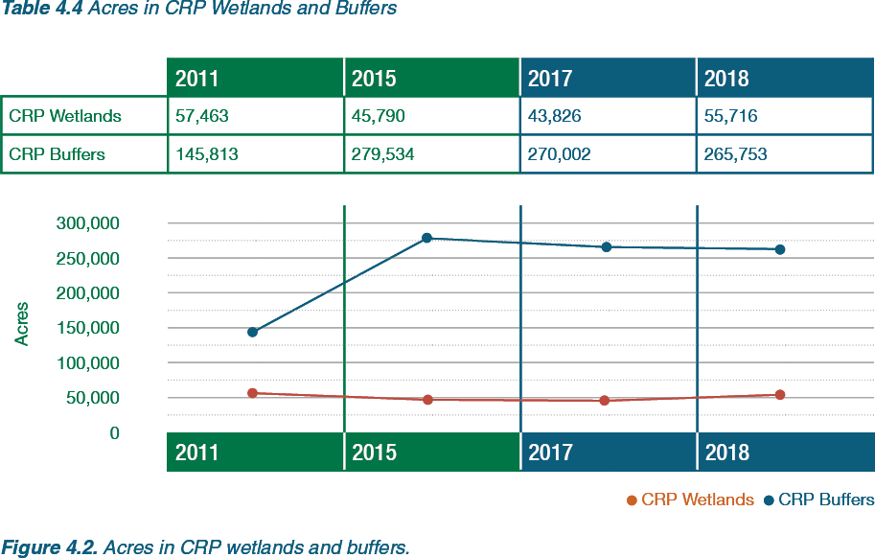
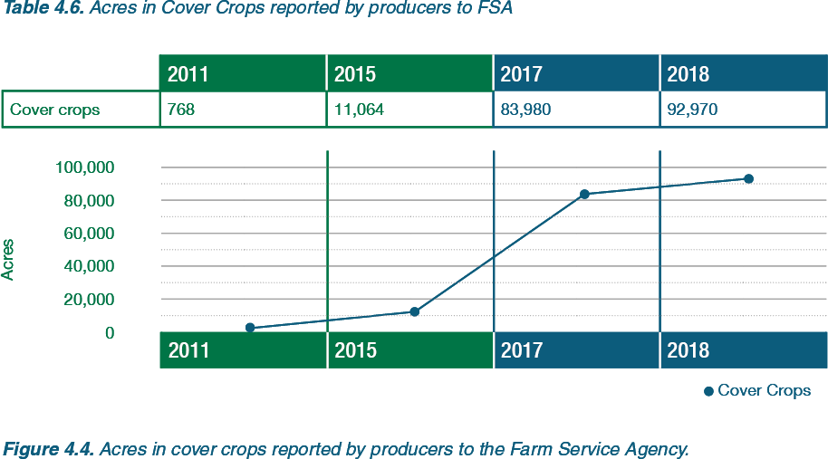
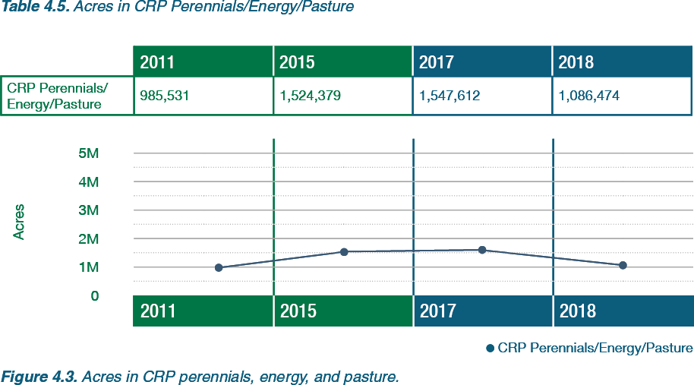
Conservation Reserve Program
Cover Crops

Slide 31

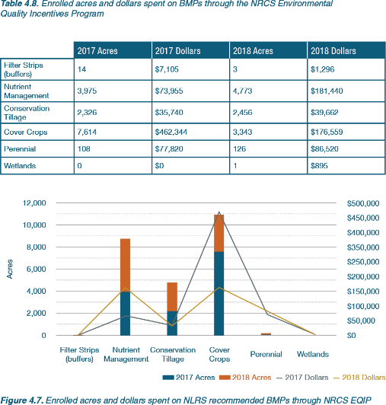
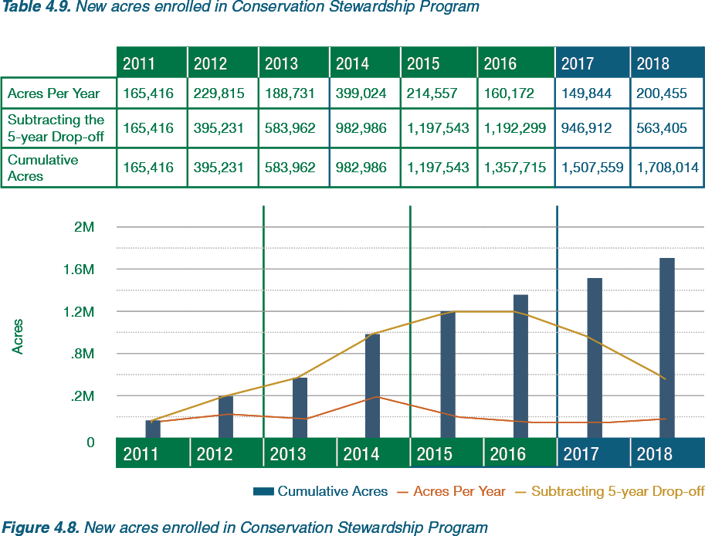
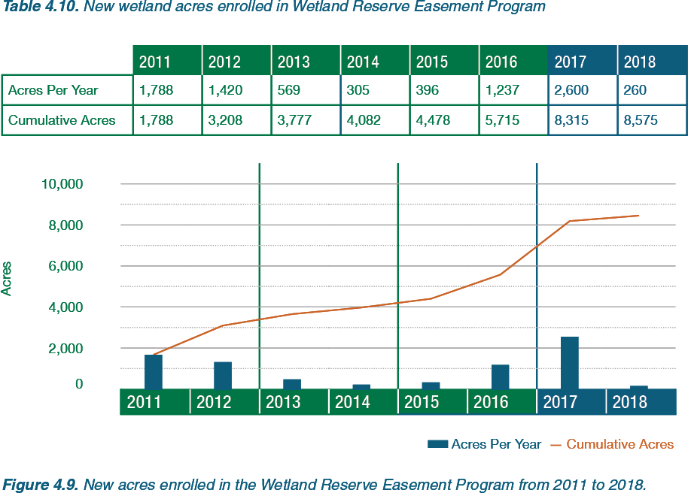
Environmental Quality
Incentives Program
Conservation
Stewardship Program
Wetland Reserve
Easement Program

Slide 32

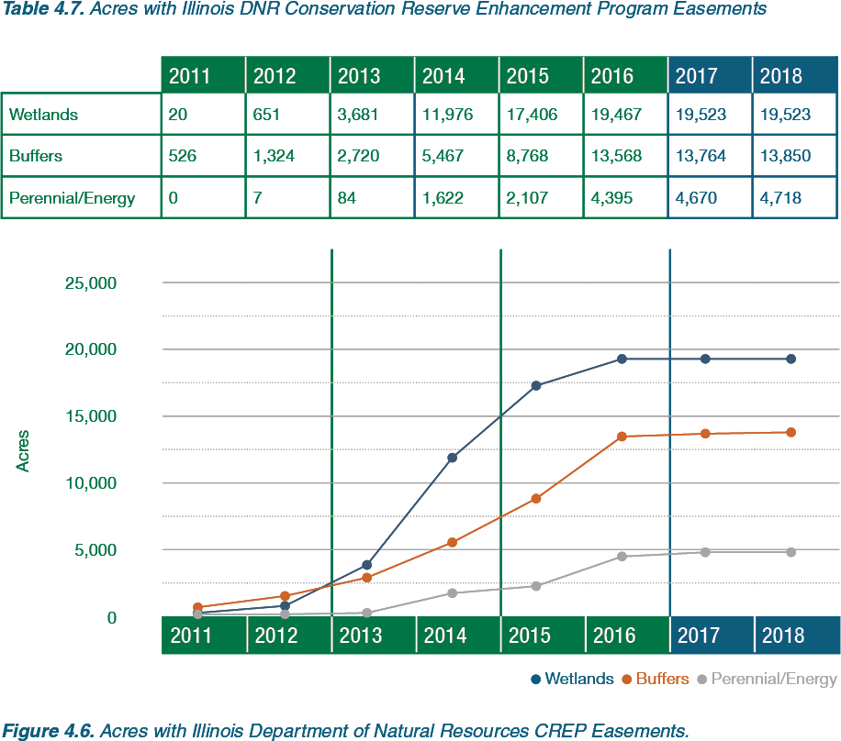
Conservation Reserve Enhancement Program

Slide 33

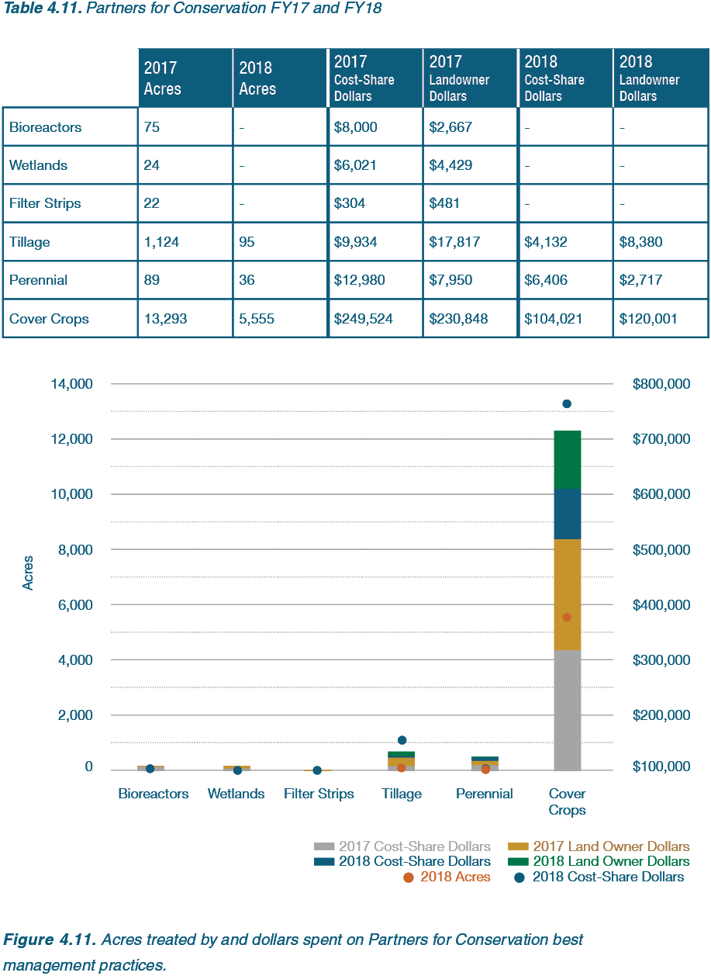
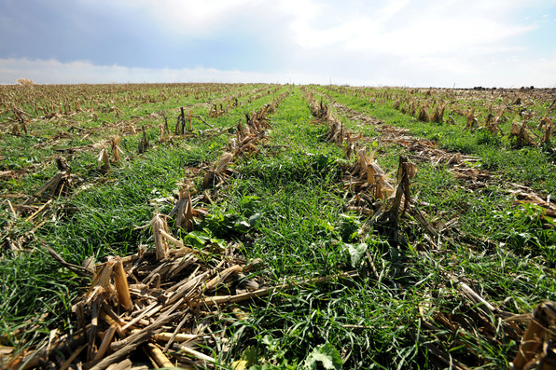
Partners for Conservation

Slide 34
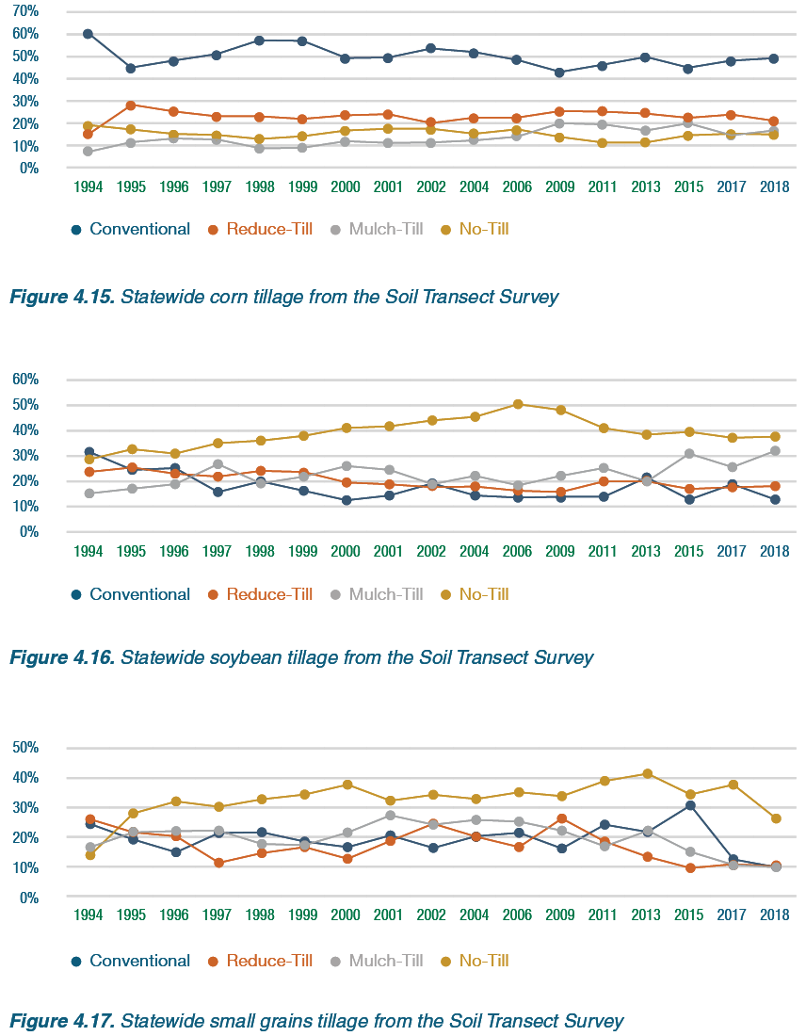
Soil Transect Survey

Slide 35
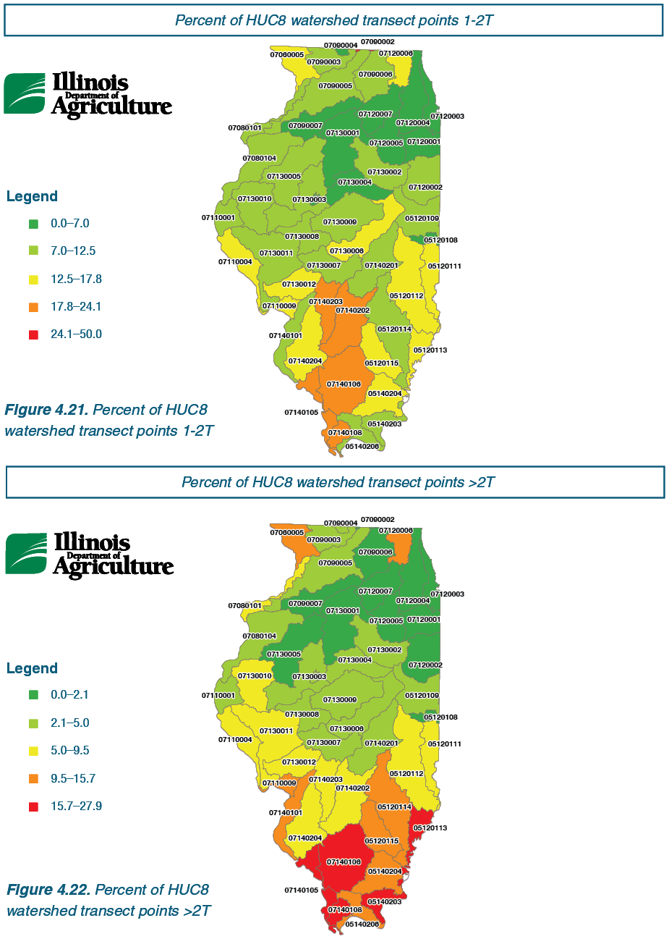
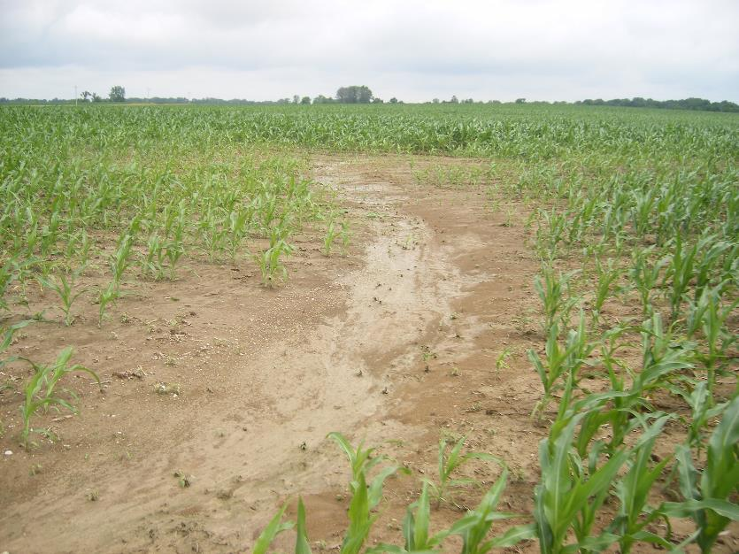
Soil Transect Survey
Photo: IDOA

Slide 36

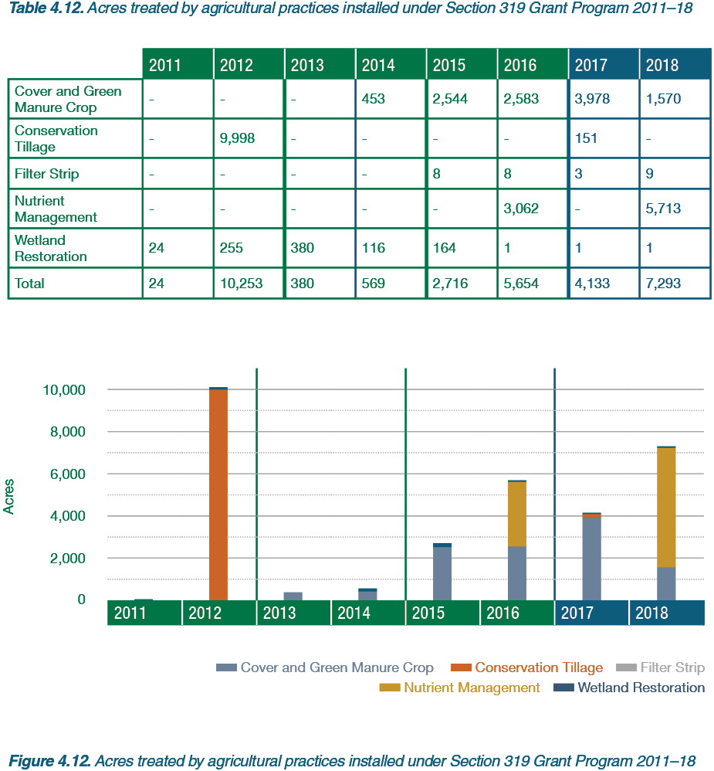
319 Nonpoint Source Grant Program

Slide 37
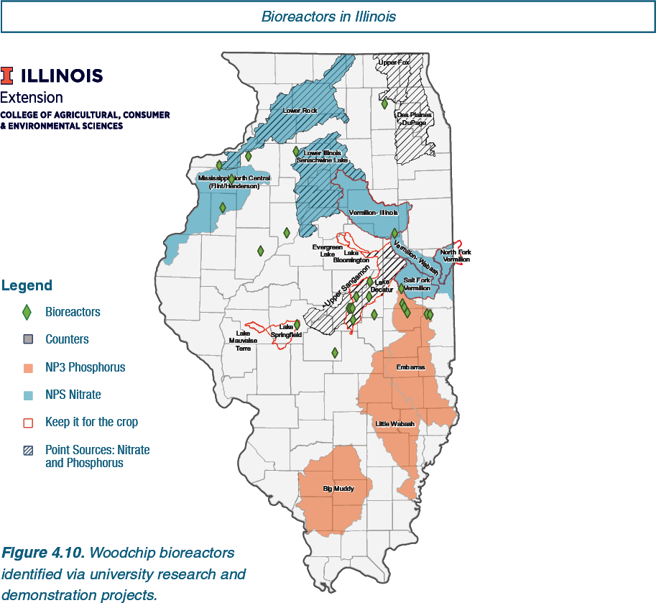
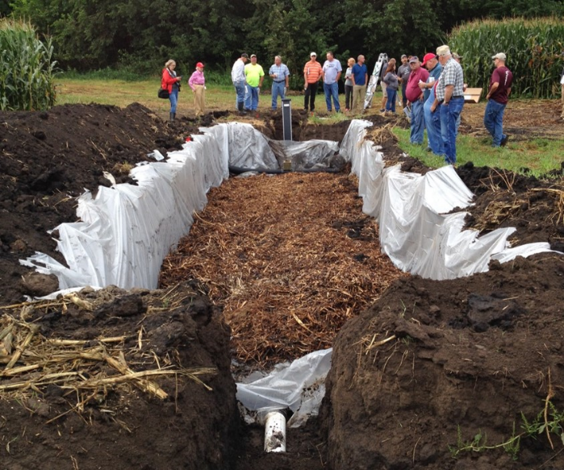
36 Woodchip Bioreactors
Treating 1,345 acres
Photo: University of Illinois Extension

Slide 38
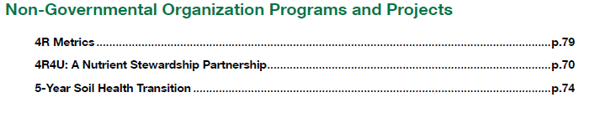
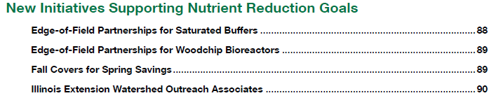
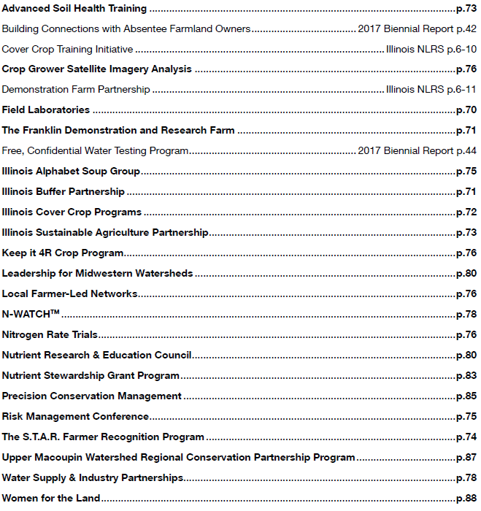







Partner Updates

Slide 39
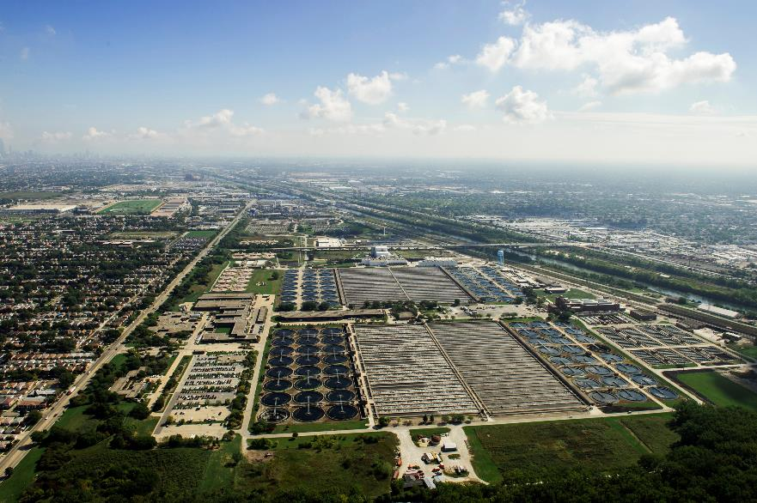

Photo: MWRDGC

Slide 40
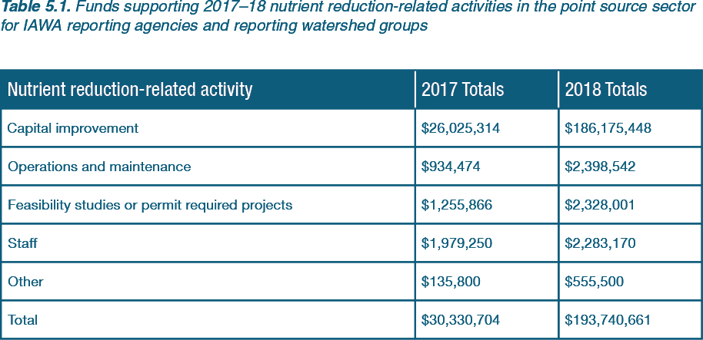
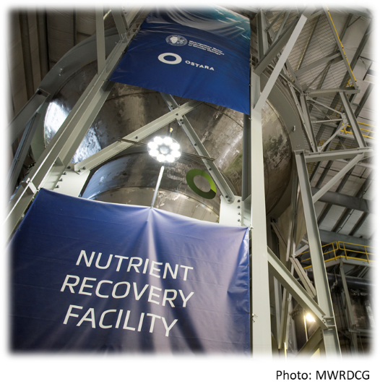


Slide 41


24%
Total Phosphorus
Reduction
10%
Total Nitrogen
Reduction

Slide 42


2018

Slide 43


Photo: C. Eliana Brown

Slide 44



Slide 45


Slide 46



Slide 47


Photo: C. Eliana Brown

Slide 48

Water Quality Goals—Nitrate

Slide 49

Water Quality Goals—Total Phosphorus

Slide 50

Implementation Scenarios

Slide 51


Implementation Scenarios

Slide 52

Implementation Scenarios
Additional Scenarios Developed in 2020

Slide 53

Implementation Scenarios-Point Sources

Slide 54

Moving Forward
Policy Working Group and other workgroups and committees continue to meet.
  May be a combination of in-person and online
Collaboration among agencies and organizations is encouraged to continue.
Promote Planning and Implementation at the watershed scale.
2021 Biennial Report release early September
NLRS Conference November 10 at I-Hotel in Champaign!
Photo: Haley Haverback-Gruber

Slide 55

Contact Us
Visit the webpage at go.Illinois.edu/NLRS
Trevor Sample—Illinois Environmental Protection Agency
  Trevor.Sample@Illinois.gov
Michael Woods—Illinois Department of Agriculture
  Michael.Woods@illinois.gov
Eliana Brown—University of Illinois Extension
  brown12@Illinois.edu

