Slide 1
BLWR Regional Meeting Series 2018 March 6th-8th
Nutrient Loss Reduction Strategy
Background & Update in Illinois
March 6th – Kara Downin, RC, Knox County SWCD
March 7th – Steve Fulling, LUC 11 Rep, Crawford County SWCD
March 8th – Steve Stierwalt, AISWCD President, Champaign County SWCD
Notes:
Good Morning. Thank you for attending today.
I will briefly cover the NLRS background and then move on to an update of activities.
Also, for those of you who don’t want to hear me say NLRS a million times, I will try to substitute in “Water Quality”, because that is essentially what this is all about.

Slide 2
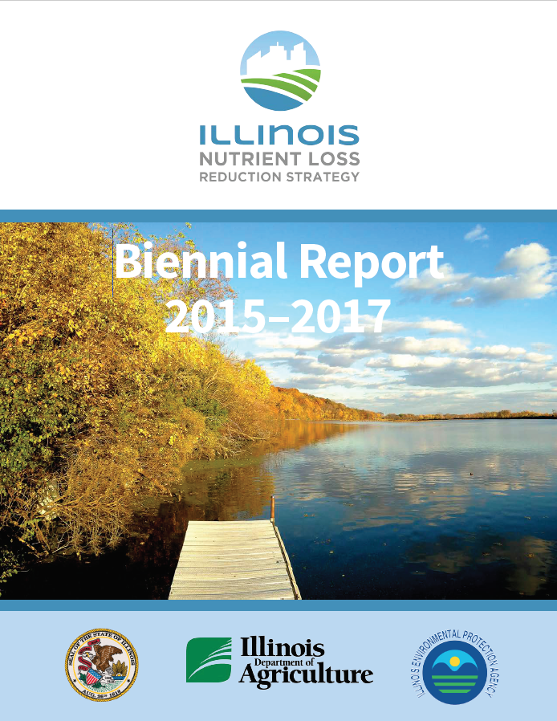
Notes:
The IL NLRS document was finalized and released in July 2015.
The Biennial Report came out in August 2017.

Slide 3
Illinois Nutrient Loss Reduction Strategy
Goals and Milestones
GOAL = 45% reduction in the annual loading of nitrate-nitrogen and phosphorus compared to 1980-1996 (baseline conditions)
Milestones
Nitrate-nitrogen 15% by 2025
Phosphorus 25% by 2025
Notes:
Review and summarize slide
We are only 7 years away from the milestone deadline

Slide 4
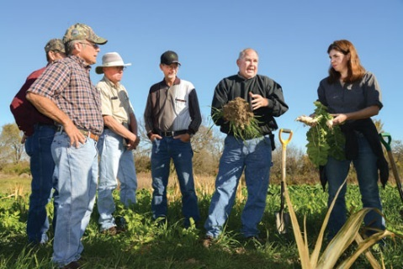
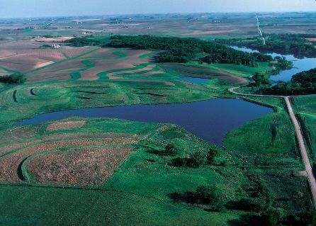
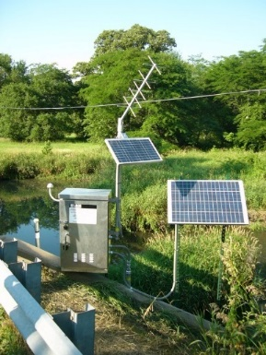
Tracking Measures
Notes:
The NLRS document created the Ag Water Quality Partnership Forum. Part of the responsibilities of this Forum is to collect data on these 4 Tracking Measures in regards to Ag. SWCDs are included in this Forum and AISWCD President, Steve Stierwalt has been in regular attendance.

Slide 5
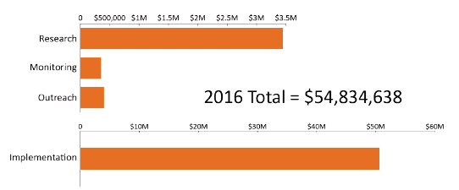
Resources
Resources – ag sector
Notes:
Tracking Measures in regard to Funding Resources, this graph depicts a summary of all partners in the Ag sector.
Funding to SWCDs is NOT included in this summary, because there was no state budget in FY16.

Slide 6
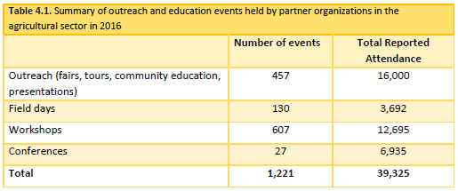
Outreach – ag sector
Notes:
In regards to SWCDs, our data was collected from our input into the Annual Progress Report/Workload Analysis that Joe Bybee sent out last month. Please make sure you complete those and submit to your IDOA Regional Rep. They were due this past Friday.

Slide 7
Tracking Measures
Notes:
Tracking Measures in regards to Land & Facilities is where conservation practices come into play.

Slide 8
Types of Ag BMPs recommended in NLRS
Nitrate
Phosphorus
In Field Practices
Nitrogen Management
MRTN (Max. Return to N), Inhibitors, Split appl.
Cover Crops
Edge of Field Practices
Bioreactors
Buffers (non-tile drained)
Wetlands
Land Use Change
Perennial/Energy Crops
In Field Practices
Reduced Tillage Systems
Soil Tests/Nutrient Management
Cover Crops
Edge of Field Practices
Buffers
Wetlands
Land Use Change
Perennial/Energy Crops
Notes:
Here are a variety of conservation practices/Best Management Practices that are listed in the NLRS document to target Nitrates (left table) and Phosphorus (right table).
Not all practices will fit every situation or field, but the idea is to encourage landowners and operators to consider several practices to work together. For example, soil test every 4 years, follow a nutrient management plan, use cover crops, rotate small grains into a C/SB plan, install a buffer where runoff leaves the field.

Slide 9
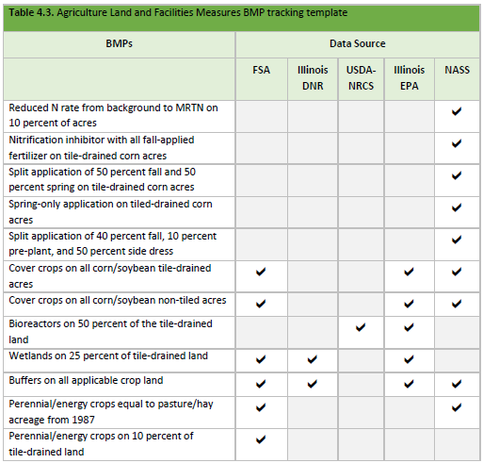
Tracking Land and Facilities Measures
Notes:
For SWCDs, practices completed within our various programs, are able to easily be tracked and recorded.

Slide 10
National Agricultural Statistic Service NLRS Producer Survey
Survey developed to capture implementation done outside of cost-share programs
Mailed to producers in July 2016
Results published December 2016
Compared 2011 baseline year data to 2015
Notes:
The NASS is another primary source of self-reporting data that is accounted for in Land and Facilities.
Encourage operators to complete this survey to help ensure continued support for and funding of conservation programs that protect natural resources while respecting farmers’ livelihoods. Document the VOLUNTARY effort being made. No one wants to see REGULATION.
Consider creating your own survey from your District to have operators complete when they stop in to FSA this spring to report acres.

Slide 11
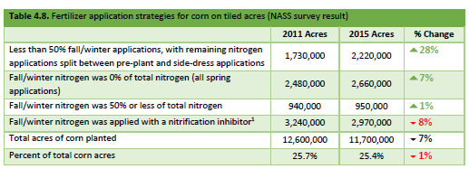
National Agricultural Statistic Service NLRS Producer Survey
Nutrient Mgt
Notes:
The NASS has survey questions in regards to Nutrient Management that are utilized for further data.

Slide 12
National Agricultural Statistic Service NLRS Producer Survey
Cover Crops
Notes:
The NASS has survey questions in regards to Cover Crops.

Slide 13
New Initiatives Supporting NLRS Goals
IFB Nutrient Stewardship Mini-Grants
4R4U
4R Metrics
Advanced Soil Health Training
Leadership for Midwestern Watersheds
Absentee Farmland Owners
PCM
Sustainable Ag Partnership
IL Corn waters testing
Illinois Cover Crops Program
Field Laboratories
MRBI and RCPP Projects
Notes:
Here are some new initiatives that are happening around the state.
SWCDs are able to collaborate with these partners and programs to bring improved water quality to your District.

Slide 14
Where do we go from here?
Continue education and outreach efforts
Stay on message
Target Cost-share funding, priority watersheds
Continue and expand non-governmental cost share programs
Scale up implementation
CONTINUE COLLABORATIONS!
Notes:
Here are some ideas for Districts to utilize.
In a few slides, I will elaborate on what the AISWCD NLRS Sub-Committee has been working on

Slide 15
University of Illinois Extension Watershed Coordinators
Illinois EPA is partnering with University of Illinois Extension to hire two watershed coordinators to work in priority watersheds
Provide outreach and technical assistance
Assist local stakeholders in:
Watershed Planning
Implementation of Watershed Plans
Coordinate local initiatives, collaborate with other organizations.
Notes:
One new partnership that has formed is between IEPA and the U of I Extension.
Trevor Sample with IEPA will be reaching out to SWCDs in the near future. This will serve as a great resource for SWCDs.

Slide 16
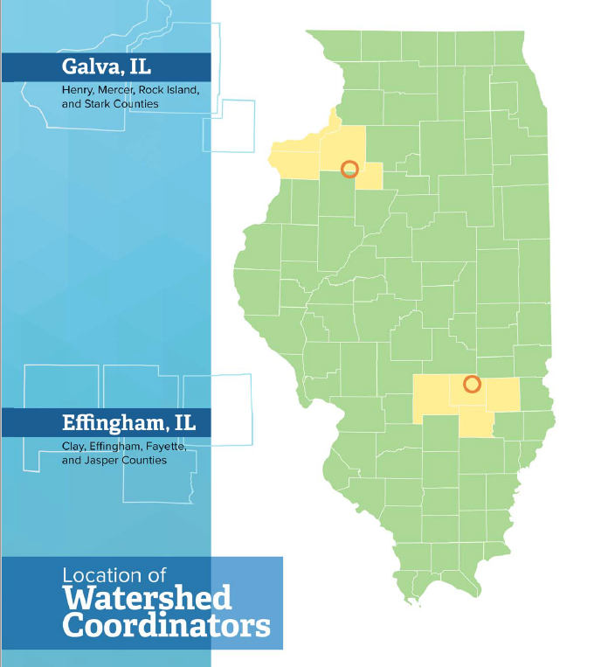
Notes:
Here are the locations where the Watershed Coordinators will be located.

Slide 17
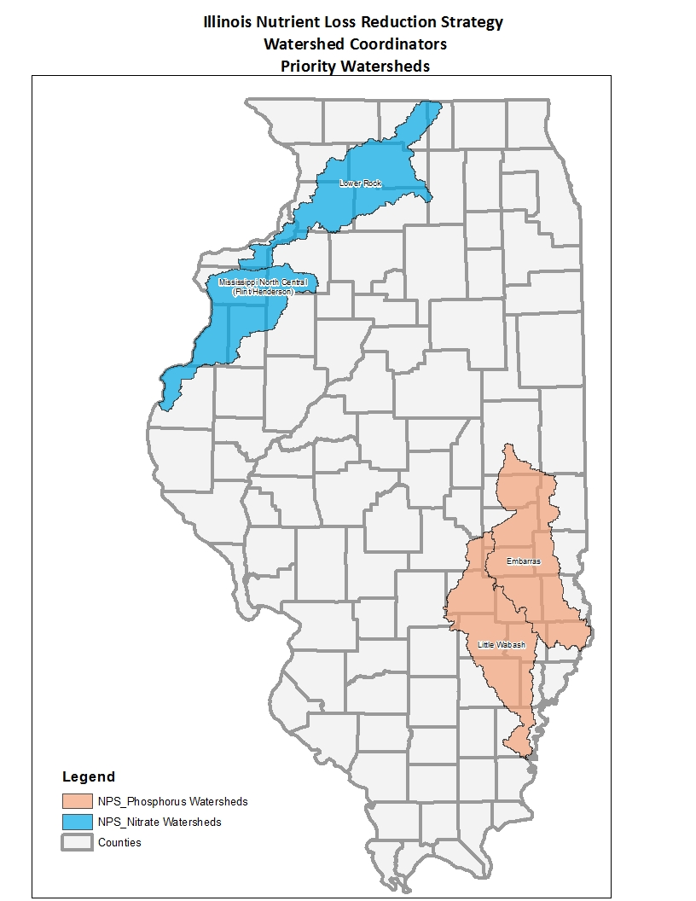
Notes:
The watershed coordinators will target four of the Priority Watersheds that are listed in the NLRS document.
The blue watersheds are a priority for high nitrates.
The orange watersheds are a priority for high phosphorus.

Slide 18
AISWCD NLRS Sub-Committee
Background
Met for the last couple of years
Goal: to better support/motivate SWCDs, more AISWCD progress/action, document the work being completed for IL NLRS Ag Water Quality Partnership Forum
Contacted me in early January to assist the Sub-Committee per Spring Duffey’s recommendation
Researched the IL NLRS document, previous Sub-Committee mtg. minutes, August NLRS SWCD survey results, AISWCD Strategic Plan, and recent input of 11 Sub-Committee members.
Held 3 Zoom Video Conf. Mtgs. since January, met at
AISWCD QB 2/28 and approved a 5-year Working Plan
Notes:
Review and summarize this slide

Slide 19
AISWCD NLRS Sub-Committee
5 Year IL NLRS Plan for AISWCD
A working draft, with each year divided into 4 categories;
Fund Seeking for NLRS/Water Quality activities,
Training for SWCD Directors and Staff,
Promotion/Advertising for items that AISWCD will complete and promotional materials to distribute to SWCDs,
Education for landowners, operators, partners, general public
Work continues to show the steps needed to accomplish
each action item within the categories
Notes:
Review and summarize this slide

Slide 20
AISWCD NLRS Sub-Committee
5 Year IL NLRS Plan for AISWCD
Fund Seeking, sample items listed;
Work with SWCDs & ISWCDEA to reach out to partners that exist locally to build a partnership with AISWCD
Consider utilizing the AISWCD Foundation to deposit partner donations to create a grant program for IL SWCDs to apply for project funding, similar to what IFB is doing for IL FB county offices.
Promote IEPA 319 Grant funds, when available. Encourage SWCDs to apply to obtain a Watershed Plan and/or Implement a Plan.
Notes:
Review and summarize this slide

Slide 21
AISWCD NLRS Sub-Committee
5 Year IL NLRS Plan for AISWCD
Training, sample items listed;
Establish SWCD Staff training on how to prioritize NLRS/Water Quality practices for effectiveness
Dedicate a page on AISWCD website for NLRS resources for IL SWCDs
Annually, celebrate accomplishments and recognize achievements. Spotlight Districts for their efforts to improve Water Quality
Notes:
Review and summarize this slide

Slide 22
AISWCD NLRS Sub-Committee
5 Year IL NLRS Plan for AISWCD
Promotion/Advertising, sample items listed;
Promote and support the 5 S.T.A.R. program
Promote a statewide effort to try Cereal Rye after Corn
Create advertising that AISWCD and 97 SWCDs work as one team for Water Quality in IL since 1938
Notes:
Review and summarize this slide

Slide 23
AISWCD NLRS Sub-Committee
5 Year IL NLRS Plan for AISWCD
Education, sample items listed;
Focus on fertilizer retailers for partnerships on the LUC level
Encourage SWCDs to form their own District-level NLRS Committees to help promote nutrient management and water quality practices at the local level.
Utilize existing quick-reference materials, like the NRCS two-page hand-out “5 Soil Health Questions to Ask Your Farmer”
Notes:
Review and summarize this slide

Slide 24
AISWCD NLRS Sub-Committee
Wrapping it up…
AISWCD NLRS plan is a starting point
More effort is needed to expand on listed suggestions and create steps to achieve action items within a 5 year time frame
Sub-committee will continue to regularly meet outside of the AISWCD QB meetings
Questions?
Notes:
Overall, I’m exited to be working with this Sub-Committee. They all seem dedicated to the cause and passionate about this topic.
I’m hopeful for the path that this 5 year Plan will take us and I look forward to helping IL SWCDs and AISWCD continue to improve Water Quality in IL.
Questions?
Thank you for your time. Now we will bring up the SWCD panel.

